Slide 1
Spoke 6 Integration
Silicon On Insulator CNOT gate
T. H. Dao, F. De Matteis, A. Salamon
February 2025

Slide 2
Outlines
Introduction
Workflow
Results
Future work

Slide 3









Introduction
Goal: the research aims to optimize a Silicon Photonic Integrated Circuit for Linear Optics Quantum Computing. The chosen scheme is the CNOT gate built with SOI technology.
Collaboration: T. H. Dao, F. Amanti, G. Andrini, F. Armani, F. Barbato, V. Bellani, V. Bonaiuto, S. Cammarata, M. Campostrini, S. Cornia, F. De Matteis, V. Demontis, G. Di Giuseppe, V.D. Tchernij, S. Donati, A. Fontana, J. Forneris, R. Francini, L. Frontini, G.C. Gazzadi, R. Gunnella, S. Iadanza, A.E. Kaplan, C. Lacava, V. Liberali, L. Martini, F. Marzioni, C. Menozzi, E.N. Hern´andez, E. Pedreschi, P. Piergentili, P. Prosposito, V. Rigato, C. Roncolato, F. Rossella, A. Salamon, M. Salvato, F. Sargeni, J. Shojaii, F. Spinella, A. Stabile, A. Toncelli, G. Trucco, V. Vitali.

Slide 4
Photonic Integrated Circuit
PICs, or optical chips, integrate multiple photonic functions for information signals imposed on optical wavelengths.
Advantages:
-Small stochastic noise level.
-PICs are strongly pursued for classical computing purposes, and the core components necessary are under research. PICs are not only CMOS compatible but also can be built with nothing changed in CMOS fabrication techniques and standards.

Slide 5
Silicon photonics with Silicon-On-Insulator technology
Silicon photonics: low spectral dispersion, high refractive index
→ easy integration of complex optical system
→ chip-integrated communication systems for world-wide communication networks.
SOI technology: Silicon optical components are built over a thick oxide layer previously deposited on top of a Si handling wafer.

Slide 6
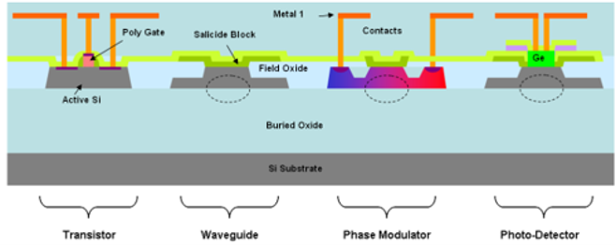
Silicon On Insulator SOI

Slide 7
Quantum Computing
• 1982: R. P. Feynman proposed building a computer based on the manipulation of wavefunctions in order to simulate nature with quantum computer.
• 1994: P. W. Shor suggested an algorirthm to factorize integers into prime numbers operating on a quantum computer more efficent than the classical analogue.
• 2001: Knill, Laflamme and Milburn demonstrated how it is posible to use linear optics for quantum information processing using beam splitters, phase shifters, single photon sources and detectors.
• 2001-2002: T. C. Ralph, N. K. Langford, T. B. Bell and A. G. White proposed a NOT-controlled linear optical gate based on coincidence.

Slide 8






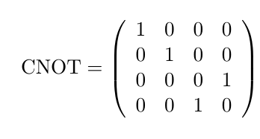

Controlled NOT (CNOT) gate
1 qubit:
Quantum logic gate for 1 qubit
2 qubits:
Controlled NOT (CNOT) gate
control bit
target bit

Slide 9
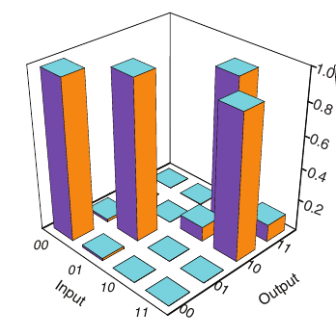
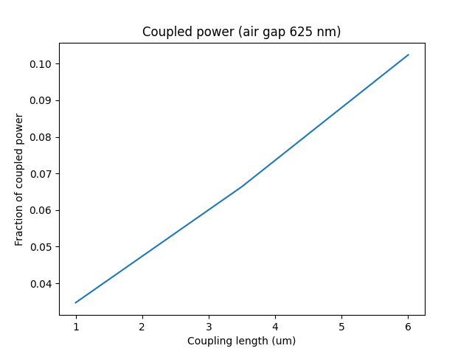
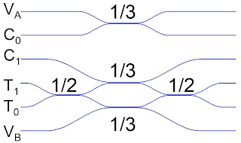
CNOT-gate with Linear Optics
Lumerical FDTD
(air gap 625 nm)
Waveguide coupler used as beam splitter (SR=1/2, SR=1/3)
Coincidence basis (C₀T₀, C₁T₀, C₀T₁, C₁T₁)
Postselected probabilistic gate (P=1/9)
T. C. Ralph et al, Linear optical controlled-NOT gate in the coincidence basis, DOI: 10.1103/PhysRevA.65.062324
A. Politi et al, Silica-on-Silicon Wavegide Quantum Circuits, DOI: 10.1126/science.1155441

Slide 10
Workflow
Design
Python (IPKISS)
Parameters
.gds files
Simulation
Lumerical
Fabrication
Characterization
Chips

Slide 11
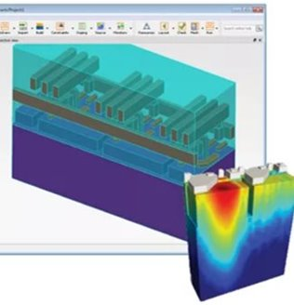
Simulation
Ansys Lumerical Photonics Simulation & Design Software
Simulating light’s interactions for the design of photonic components and systems
License

Slide 12
Lumerical Solutions Products
Device Suite for photonic multiphysics simulation
System Suite for Photonic integrated circuit simulation
FDTD 3D Electromagnetic Simulator
MODE Waveguide Simulator
CHARGE 3D Charge Transport Simulator
HEAT 3D Heat Transport Simulator
DGTD 3D Electromagnetic Simulator
FEEM Waveguide Simulator
MQW Quantum Well Gain Simulator
STACK Optical Multilayer Simulator
INTERCONNECT Photonic Integrated Circuit Simulator
CML Compiler Photonic Model Development Kit
Laser Library Advanced Laser Modeling Extension
System Library Advanced System Modeling Extension
Photonic Verilog-A Platform Runtime Library & Utilities for PIC Simulation

Slide 13

Finite Difference Time Domain (FDTD) solver
The Finite-Difference Time-Domain (FDTD) method is a powerful tool for modeling nano-scale optical devices. Giving a direct time and space solution for Maxwell’s equations without any physical approximation, FDTD offers an unique insight into all types of problems in electromagnetics and photonics. Even the frequency solution can be obtained by exploiting Fourier transforms, from which a full range of useful quantities can be calculated.
The FDTD method solves Maxwell’s equations on a mesh and computes E and H at grid points spaced Δx, Δy, and Δz apart, with E and H interlaced in all three spatial dimensions. FDTD includes the effects of scattering, transmission, reflection, absorption, etc..
FDTD can simulate any structure where Maxwell’s equations describe the necessary physics. Typical applications for this method include: LEDs, solar cells, filters, optical switches, semiconductor-based photonic devices, sensors, nano- and micro-lithography, nonlinear devices, and meta-materials (negative index of refraction).

Slide 14


Design
Python is a programming language that lets you work quickly and integrate systems more effectively.
Luceda Photonics Design Platform, the first-time-right photonic IC design software, automates and integrates all aspects of the photonic design flow in one platform, using one standard language.

Slide 15
Results
Simulation
Directional coupler
Bragg grating coupler

Slide 16

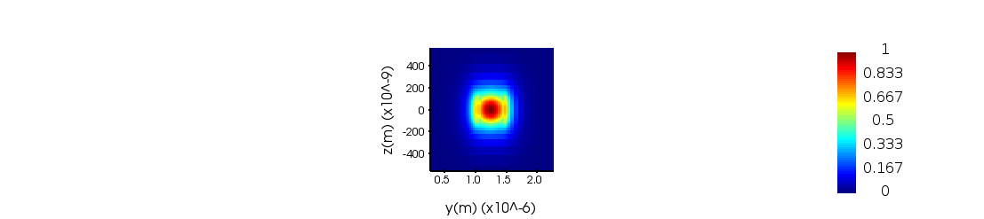

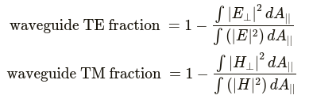
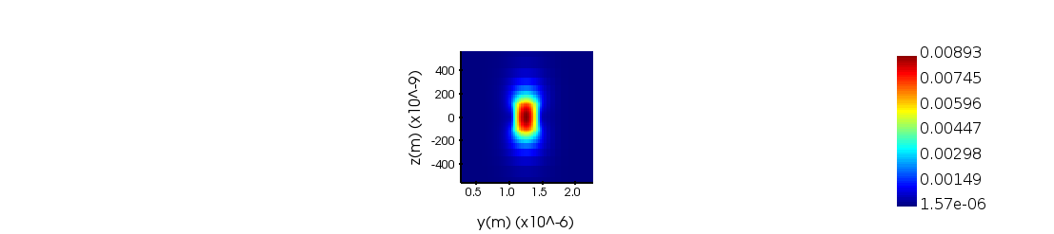

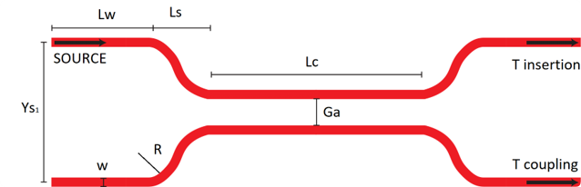
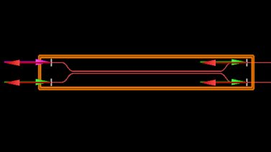
Directional coupler
E_TE0
E_TM0
H_TE0
H_TM0
Effective index | Mode | TE polarization fraction (Ey) | Waveguide TE/TM fraction (%)
2.351788 | TE0 | 98 | 72.67/81.52
1.750815 | TM0 | 4 | 74.39/88.14

Slide 17
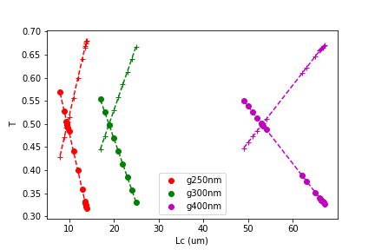
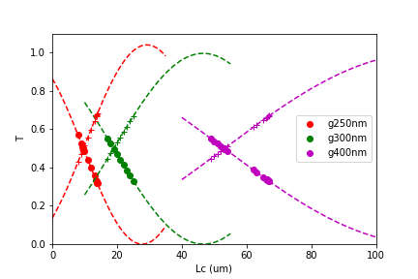
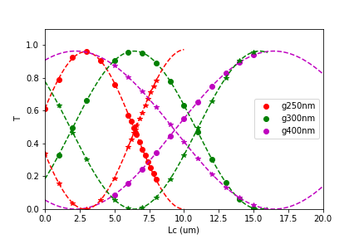
Directional coupler
Gap (um) | SR (Ti/Tc) | TE |  | TM
 |  | Lc_lin (um) | Lc_sin2 (um) | Lc_sin2 (um)
0.25 | ½-½ | 9.60724607 | 9.60654607 | 6.46486465
0.25 | 1/3-2/3 | 13.54303543 | 13.54443544 | 7.23227232
0.3 | ½-½ | 18.92133921 | 18.921178922 | 1.910419
0.3 | 1/3-2/3 | 24.89289893 | 24.9297993 | 0.93568936
0.4 | ½-½ | 53.1299313 | 53.11673117 | 9.32949329
0.4 | 1/3-2/3 | 66.54066541 | 66.56886569 | 7.78887789
TE Linear fit
TE sin^2 fit
TM sin^2 fit

Slide 18
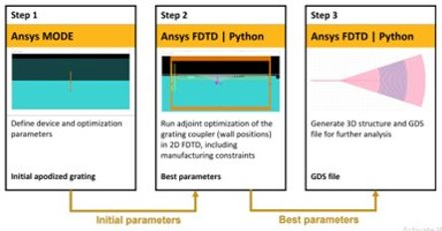
Bragg grating coupler
Apodized fully etched grating coupler:
Etch depth: 220 nm
Tilt angle theta of the source: 6.8

Slide 19
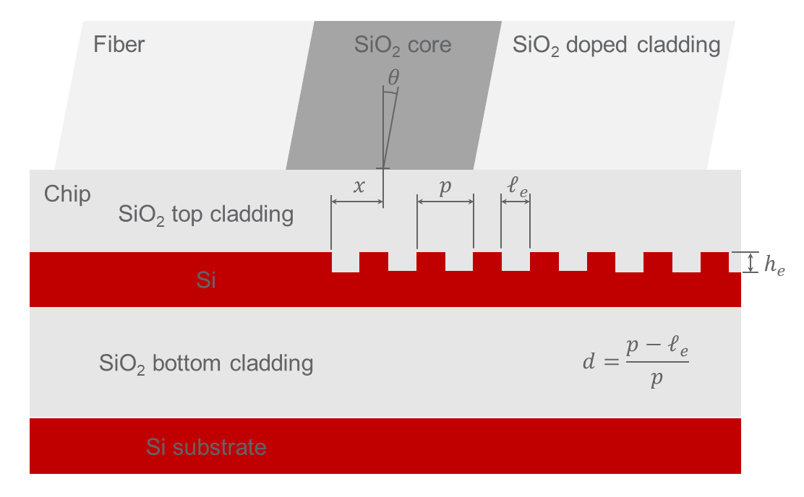

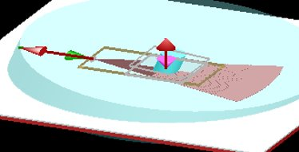
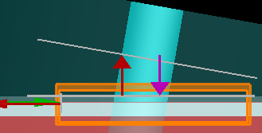
Bragg grating coupler
3D
2D

Slide 20
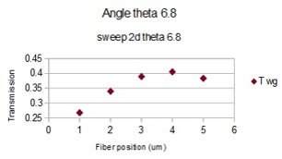
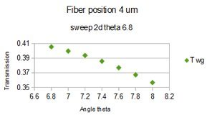
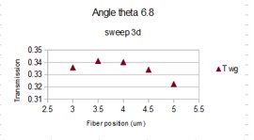
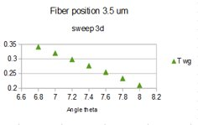
Bragg grating coupler
Transmission

Slide 21
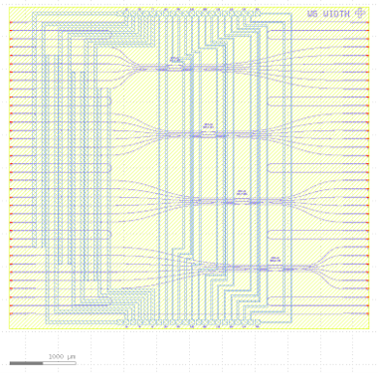
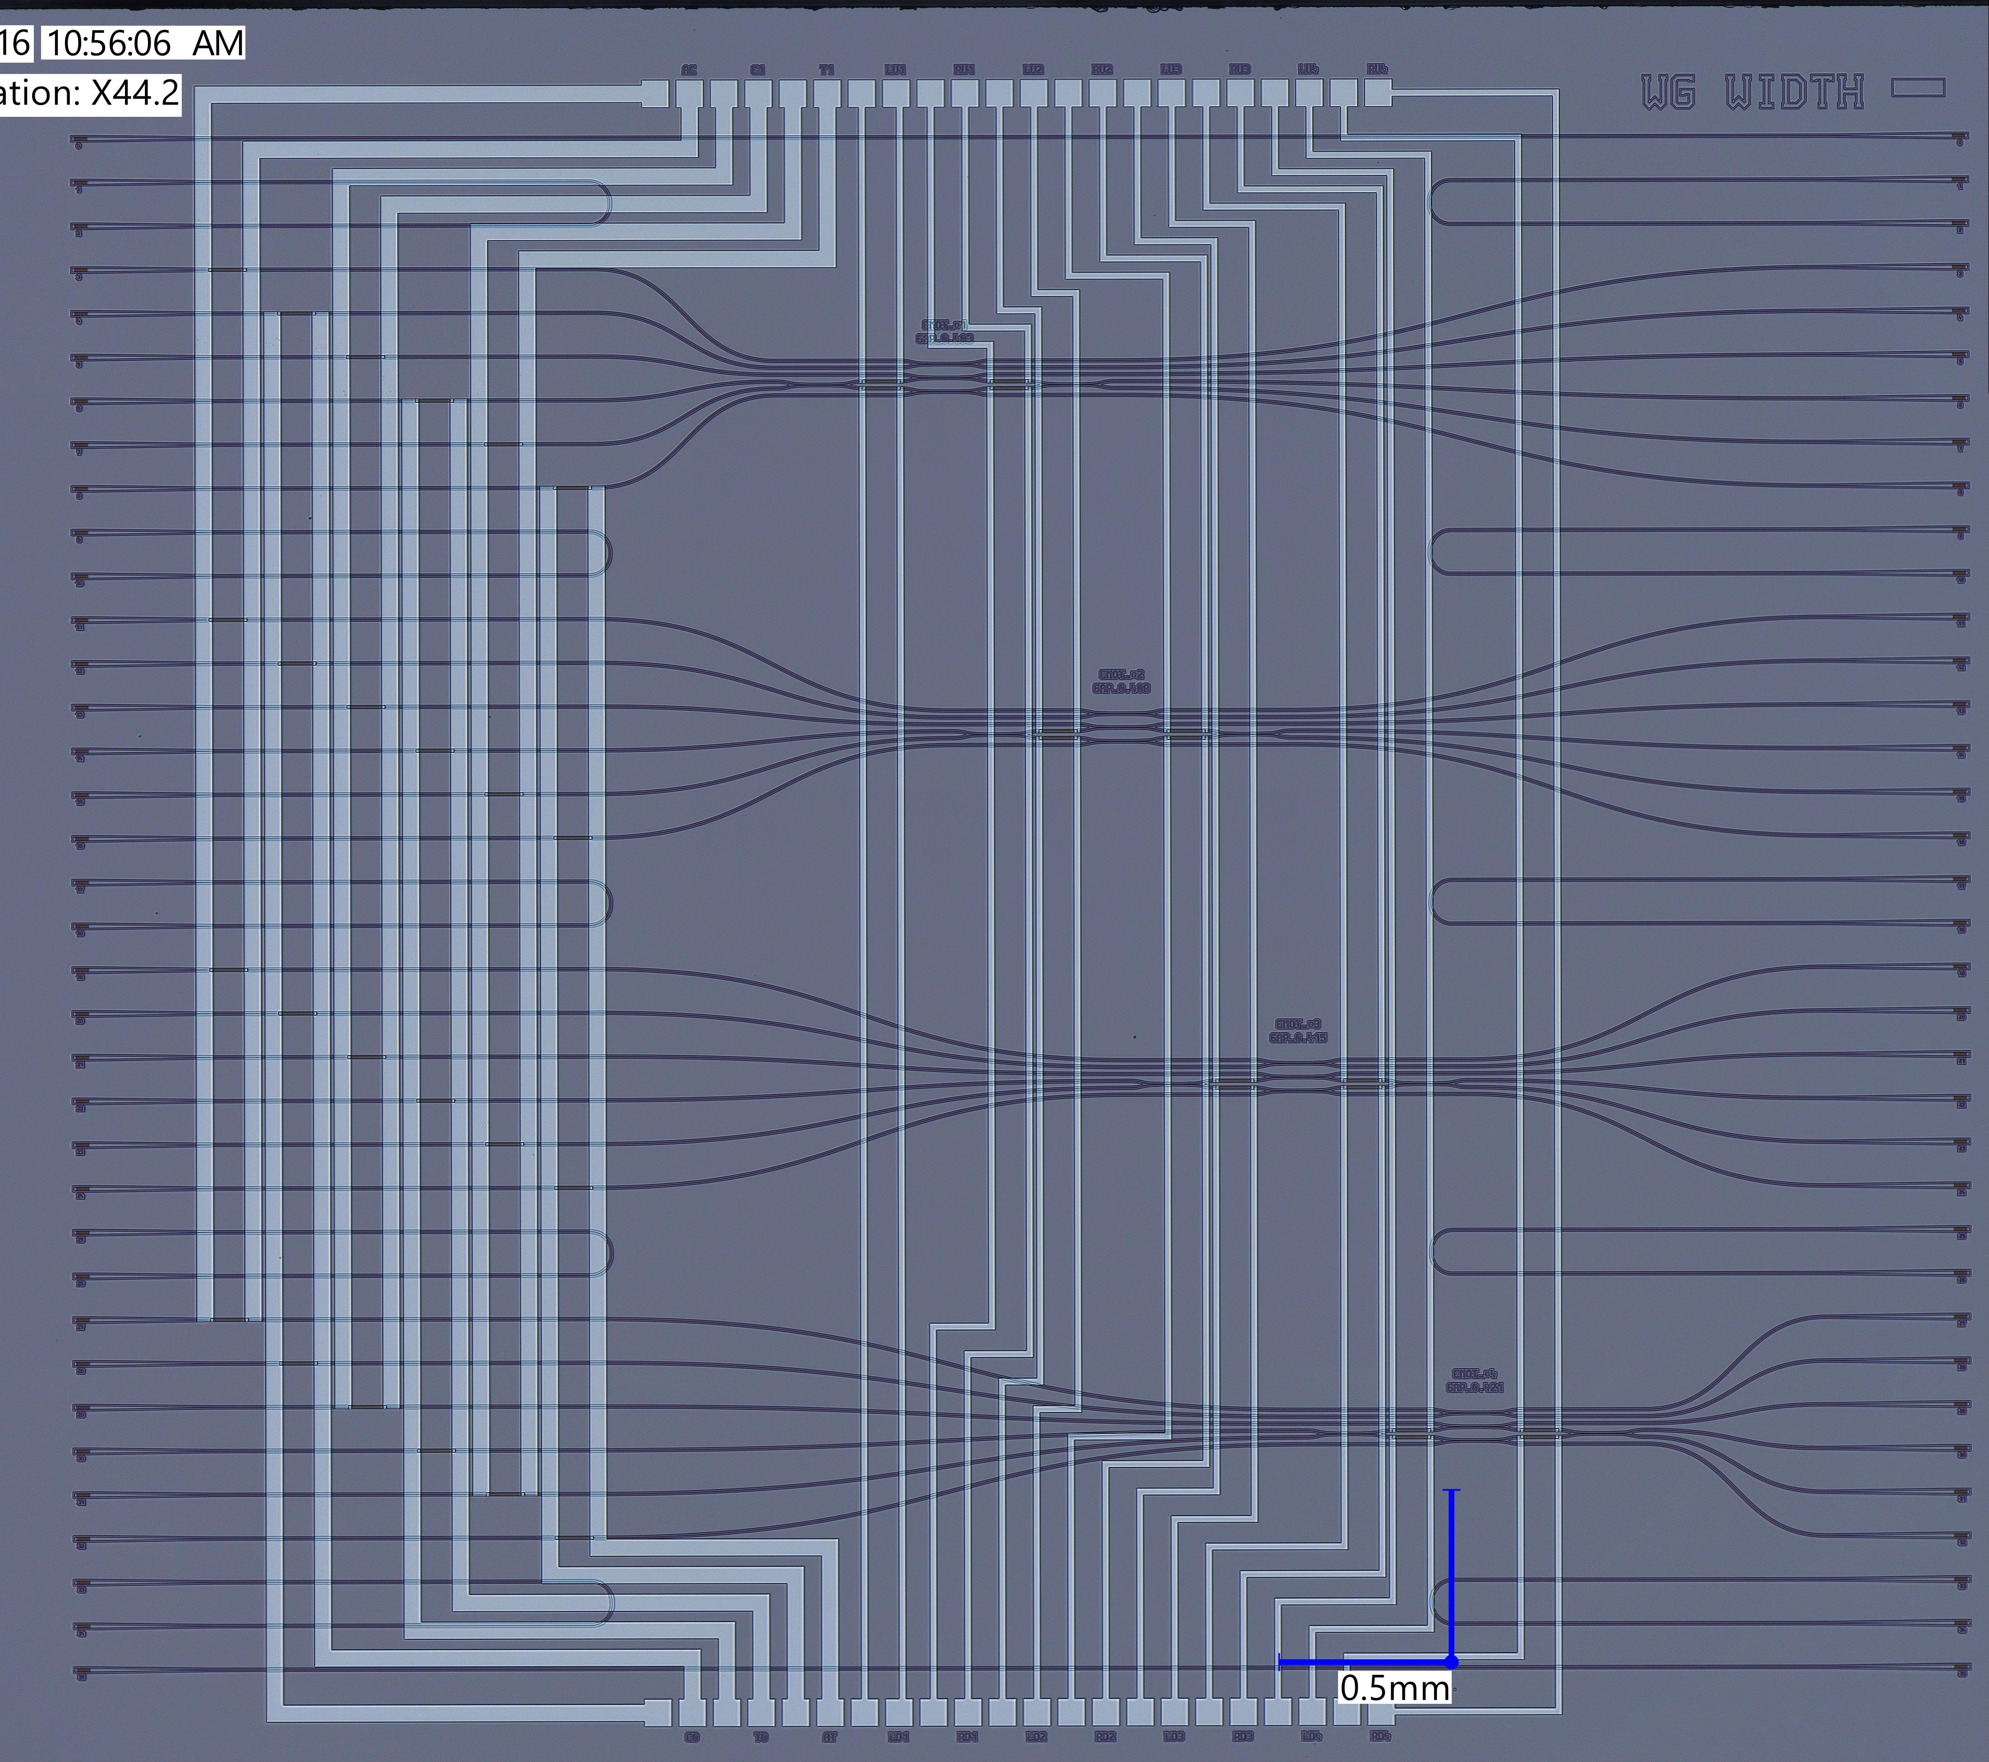

Results
Chip layout

Slide 22
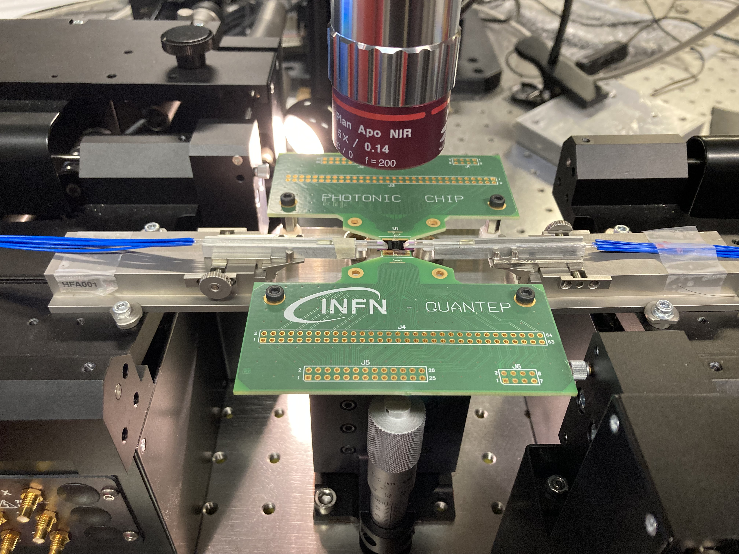
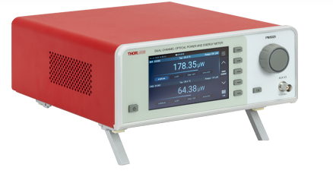
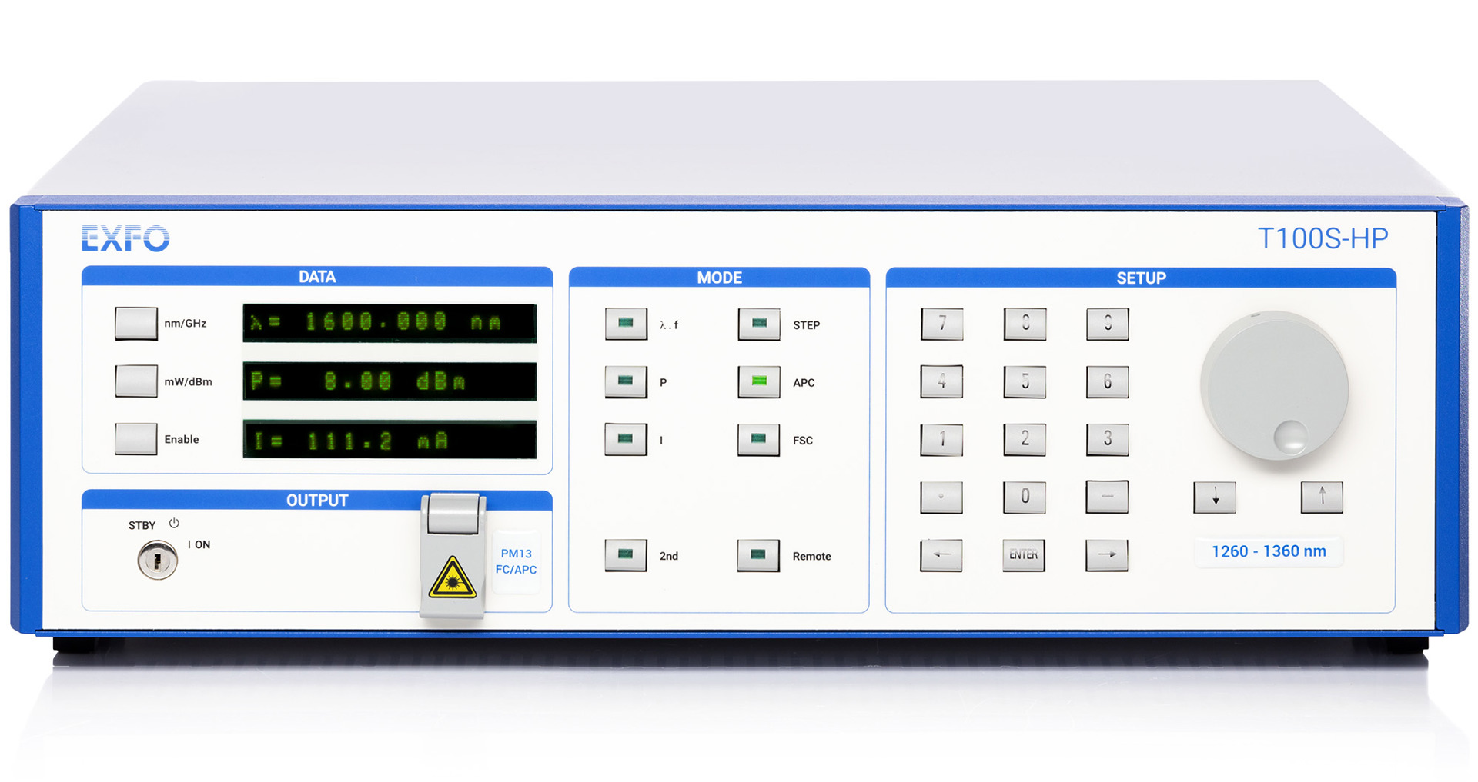
Results
Preliminary measurement

Slide 23
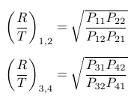
Preliminary measurement
1a
3c
1.1)P_{ac}=PaRc
1.2)P_{ad}=PaTd
2.1)P_{bc}=PbTc
2.2)P_{bd}=PbRd
3.1)P_{ca}=PcRa
3.2)P_{cb}=PcTb
4.1)P_{da}=PdTa
4.2)P_{db}=PdRb
T, R
2b
4d
DC 1
η= 1/3
DC 2
η= 1/3
DC 3
DC 4
η= 1/2
η= 1/2
DC 5
η= 1/3

Slide 24
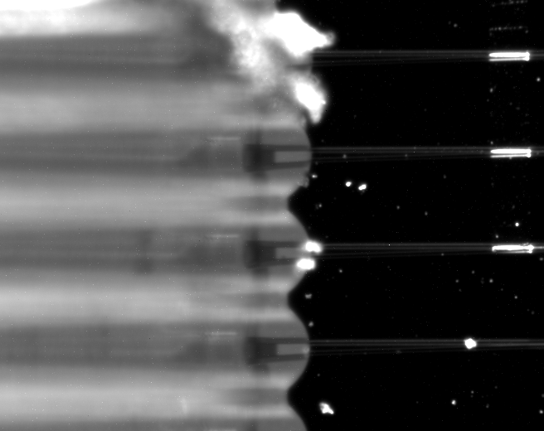
Preliminary measurement

Slide 25
Future work
Characterization and measurement
Repeat the process

Slide 26
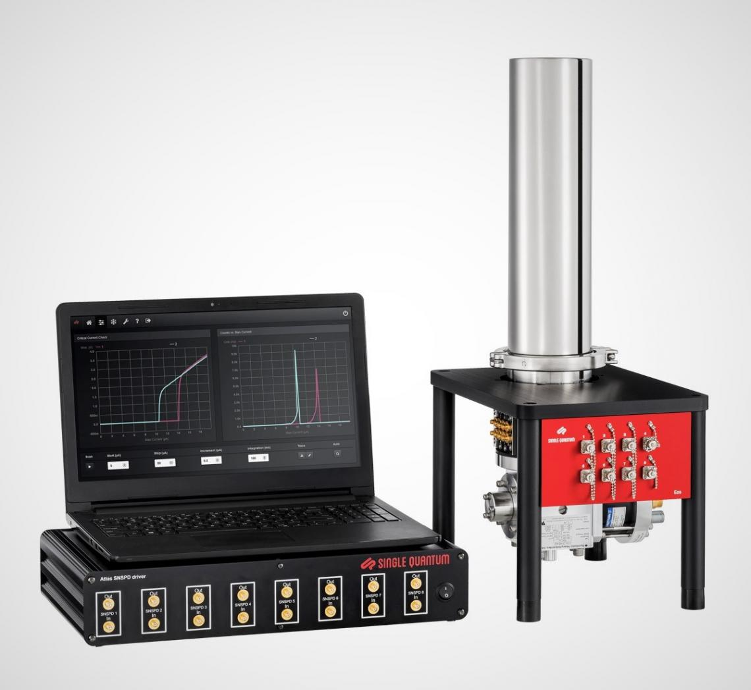
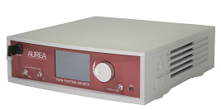
Measurement with single photon
Single photon source
Single photon detector

Slide 27
Thank you for your attention!

