Slide 1
Quantum Dot Intersubband Photodetectors for LWIR photons
Stefano Vichi, S. Asahi*, S. Bietti, A. Tuktamyshev, A. Fedorov**, T. Kita* and S. Sanguinetti
Materials Science Department, University of Milano-Bicocca, Milano (Italy)
* Department of Electrical and Electronic Engineering, Kobe University, Kobe (Japan)
** L-NESS & CNR-IFN, Milano (Italy)

Slide 2
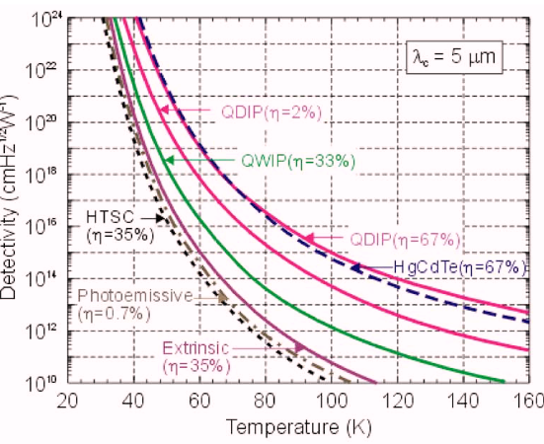


Mature technology
High quantum efficiency (~70%)
HgCdTe
High uniformity on big areas
Can be tuned in the range 1-30 µm
Higher density of pixels
Lower production costs
Low growth uniformity
Uncooled (or Peltier) detection
Extremely high cost
Rogalski et al., J. Appl. Phys. 105, 091101 (2009)

Slide 3
Mature technology
Short carrier lifetime (lower quantum efficiency)
QWIP (Quantum Well)
High uniformity on big areas
Only IR radiation parallel to the QW is detected
Higher density of pixels
Lower production costs
High growth uniformity
Uncooled (or Peltier) detection
Lower cost
Multispectral imaging
Rogalski et al., J. Appl. Phys. 105, 091101 (2009)

Slide 4
Technology based on well estabilshed GaAs technology
Low dark current due to lower thermal emission
QDIP (Quantum Dot)
High optical absorption at normal incidence
Possible high operating temperature (Peltier cooling -80°C)
Rogalski et al., J. Appl. Phys. 105, 091101 (2009)

Slide 5
The decrease in detectivity with temperature is a crucial issue.
Up to now external cooling is always required to improve S/N ratio.
Increased complexity
Reduced device lifetime in space satellites

Slide 6
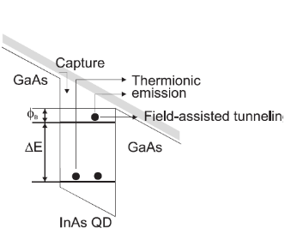
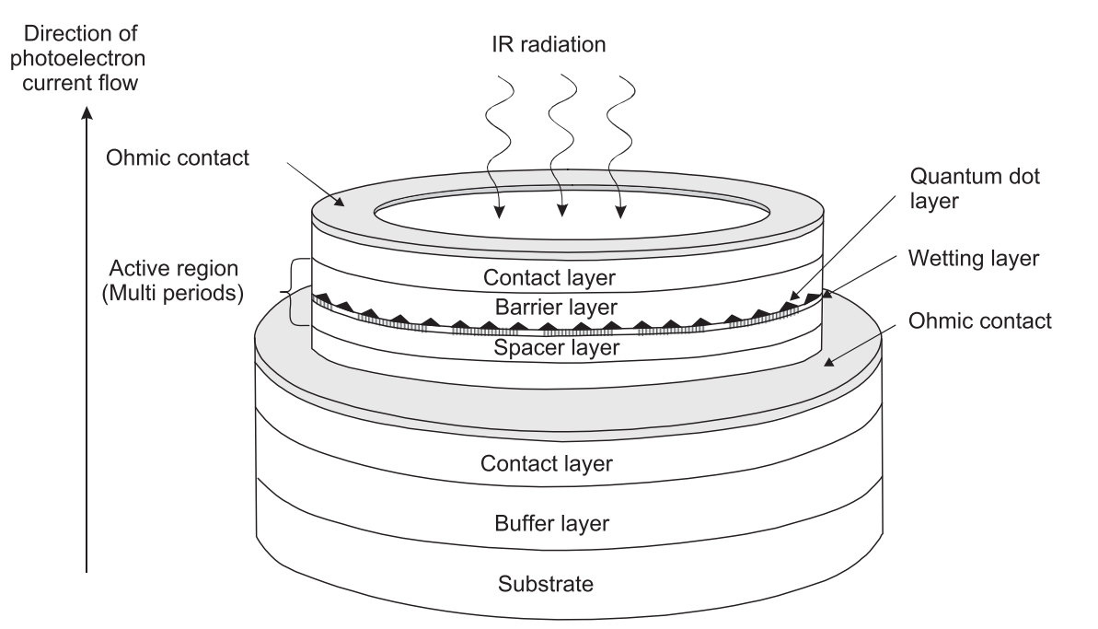
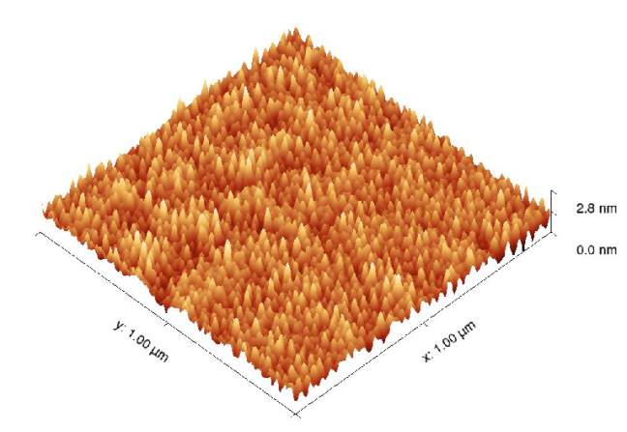
QDIP are promising but not yet competitive.
Large dark current at room temperatures
Low density of absorbers
Barrier
Intraband transitions

Slide 7
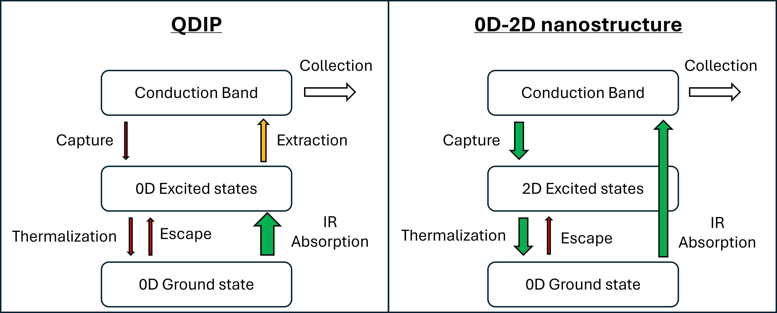
Increase capture and thermalization efficiencies without increasing the escape probability.
Capture and thermalization are very efficient in 2D nanostructures.
0D nanostructures have low escape probability and high absorption coefficient.
What if we can combine these advantages?
Small capture
Low thermalization efficiency (phonon bottleneck)
Low escape probability (phonon bottleneck)
Large absorption coefficient
Ok extraction (tunneling)

Slide 8
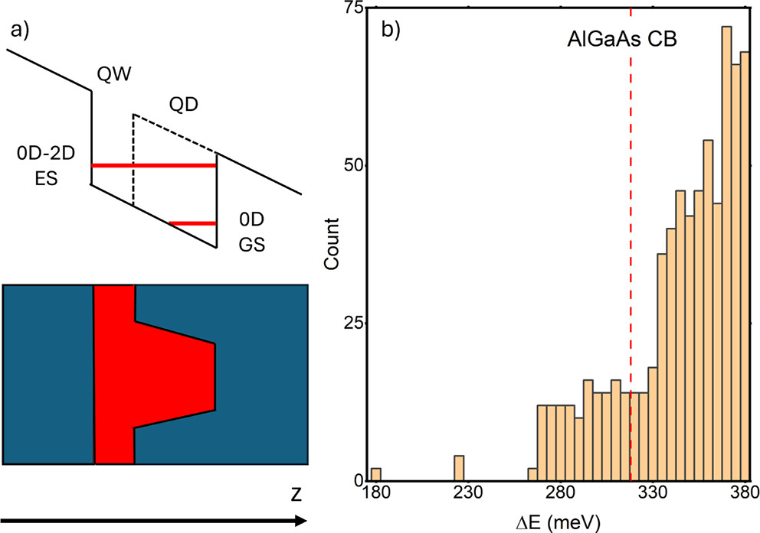
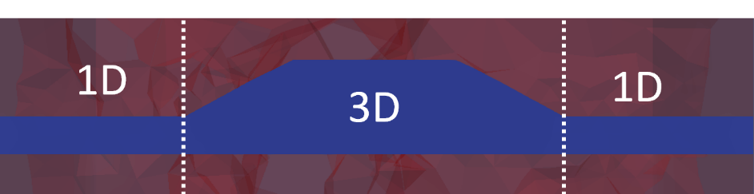
We designed and realized by Droplet Epitaxy a hybrid 0D-2D nanostructure (QDs on top of a QW) made of GaAs/AlGaAs.
The absence of a potential barrier between 0D and 2D allows to spatially modulate the properties quantum confinement.
QD-like low energy states
QW-like high energy states
2D
0D
2D

Slide 9
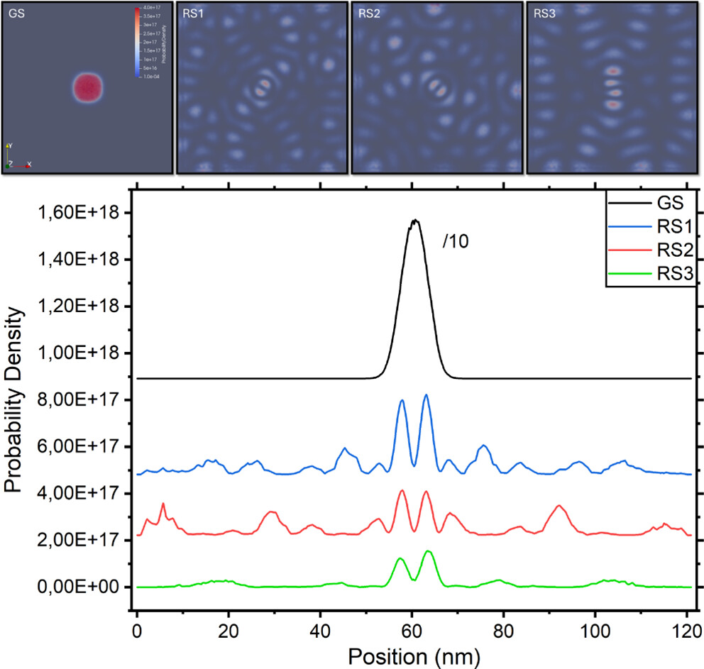
The QW introduces resonant states in CB, E>E_{CB} with a localization in the QD region -> large absorption probaility
Vichi et al., ACSPhotonics 12,447−456 (2025)

Slide 10
Small capture
Low thermalization efficiency (phonon bottleneck)
Low escape probability (phonon bottleneck)
Large absorption coefficient
Ok extraction (tunneling)
Large capture
High thermalization efficiency (carrier-carrier scattering)
Low escape probability (phonon bottleneck)
Good absorption coefficient
Large extraction (resonant states)
≠ℏω_{LO}
Vichi et al., ACSPhotonics 12,447−456 (2025)

Slide 11
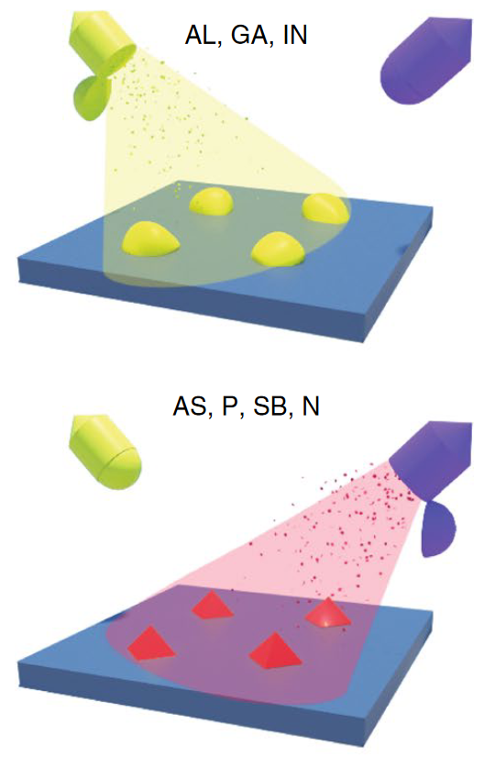
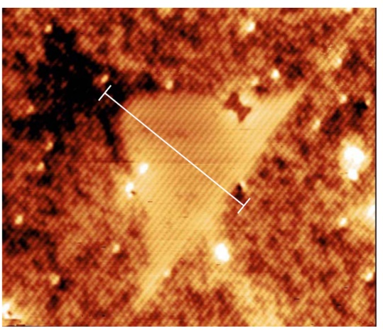

Droplet Epitaxy
Two-step growth of self-assembled QDs:
Deposition of group III to form metal droplets
Crystallization with group V flux
Advantages:
Strain-free growth
Independent control on QD morphological parameters (height, aspect ratio, shape)
Narrow size dispersion
AlGaAs
GaAs
Keizer APL 96 (2010) 62101
20 nm
AlGaAs
Gurioli et al., Nat. Mater. 18, 799 (2019)
Notes:
DE uses growth kinetics to form QD.

Slide 12
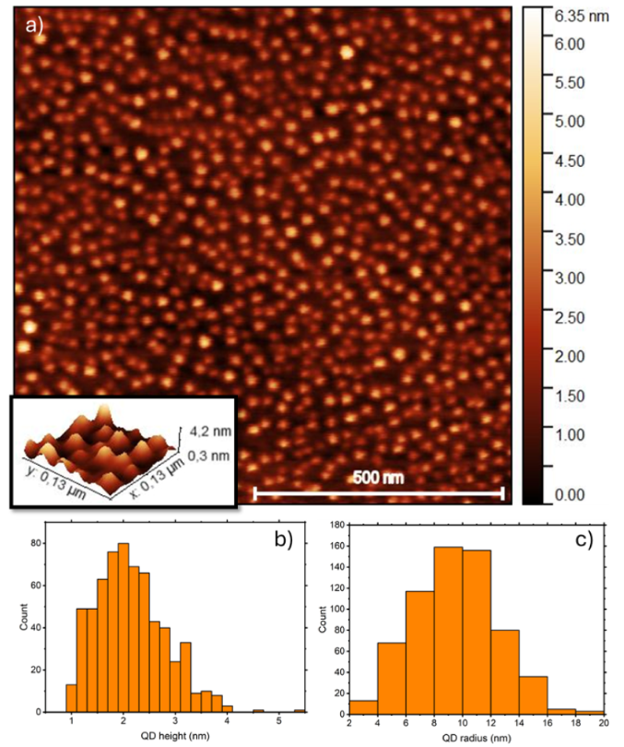
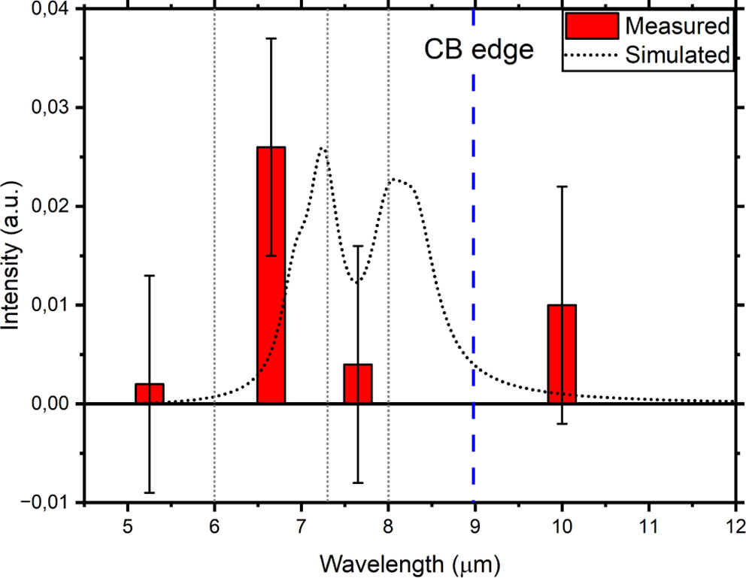
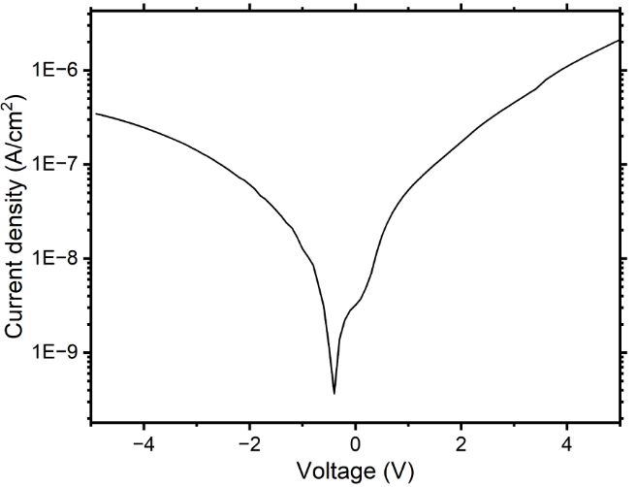
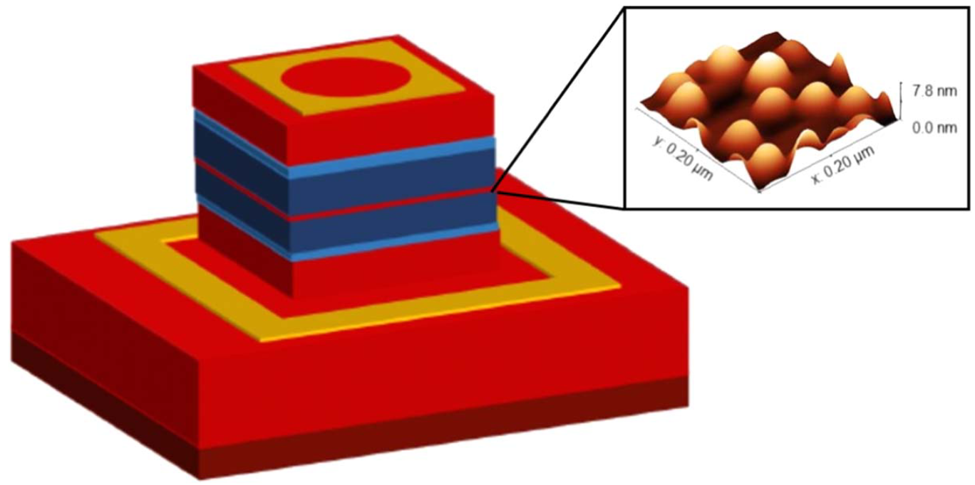
RT dark current
Room temperature absorption signal detectivity = 2*10⁻⁴ A/W at -4 V
QD density = 7*10¹⁰ cm⁻²

Slide 13
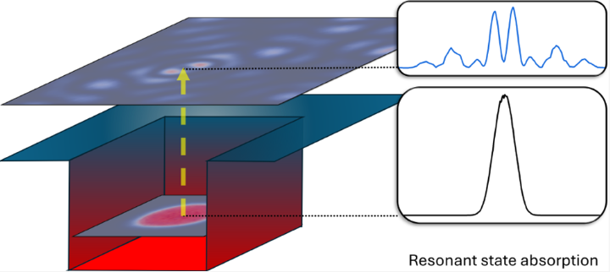
CONCLUSIONS:
Innovative quantum state design to modulate quantum confinement:
- 0D ground state
- 2D excited states
To exploit the advantages of both nanostructures.
Achieved room temperature operation R = 2*10⁻⁴ A/W
Vichi et al., ACS Photonics 12,447−456 (2025)

Slide 14
EXTRA SLIDES

Slide 15
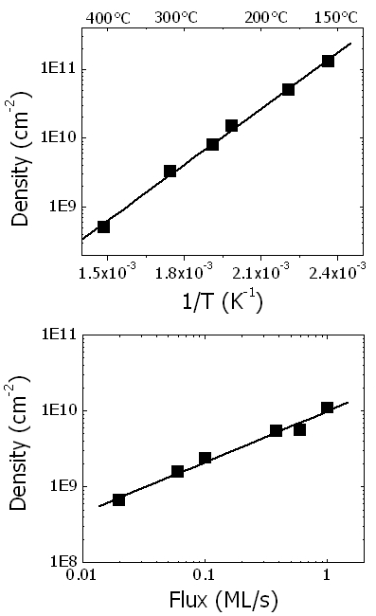
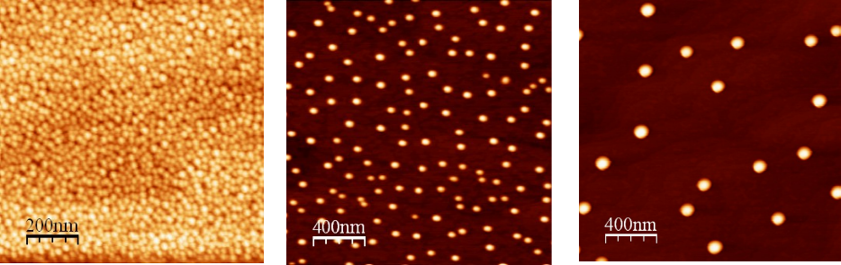
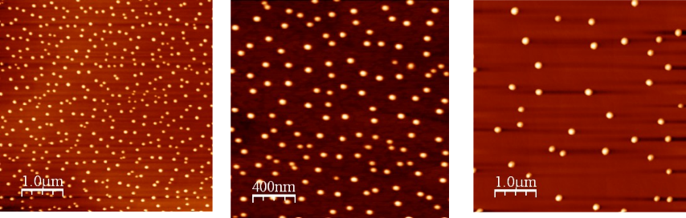
0.1 ML/s
Ga flux constant, increasing T
Ga, In, Al… molecular beam
Temperature
T constant, increasing Ga flux
Flux
Droplets
300 °C
15
Ga droplet deposition
Notes:
15
15

Slide 16
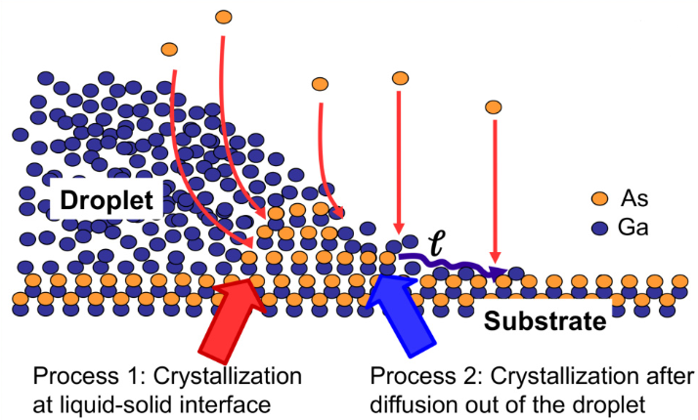
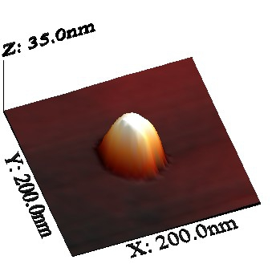
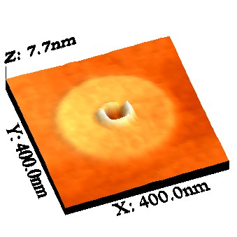
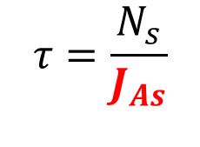

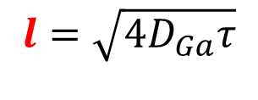
Droplet deposition:
Ga amount --> droplet volume
Temperature --> droplet density
Crystalization controls geometry:
As incorporation in the droplet and crystalization at the liquid-solid interface
As adsorption on the surface and crystalization after Ga out-diffusion
$$l=\sqrt{4D_{Ga}τ}$$
Diff. length
$$D_{Ga}=D_{0}e^{{−E_{a}}/{kT}}$$
Diffusivity
$$τ=\frac{N_{s}}{J_{As}}$$
Lifetime
DE-QDs formation
Notes:
DE uses growth kinetics to form QD.
In step 1 there is an initial formation of the ring

Slide 17
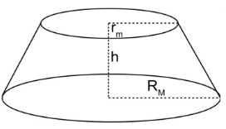
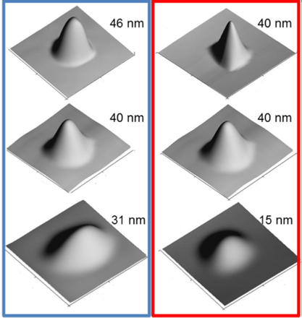

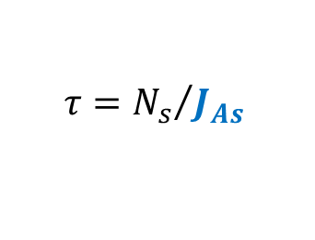
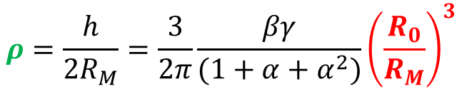


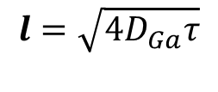
$$l=\sqrt{4D_{Ga}τ}$$
$$τ={N_{s}}/{J_{As}}$$
$$D_{Ga}=D_{0}e^{{−E_{a}}/{kT}}$$
$$V_{0}=γR_{0}^{3}$$
$$R_{M}=R_{0}+l$$
5x10⁻⁵ torr
150 °C
$$ρ=\frac{h}{2R_{M}}=\frac{3}{2π}\frac{βγ}{(1+α+α^{2})}{\left(\frac{R_{0}}{R_{M}}\right)}^{3}$$
How to change R without changing h?
Increase diffusion length
How to change h without changing R?
Increase droplet volume
1x10⁻⁵ torr
200 °C
5x10⁻⁶ torr
250 °C
DE-QD shape engineering
Bietti et al., Phys Rev B 92, 075425 (2015)

Slide 18
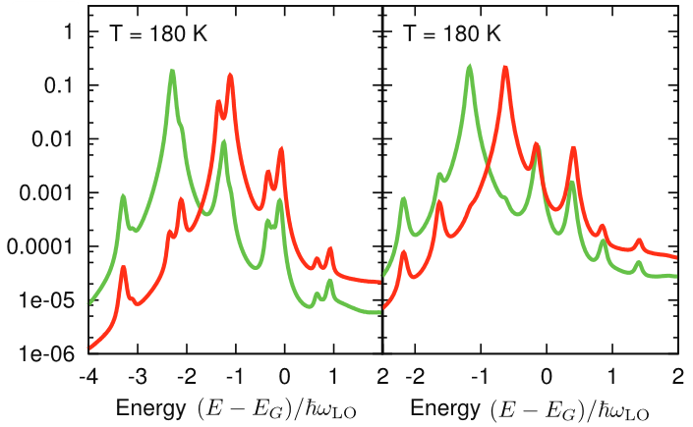
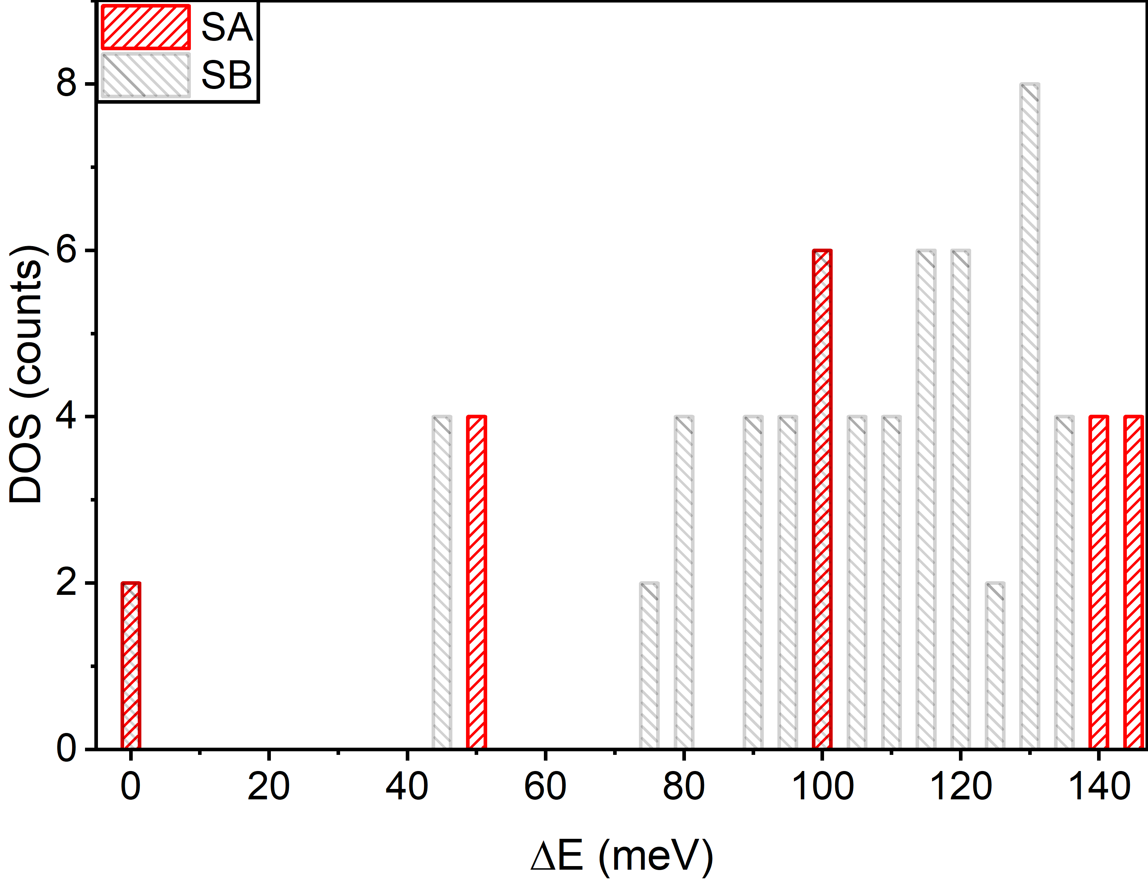


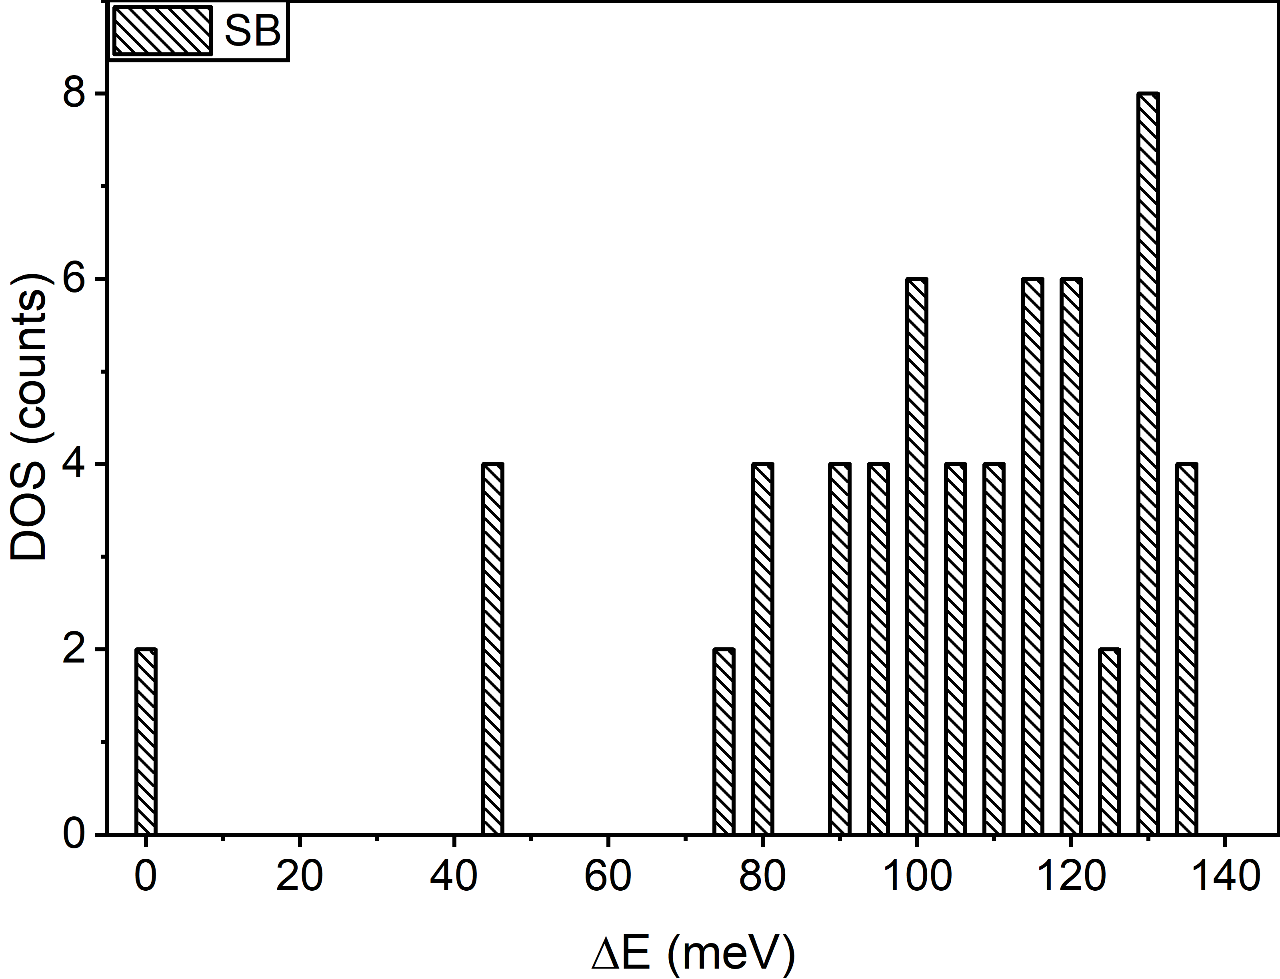
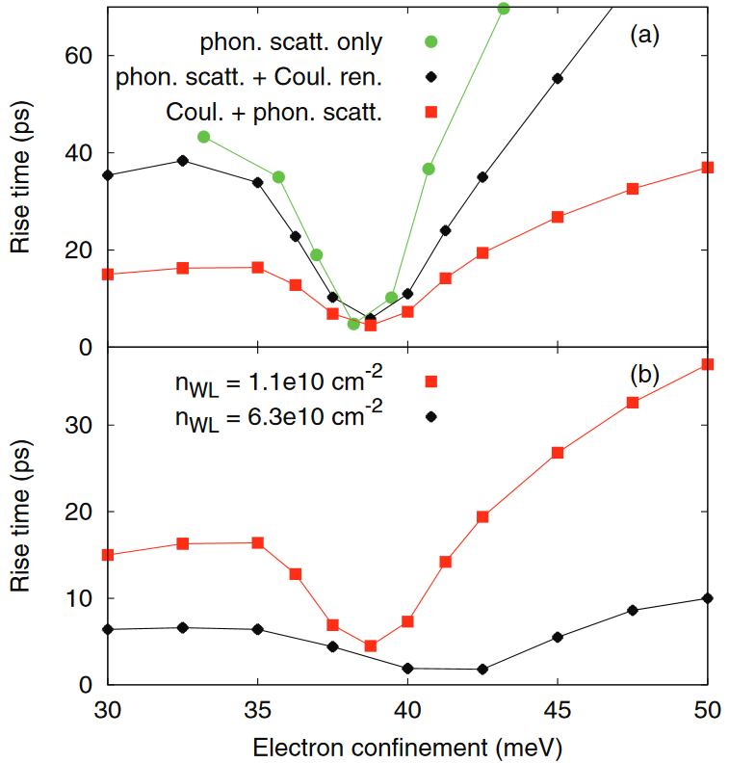
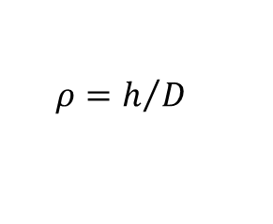
Aspect Ratio effect on LO phonon detuning
QD-IBSC: engineering of carrier dynamics
QD: h≈3, 6 nm, D≈25
Aspect ratio
$$ρ=h/D$$
ρ=0.26
ρ=0.12
ΔE=40 meV
ΔE=20 meV
ħω_{LO}=36 meV
Steinhoff et al., Physical Review B 88, 205309 (2013)
Scaccabarozzi et al., Prog Photovolt Res Appl. 31, 637 (2023)

