Slide 1
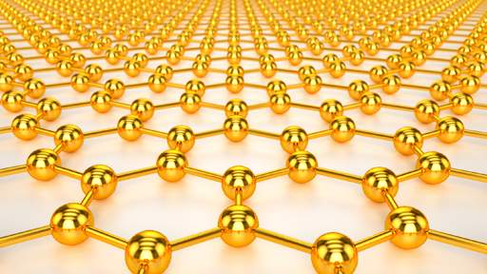

Employing Nanotechnology: Improving Solar Cell Performance by Integrating Quantum Dots and Gold Nanoparticles
Secondo Congresso Nazionale di NQSTI
Inaugurazione dell’International Year of Quantum Science and Technology
Roma, 5 – 7 Febbraio 2025
Ilaria Citro CNR-IPCF (Istituto per i Processi Chimico Fisici), Messina
Notes:
Good morning everyone, i would thank the chair for the kind introduction. My name is Ilaria Citro and i work at the CNR IPCF of Messina and today my talk would be about the use of gold nanoparticles within third generation solar devices to increase their efficiency, and evaluating their effect in the presence of natural and synthetic dyes

Slide 2
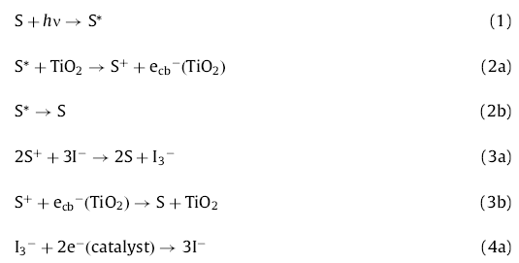
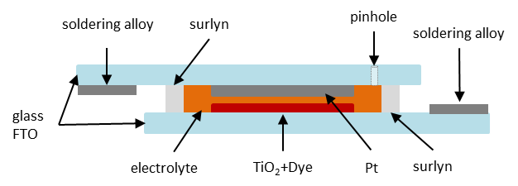
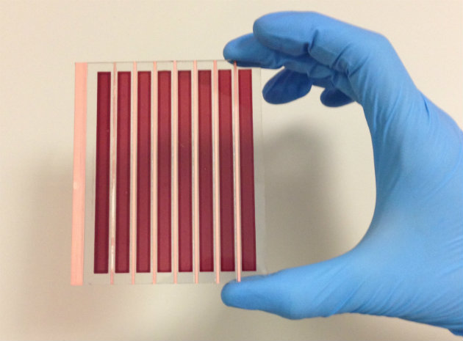
DSSC: Operating processes and sandwich structure
Light absorption
Electron injection
Back electron transfer
Dye Regeneration
Recombination
Electrolyte Regeneration
Recombination
Scheme 1 - The processes contributing to Power Conversion Efficiency (PCE) are highlighted in red. Conversely, the recombination and back electron-transfer processes, which adversely affect the PCE, are denoted in blue.
Schema 2 – solar cells sandwich structure
Notes:
The DSSC has a typical sandwich shape where all active layers are between two transparent conductive glasses. The working electrode is conductive glass where a mesoporous layer of TiO₂ (or another semiconductor) lies. The TiO₂ layer is then sensitized by a dye and impregnated with an electrolyte solution (redox mediator) and the device is finally closed with another conductive glass, the counter electrode where a catalyst is deposited. The dye absorbs the solar radiation and injects excited electrons in the conduction band of the semiconductor; the redox mediator works to regenerate the oxidized dye. The redox mediator regenerates itself by accepting electrons from the catalyst and, in this way, the electrons’ flow continues again and again.

Slide 3
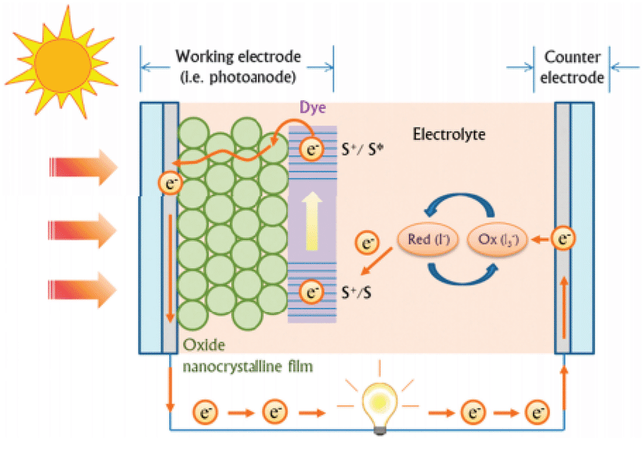
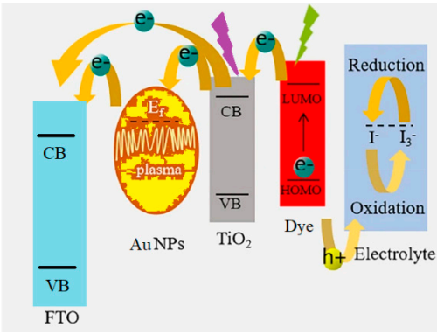
DYE SENSITIZED SOLAR CELLS AND GOLD NANOPARTICLES
An optimization work on dye-sensitized solar cells (DSSCs) based on both artificial and natural dyes was carried out by a fine synthesis work embedding gold nanoparticles in a TiO2 semiconductor, so we were able to boost the power conversion efficiency (PCE).
Au NP@TiO₂
Notes:
My research focuses specifically on the integration of gold nanoparticles into the TiO2 semiconductor matrix of these solar cells. In this context, TiO2 plays a vital role as the semiconductor material. Its unique properties, including high electron mobility and stability, make it an ideal candidate for efficient electron transport in DSSCs.
It has been found that plasmonic NPs absorb light via the collective oscillations of surface electrons, which can be excited and directly injected into the conduction band of semiconductors. Furthermore, the poor light absorption capability of TiO₂ can also be extended through the enhancement of the photo-absorption cross-section of dye molecules. In addition, the formation of Schottky barriers at the interface of metal oxide and metal NPs can significantly reduce the recombination rate of photo-excited electron–hole pairs. The core-shell Au NPs were incorporated directly into the TiO₂ paste to assemble the photo-active layer. This structure boosts the PCE, mainly influencing the open circuit voltage and Jsc. We tested the effect of core–shell Au@TiO₂ NPs in a natural dye-based DSSC with betalains from Sicilian prickly pear. In the struggle to cut costs and to use increasingly pollution-free materials, it is of significant importance to investigate the use of natural dyes that are ideal candidates for environmentally friendly solar cells.

Slide 4
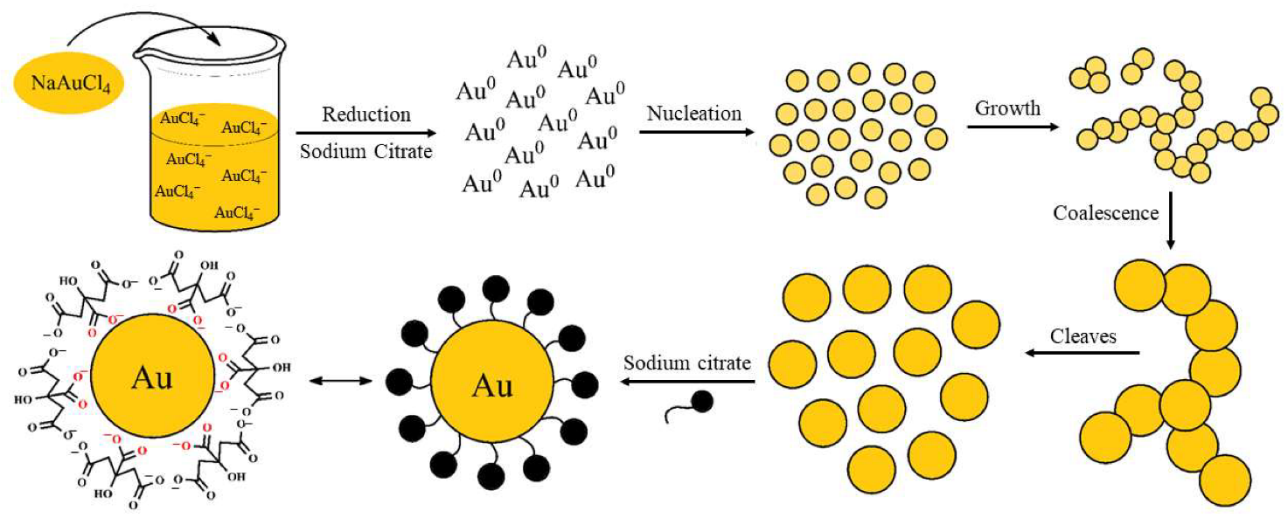
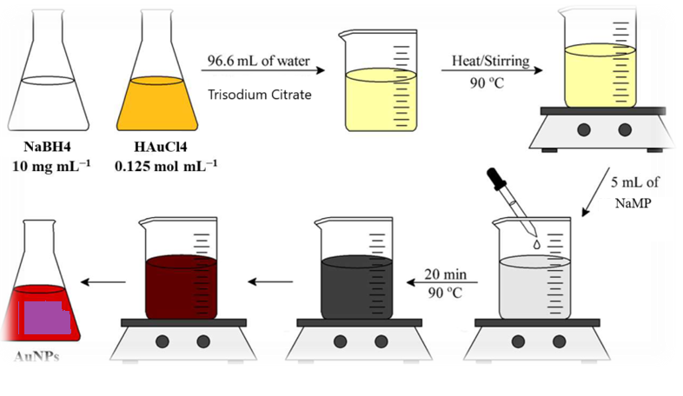
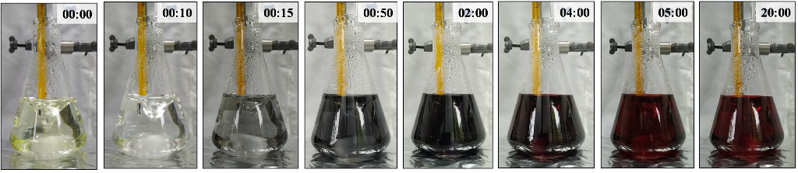
SYNTHESIS OF GOLD NANOPARTICLES COLLOIDAL SOLUTION
The synthesis procedure is a combination of a redox reaction carried out by NaBH4 assisted by trisodium citrate (TC) as a chelant, to produce the gold nanoparticles (Au NPs), followed by their functionalization to provide anchoring molecules, and, finally, the same acid hydrolysis with solvothermal treatment described above to obtain TiO2 nanopowders was then used to embed the Au NPs.
Notes:
Using the citrate reduction method we have obtained a colloidal solution of gold nanoparticles. In this method, we start with two primary solutions. The first one is a sodium citrate solution, which acts as both a reducing agent and a stabilizer, which is crucial for the success of the synthesis. The second solution contains tetrachloroauric acid sodium salt, a yellow liquid which serves as our gold precursor.
The second step includes dilution and mixing of our gold precursor with water. The third step involves heating and stirring the diluted solution. This heating is essential to accelerate the reaction and ensure that the gold ions are effectively reduced. At this stage, the solution maintains its yellow coloring. Next comes the critical moment: the addition of our sodium citrate solution, that reduces the gold ions, marking the beginning of our nanoparticle formation. The color changes during this process and shifts to a dark red, reflecting the formation of uniform nanoparticles. This striking red color is due to a phenomenon known as surface plasmon resonance, where the collective oscillation of electrons in the nanoparticles interacts with light.

Slide 5
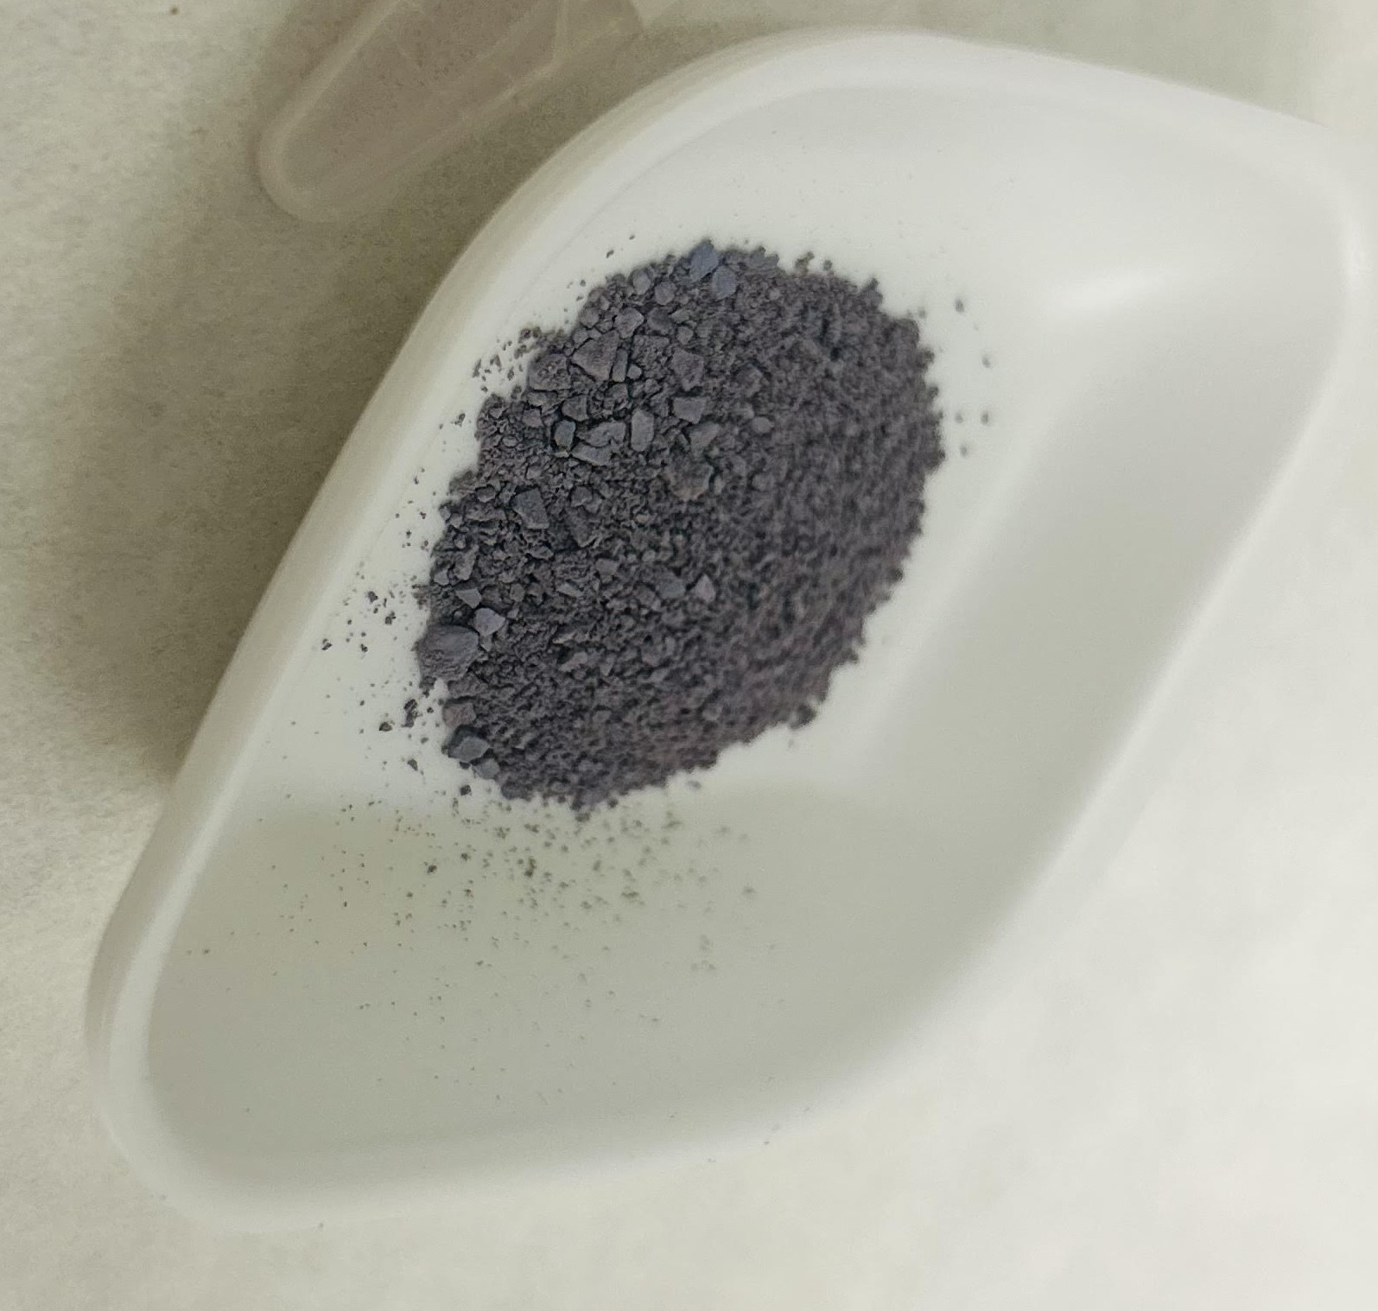
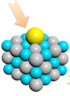
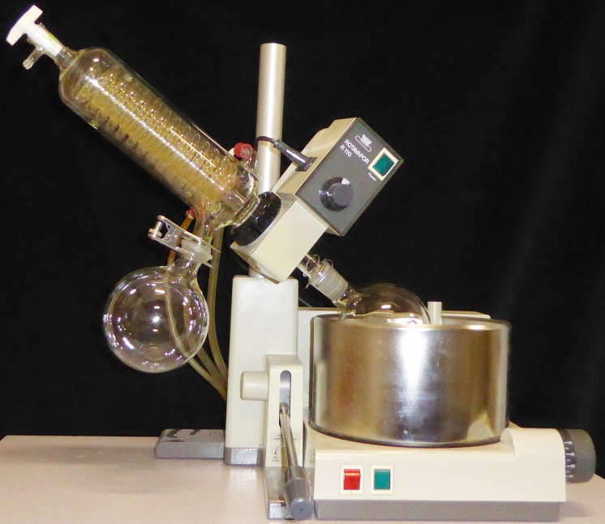
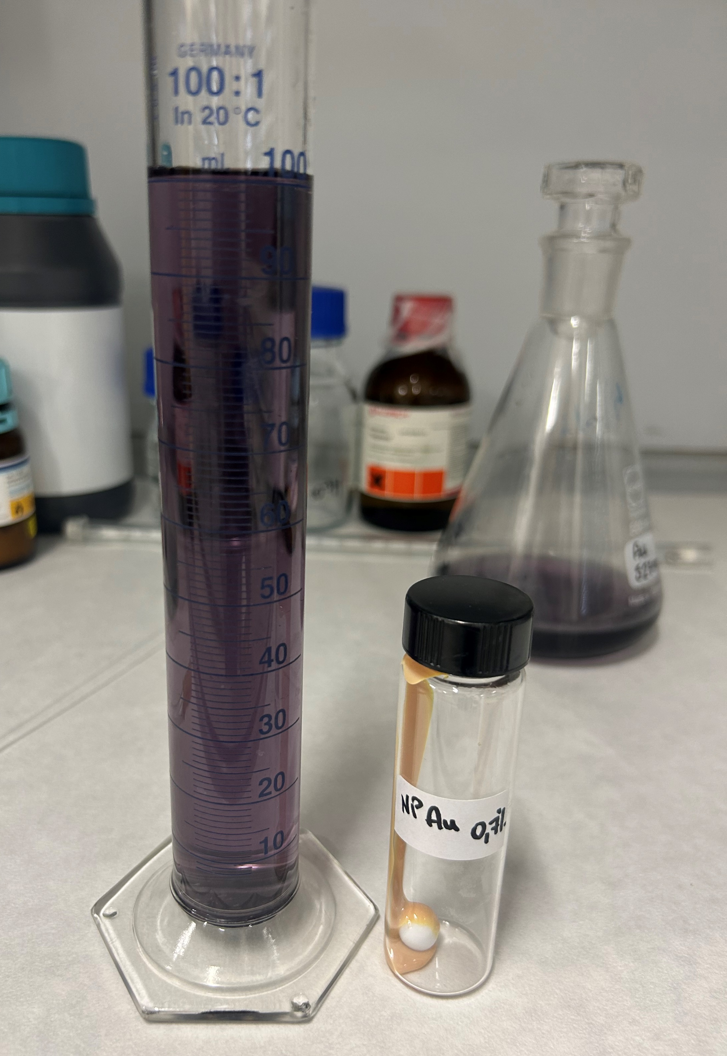
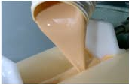
PREPARATION OF Au@TiO2 DOPED PASTE
Gold nanoclusters were dissolved in ethanol for a night by stirring; then, they were embedded directly on the TiO2 paste (furnished by Dyesol) with 0.7% in weight of gold nanoparticles. The doped paste was mixed for 2 days, alternating stirring and ultrasonic baths, until it was uniform and homogeneous.
Notes:
For the preparation of doped TiO2 paste, Gold nanoclusters were dissolved in ethanol for a night by stirring; then, they were embedded directly on the TiO₂ paste (we used a commercial paste furnished by Dyesol) with 0.7% in weight of gold nanoparticles. The doped paste was mixed for 2 days, alternating stirring and ultrasonic baths, until it was uniform and homogeneous.

Slide 6
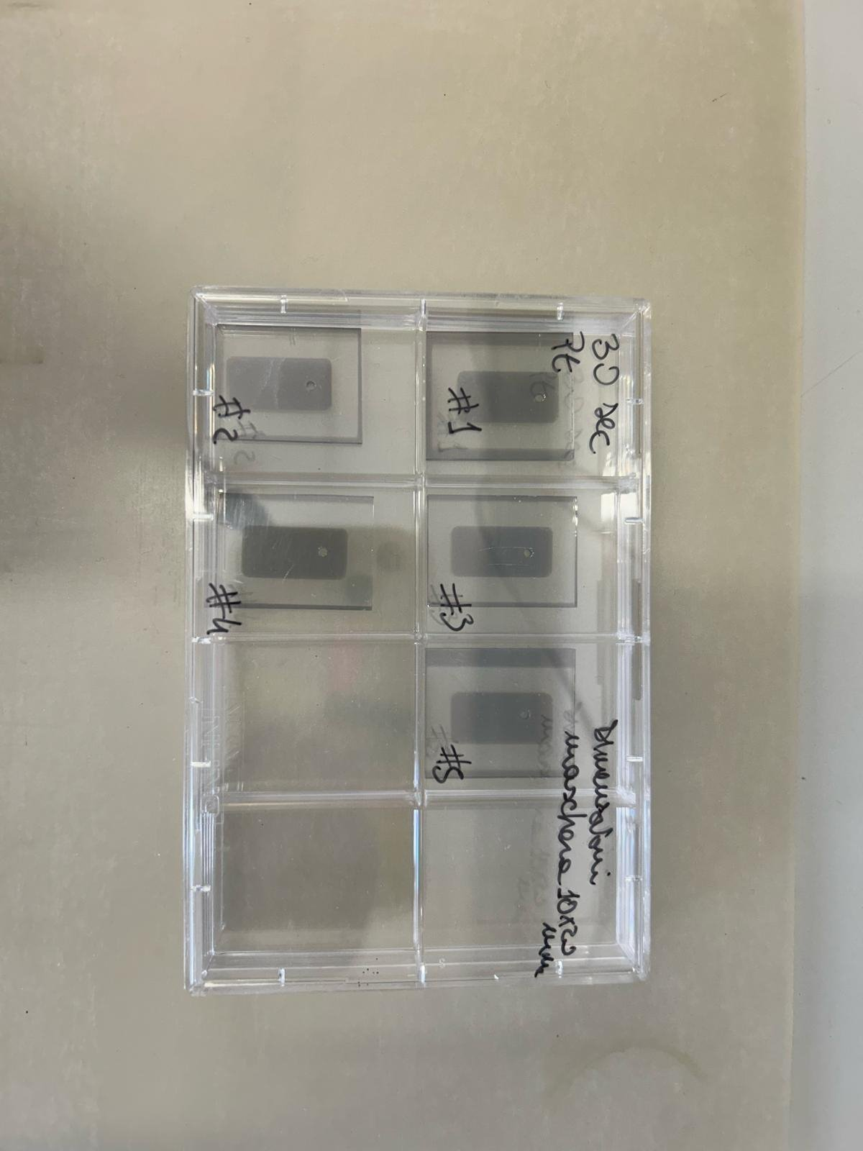
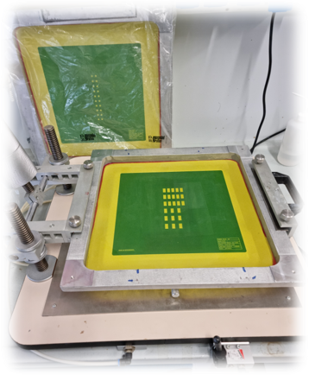
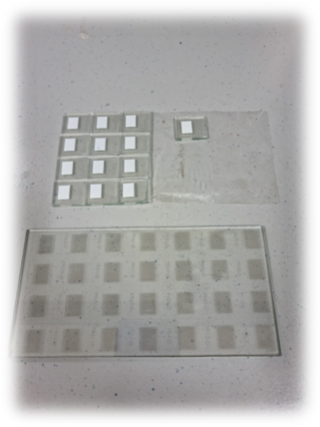
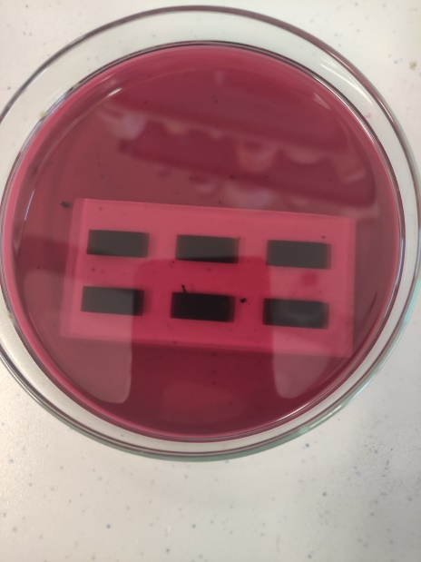
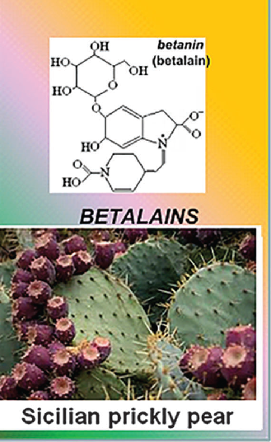
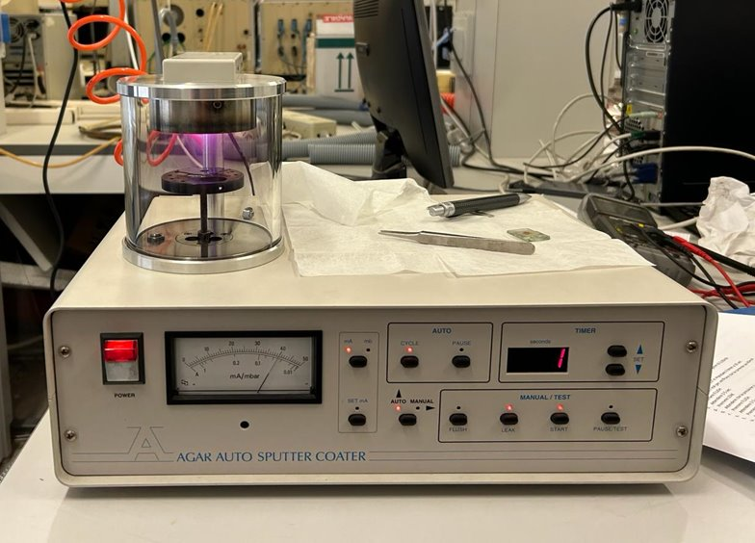
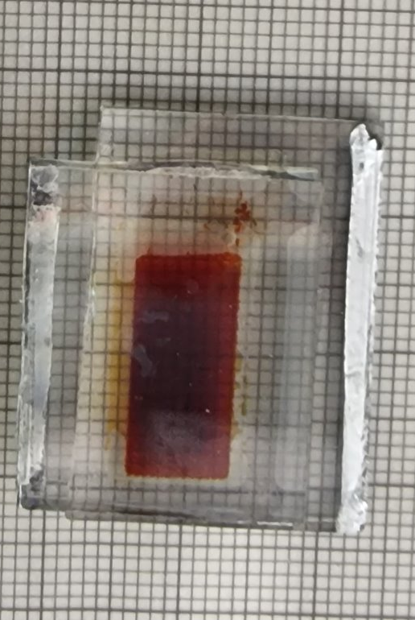
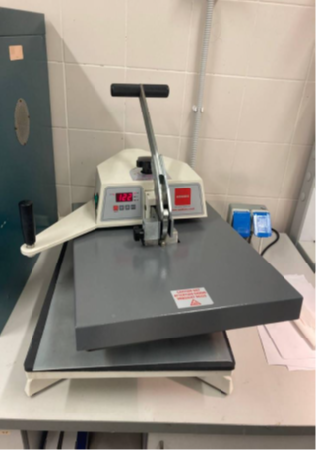
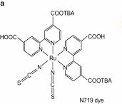
DEVICE FABBRICATION
PREPARATION OF DYE SOLUTION
SENSITIZATION OF ANODES
A ruthenium complex, N719 was dissolved with a concentration of 0.3 mM in ethanol solvent. One hundred grams of Sicilian prickly pear was collected from the plant when fruits reached the typical red color. Later, fruits were washed with distilled water and left to dry. Using a mortar and a pestle, the fruits were mashed to facilitate the dye extraction process. A doubled amount of acid solution at pH 2, compared to the obtained liquid, was added and the extract was left in an ultrasonic bath for 20 min. At the end, the extract was filtrated.
SCREEN PRINTING OF TiO2 PASTE
SEALING DSSC
SPUTTERING OF PLATINUM
Notes:
After having prepared and optimized the doped semiconductor pastes, we proceeded with the development, step by step, of our solar devices. Glass substrates, after cleaning procedures, were mainly prepared using two techniques: screen printing and sputtering. Subsequently the supports must undergo a heating process at 500 °C for 30 min. Once the anodes were ready, while still warm, they were soaked in the dye overnight, at room temperature in the dark. In the CE, a small hole was drilled with the aim to ensure electrolyte insertion and the catalyst based on Platinum was deposited on conductive glass with the sputtering technique. Finally, we proceed with hot sealing, inject the electrolic solution between the two electrodes and close the hole. The device is ready to produce energy and be characterized.
For this study, as mentioned before, two dyes of very different nature were used: N719, a synthetic dye based on Ruthenium and betalain, a natural dye extracted from a typical Sicilian variety of prickly pear.

Slide 7
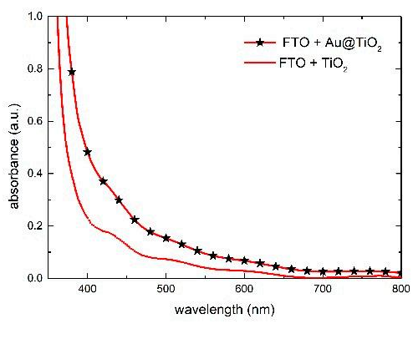
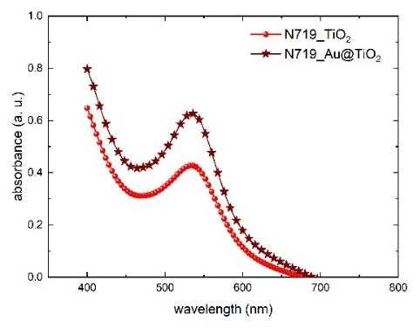
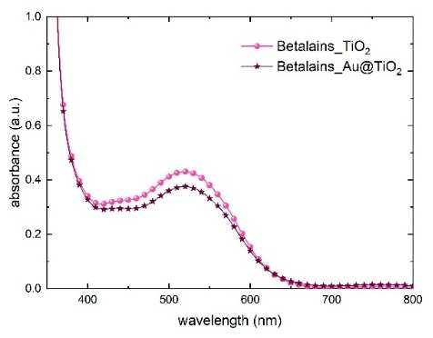
SPECTROPHOTOMETRIC MEASUREMENTS
Absorbance spectra of the reference TiO2 and the one mixed with Au@TiO2
Absorbance spectra of the WE with the reference TiO2 and the one mixed with Au@TiO2 after dipping in N719 and betalains.
Gold nanoparticles do not exhibit the plasmonic effect and do not affect the intensity of absorbance, leading to no differences between the reference TiO2 and the doped TiO2. The variations in molar extinction coefficients (ε) are probably responsible for this differing behavior. In fact, N719 has a lower ε compared to betalains, and the greater capacity of betalains to absorb photons may lead to saturation of the absorption..
Notes:
In order to investigate the plasmonic effect of gold NPs when mixed in the TiO₂ paste, UV absorption spectra of solid bulk WEs (FTO/TiO₂) were made. we compare the reference TiO₂ layer with the one mixed with Au@TiO₂ nanoparticles. The presence of gold can be clearly recognized thanks to the absorbance increment in the spectral region 450–600 nm. This boosting effect has been confirmed on samples impregnated with the N719 dye. However, a different behavior was observed in samples impregnated with the betalain-based dye. Surprisingly, gold nanoparticles do not show the plasmonic effect and do not influence the absorbance intensity, resulting in no differences at all between the reference TiO₂ and the doped TiO₂ . The different molar extinction coefficients (ε) are likely to be the cause of the dissimilar behavior. Indeed, N719 has a lower ε than betalains and the higher ability of the betalains to capture photons could saturate the absorption.

Slide 8
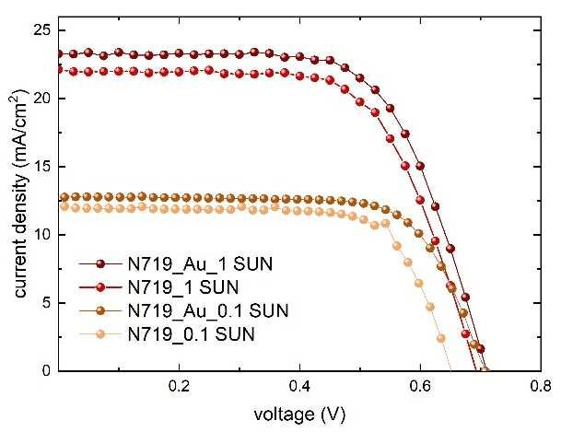
PHOTOVOLTAIC PERFORMANCES: SYNTHETIC DYE N719
Photovoltaic parameter comparison between TiO₂ reference devices and Au@TiO₂ containing device. Relative increment is calculated as an average.
I-V PARAMETERS | TiO₂@N719 | Au@TiO₂@N719
Jsc (mA/cm²) | 21.5 ± 0.3 | 22.1 ± 0.4
Voc (V) | 0.69 ± 0.01 | 0.72 ± 0.02
FF (%) | 65 ± 1 | 65 ± 1
η (%) | 9.8 ± 0.2 | 10.3 ± 0.3
In order to identify the effect of gold nanoparticles on the complete device, we prepared 10 samples of N719 devices (five with Au@TiO2 and five without). In accordance with the previous spectrophotometric analysis, the best Au@TiO2-containing cell shows a PCE increase from 9.9% to 10.5%.
Notes:
Our solar cells are characterized also with photovoltaic measurements, using a solar simulator with different power In accordance with the previous spectrophotometric analysis, the best Au@TiO₂-containing cell shows a PCE increase from 9.9% to 10.5%. The boost of the device performances by adding Au NPs in the TiO₂ layer is confirmed. The current density improvement of 3% is due to the charge transfer from gold plasmon to TiO₂. The TiO₂ absorption increment, shown in the absorption spectra, derives from the plasmonic resonance effect that excites Au NPs, increasing the energetic field on the TiO₂ surface. This leads to a strong separation between holes and electrons that reduces charge recombination. For this reason Au NPs not only affect the J_{sc}, but also positively influence V_{oc} with an increasing of 4%.

Slide 9
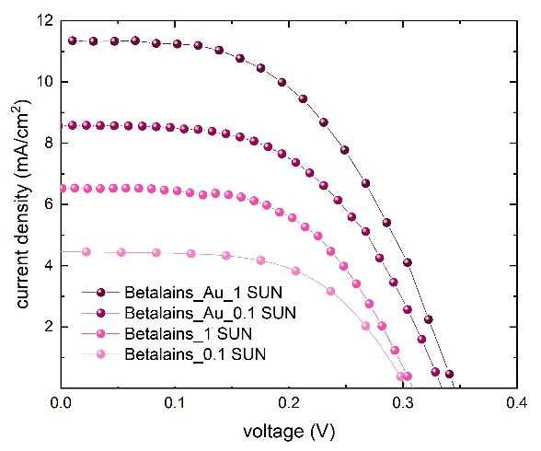
PHOTOVOLTAIC PERFORMANCES: NATURAL DYE BEATALAIN
Sample | Anode | Irradiation (mW/cm²) | J_{SC} (mA/cm²) | Voc (V) | FF (%) | PCE (%)
Betalains | TiO₂@Au | 100 | 11.3 | 0.34 | 52 | 2.0
Betalains | TiO2 | 100 | 6.5 | 0.30 | 57 | 1.1
Betalains | TiO₂@Au | 10 (LED) | 8.6 | 0.33 | 54 | 15.3
Betalains | TiO2 | 10 (LED) | 4.4 | 0.31 | 57 | 7.9
N719 | TiO₂@Au | 100 | 23.3 | 0.71 | 65 | 10.8
N719 | TiO2 | 100 | 22.0 | 0.69 | 65 | 9.9
N719 | TiO₂@Au | 10 (LED) | 12.8 | 0.71 | 70 | 6.6
N719 | TiO2 | 10 (LED) | 12.0 | 0.65 | 72 | 5.2
Electrical parameter at 1 SUN, 100 mW/cm² (solar simulator) and 0.1 SUN, 10 mW/cm² (LED).
Au NPs reduce charge recombination and, for this reason, the J_{sc} is boosted by 74%, from 6.52 mA/cm² to 11.35 mA/cm^{2.} Indeed, artificial dyes regenerate in the iodide electrolyte almost four times faster than natural dyes. For this reason, a natural dye benefits, in a wider way, the electronic effect of Au NPs, exponentially improving the Jsc performances.
Notes:
This time, the same trend in terms of PCE has been revealed for the gold-containing device based on betalains that doubled the efficiency, from 1.1% to 2%. We performed JV measurement also at 0.1 SUN (indoor conditions, blue LED irradiation) with the aim of proving the capability of natural dye to produce high PCE under shadow conditions and considering their application in an indoor contextAlthough the absorption spectrum did not show the resonance effect of the Au NPs in the betalain–gold-based device, the photovoltaic performance shows that gold nanoparticles indeed affect its electrical parameters; both V_{oc} and J_{sc} increase. This means that with betalain-based dye, an actual optical effect is not visible for the reasons already explained, but the electric effect is present. The reason for the 5% enhancement of J_{sc} performances in N719 devices and 74% in betalain devices can be explained considering that, Indeed, artificial dyes regenerate in the iodide electrolyte almost four times faster than natural dyes. For this reason, a natural dye benefits, in a wider way, the electronic effect of Au NPs, exponentially improving the J_{sc} performances.

Slide 10
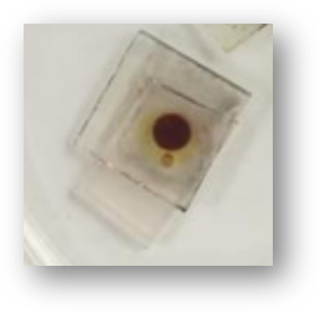
CONCLUSIONS
General increase in photoelectrochemical performance.
The plasmonic effect contributes to electronic enhancement.
Reduction of charge recombination.
Exponential advantage of a natural dye compared to an artificial one.
The artificial dye regenerates four times faster than the natural one.
Notes:
I conclude my presentation by focusing on the main results obtained and the consequent considerations made also in anticipation of future studies. We compared the plasmonic effect of gold in a DSSC device containing an artificial and a natural dye, respectively.
We have discovered that the plasmonic gold resonance does not affect the optical properties of a natural-based device, contrary to the artificial one, but the plasmonic contribution is effective from an electrical point of view. In the natural-based device, the optical effect of gold is not visible as the molar extinction coefficient of betalains is much higher than that of N719, thus saturating the absorption effect. On the other hand, it was found that an artificial dye regenerates four times faster than a natural one; therefore, the electronic enhancement effect in reducing charge recombination exponentially benefits a natural dye rather than an artificial one.

Slide 11
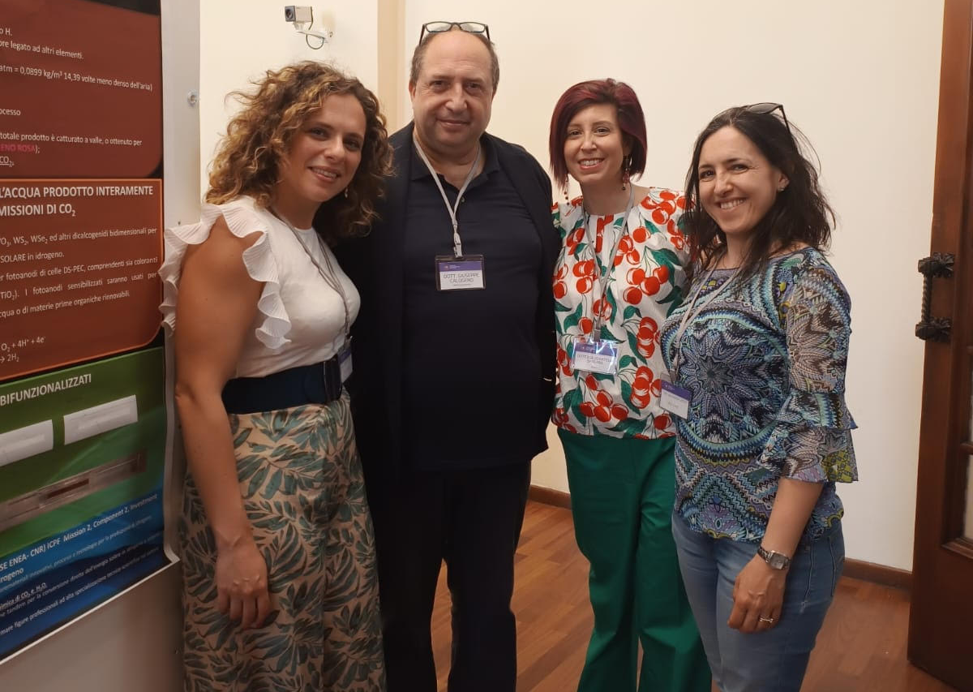
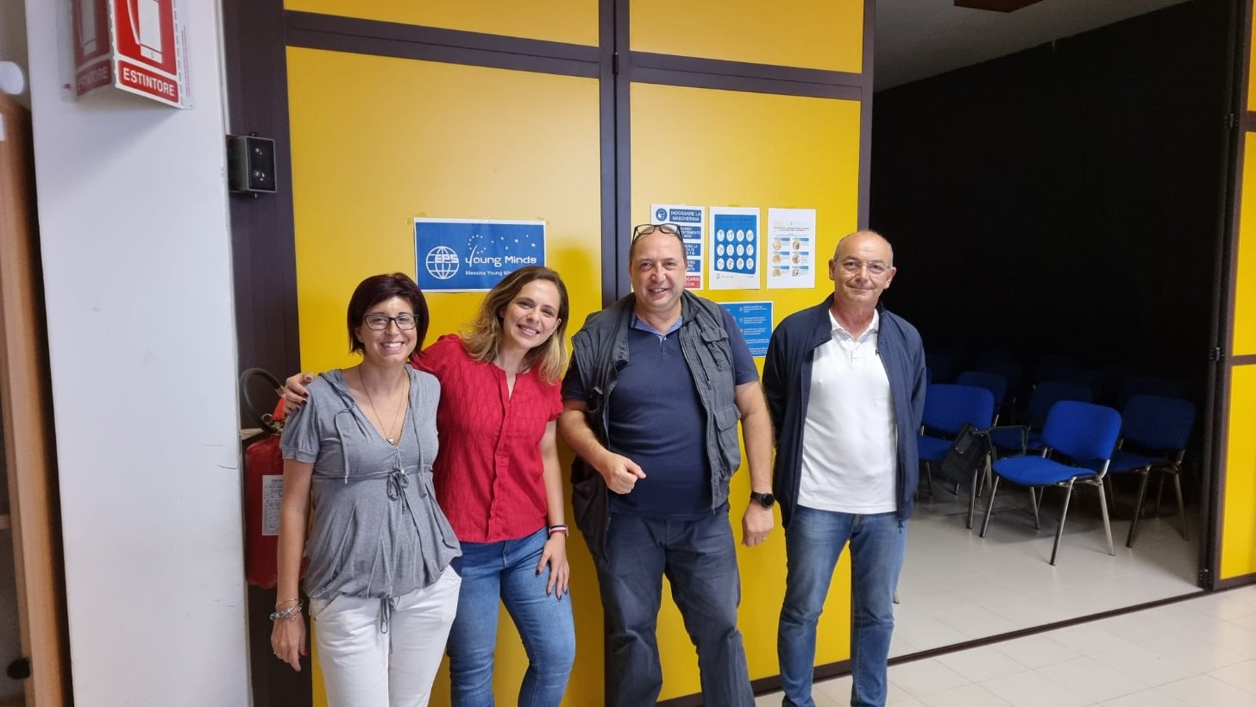

S.O.L.A.R.E. (Spectrophotometry, Optoelectronics, Luminescence, Analysis, Relaxation, Energy) ​ The research activity of the lab is focused on solar energy conversion using photoelectrochemical devices.
I. Citro, J. Barrichello, M. Lanza, M. Latino, D. Spadaro, G. Calogero
RETE ITALIANA DEL FOTOVOLTAICO PER LA RICERCA, LO SVILUPPO E L’INNOVAZIONE (RETEIFV)
Notes:
Here I present to you the colleagues of the solar laboratory with whom I have the pleasure of working and collaborating for years now.

Slide 12
Thank you for your attention!
Secondo Congresso Nazionale di NQSTI
Inaugurazione dell’International Year of Quantum Science and Technology
Roma, 5 – 7 Febbraio 2025
Ilaria Citro CNR-IPCF (Istituto per i Processi Chimico Fisici), Messina

