Slide 1

Università di Napoli “Federico II”
High-Q cavity coupled to a high permittivity dielectric resonator for sensing applications
Antonio Cassinese
Dept. of Physics, Università di Napoli Federico II.
https://arxiv.org/abs/2410.05831
Shahnam Gorgi Zadeh, CERN, Alberto Ghirri, CNR NANO, Sergio Pagano, Univ. Of Salerno, Simone Tocci, Claudio Gatti, INFN- LNF and Antonio Cassinese Univ. Napoli Federico II
QT4HEP- 2nd Workshop NQSTI 5-7 February 2025

Slide 2
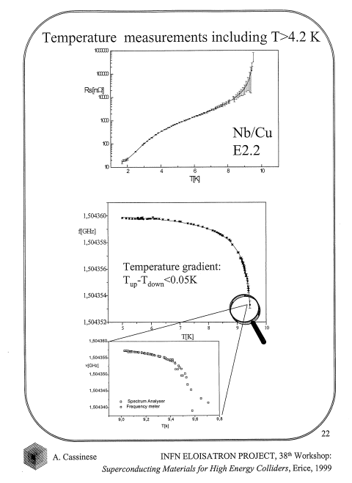
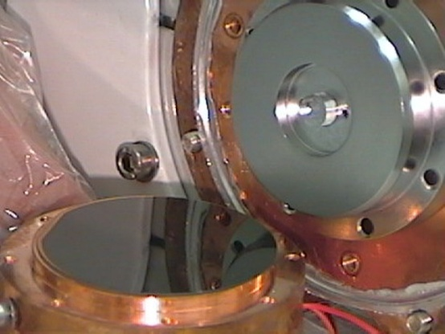
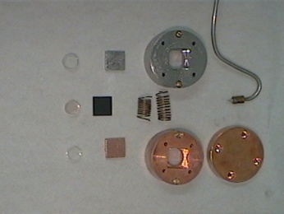
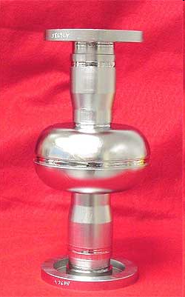
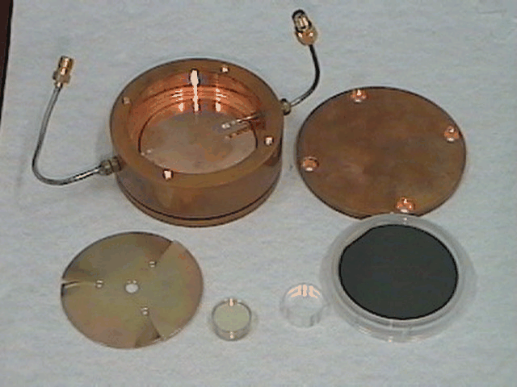
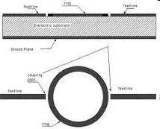
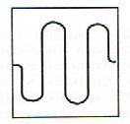
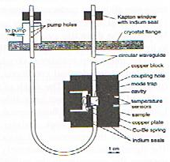
High Q microwave resonator Period: 1994 -2002
Nb or Cu/Nb 1.5 Ghz single cell
Dielectric resonators f=9 and19 Ghz
Phd thesis 1995
Univ. Wuppertal
End wall cavity 87 Ghz
T. Kaiser, et al. ,Particle Accelerators 60, 171 (1998).
Microstrip resonator
f=1,5-5 Ghz
Meander
Superconducting cavities
f=1,5GHz (CERN, INFN- LNL)
ring
Progetto Finalizzato CERN-INFN

Slide 3
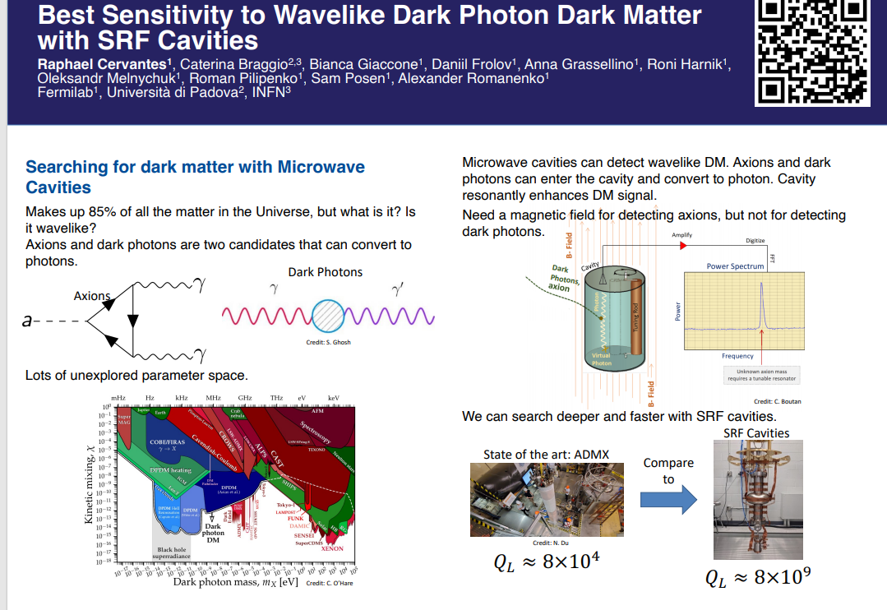
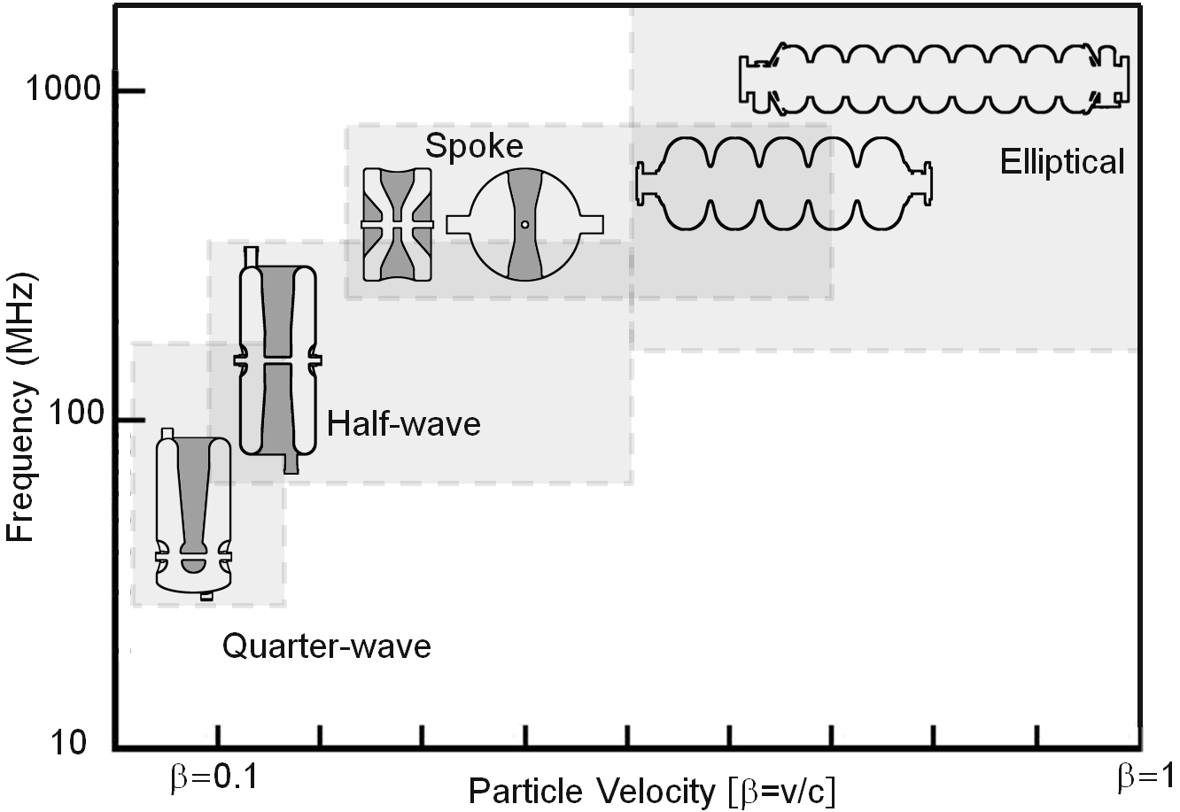
Already Existing cavities :
Choose Cavity Geometry to Match Particle Speed β = v/c values

Slide 4
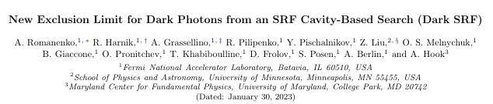
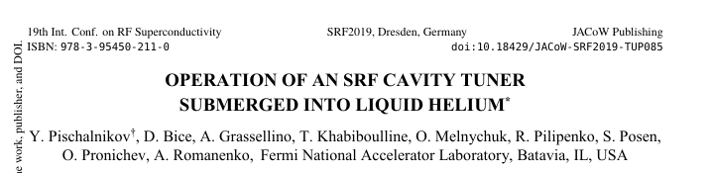
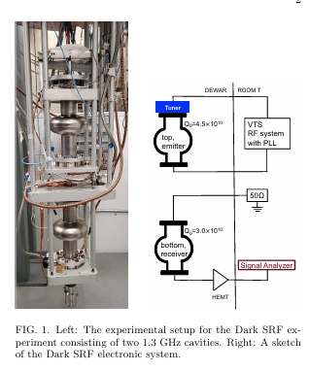
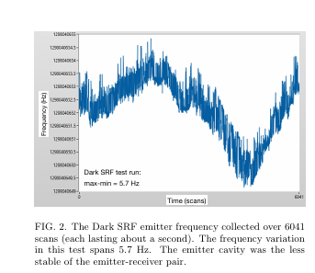

arXiv:2301.11512v1 [hep-ex] 27 Jan 2023
Minimum-to-maximum frequency variation in this run was 3Hz.

Slide 5
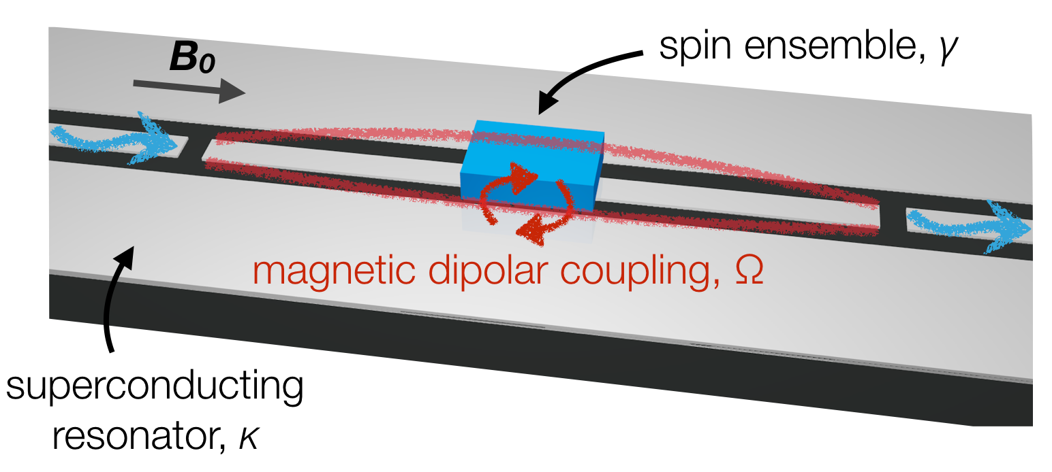
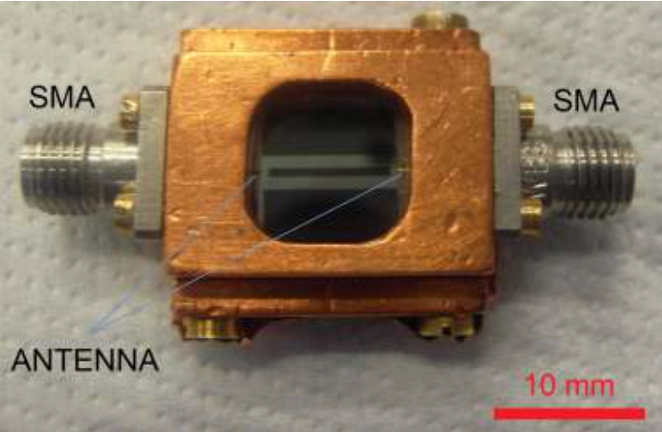
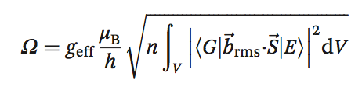
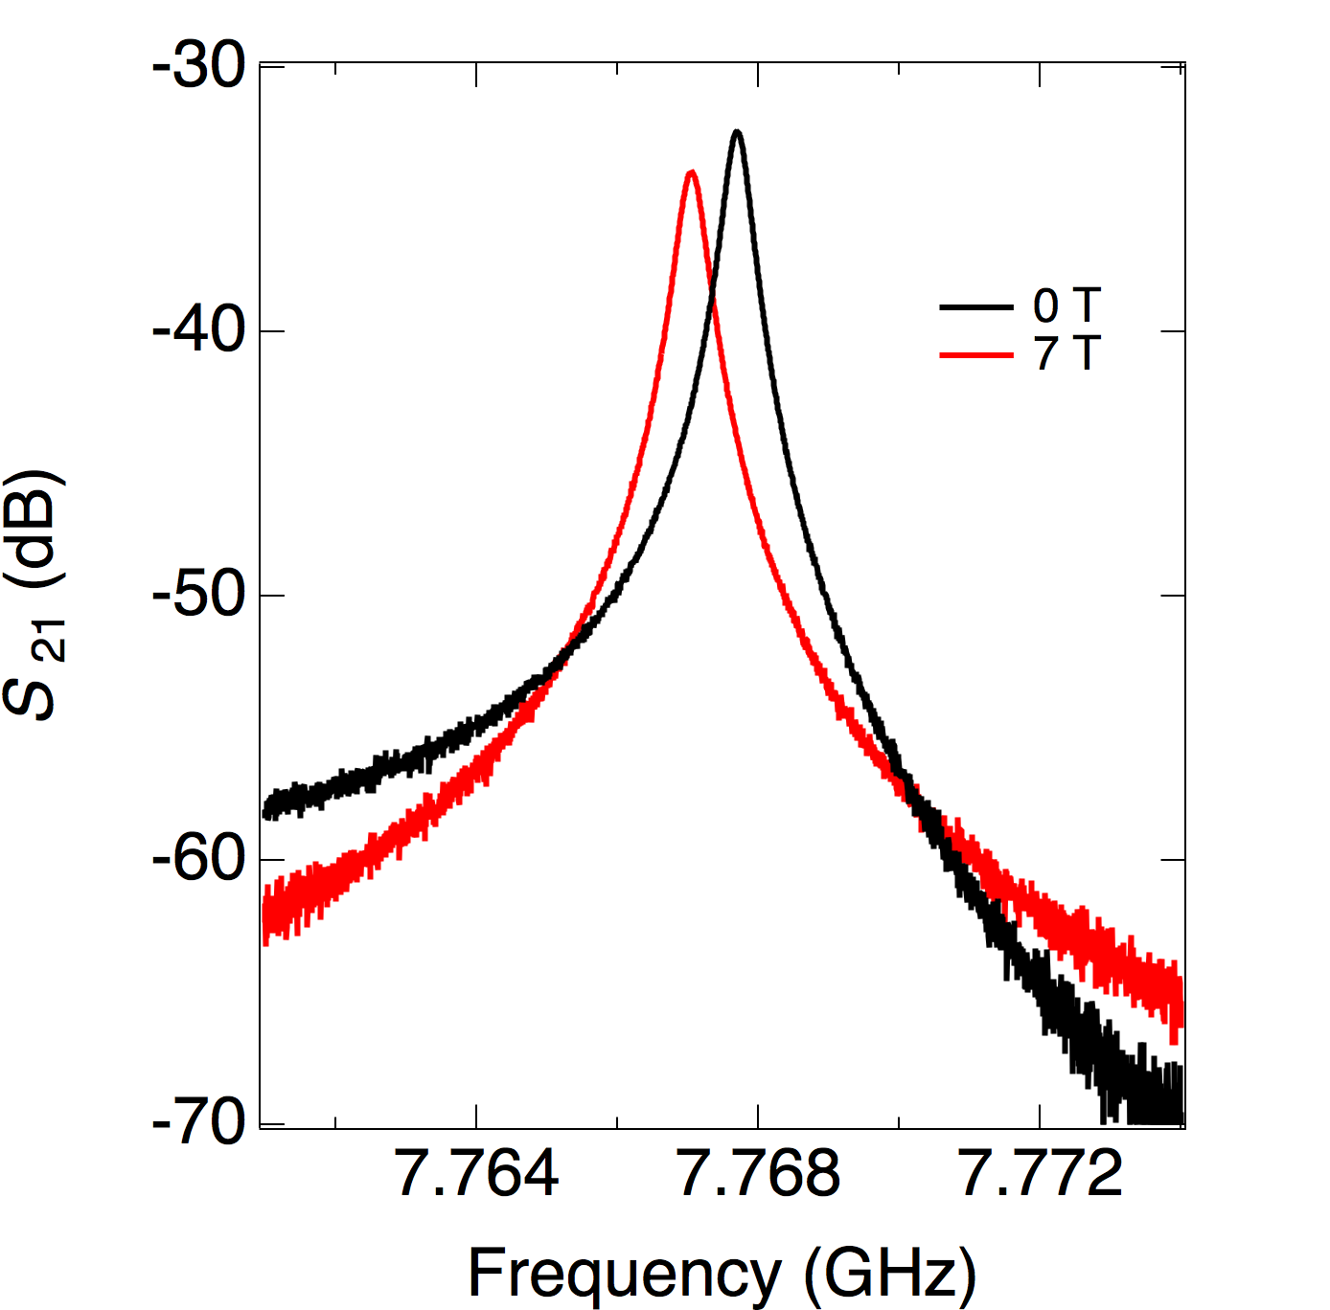
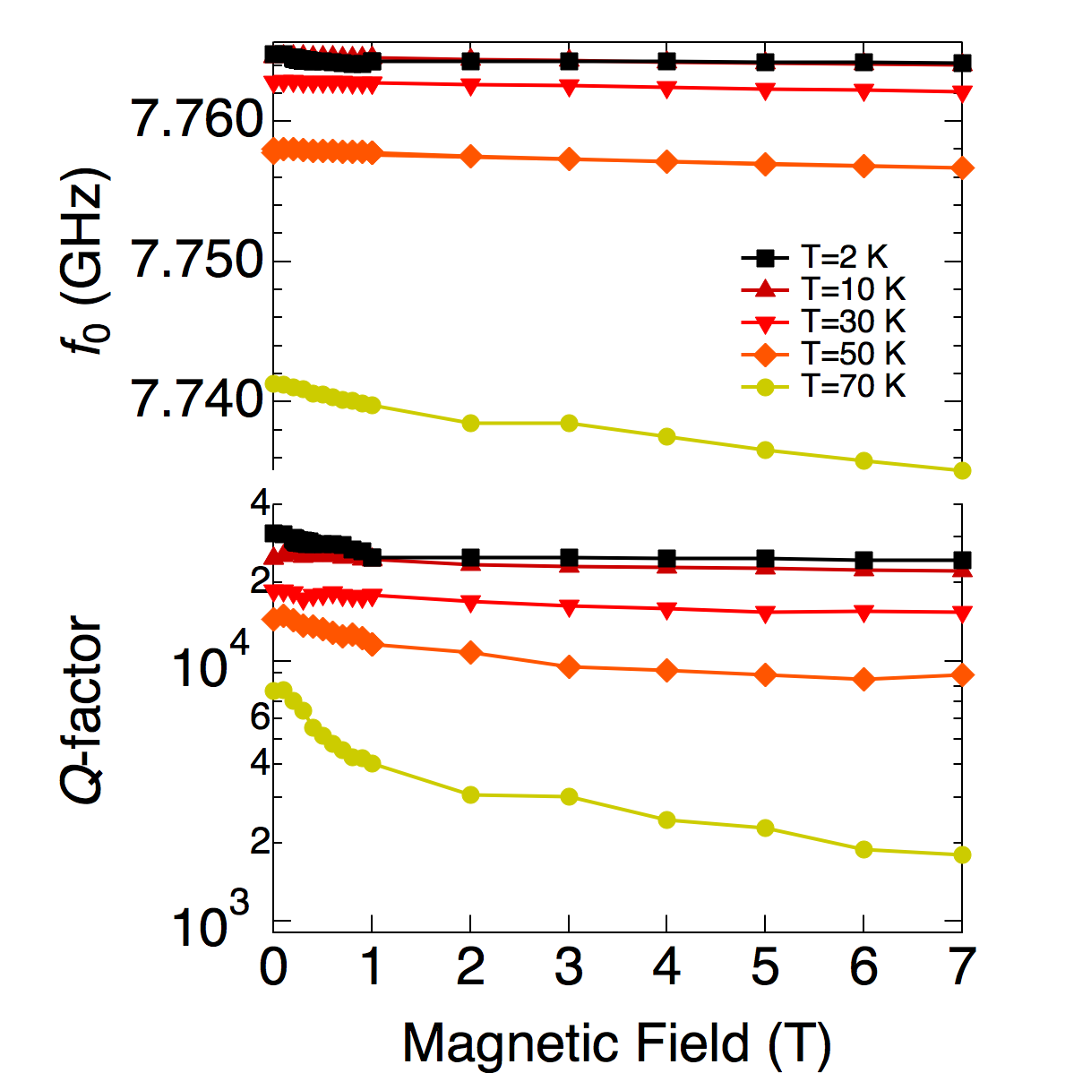
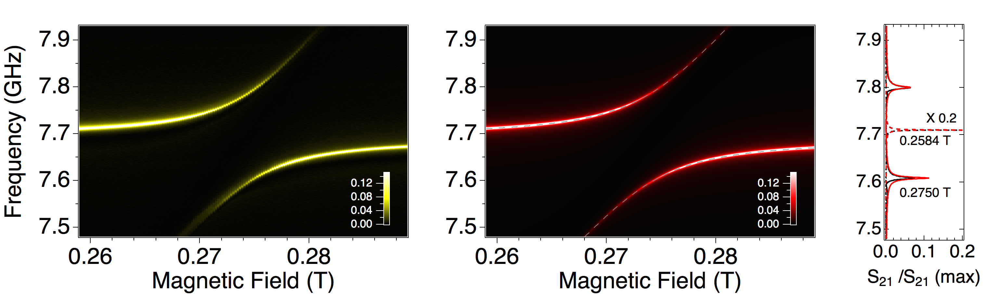
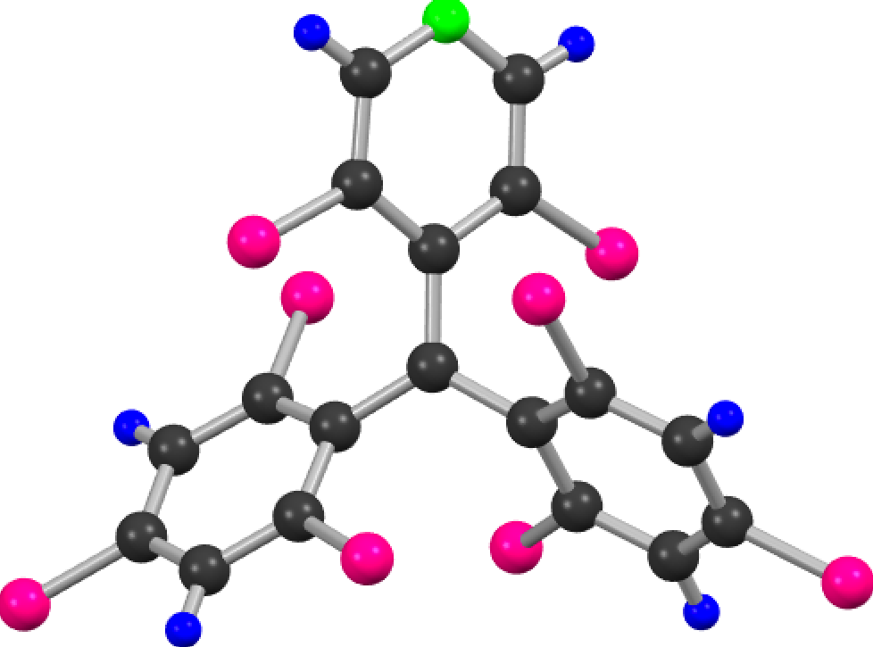
Coherent coupling between molecular spin ensembles and high critical temperature superconducting coplanar resonators ( > 2016)
Uni Modena-CNR NANO
Ω >> γ, κ
Q-factor > 10⁴ at 2 K
Wide temperature range (Tc=87 K)
Stable in applied magnetic field up to 7 T (in-plane) and 1 T (out-of-plane)
High critical current density
Bare resonator
Strong coupling regime:
Appl. Phys. Lett. 106, 184101 (2015)
We report the evolution of the transmission peak in correspondence to the resonance field of the DPPH spin ensemble (Br=0.276 T). At 2 K, two branches are observed, which indicate the presence of a large anticrossing between the resonator mode and the spin ensemble
Strong coupling with ensembles of organic radical spins
N
PyBTM
H
2 K
.
C
Cl
190 MHz
Recently we are working 2D and 3D cavities and MASER applications by consider different active materials
Phys. Rev. A 93, 063855 (2016)
Radicals synthesized
by L. Beverina (Uni. Milano Bicocca)

Slide 6
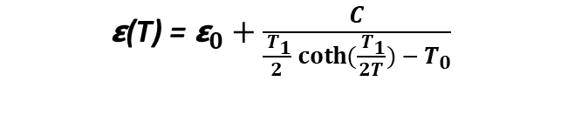
$\text{ε}\text{(}\text{T}\text{)}$ = ${\text{ε}}_{0}+\frac{C}{\frac{{ T}_{1}}{2}\coth{(\frac{{ T}_{1}}{2T}}) −{ T}_{0}}$
Where:
T is temperature
C, T₁ and T₀ are fitting parameters

Slide 9
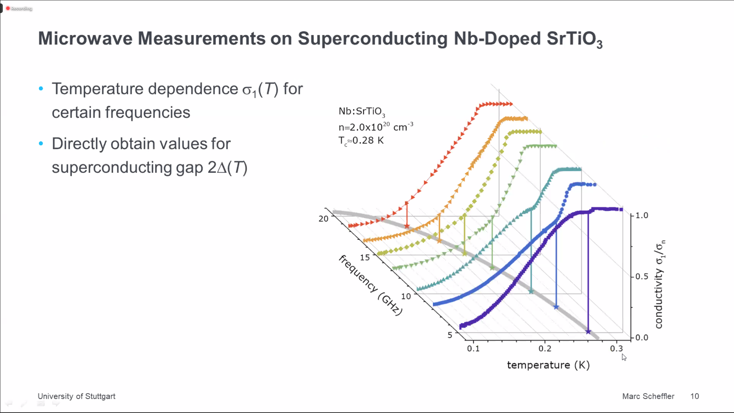

Slide 10
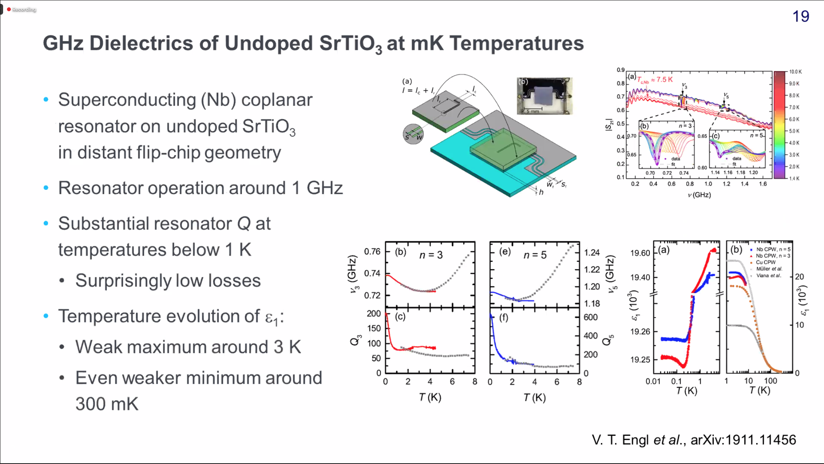

Slide 11
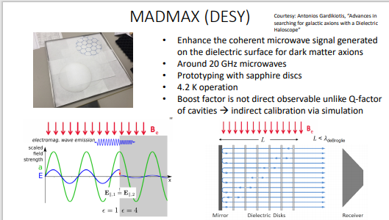
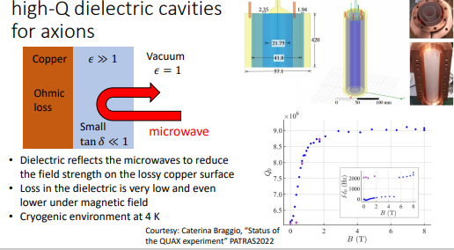
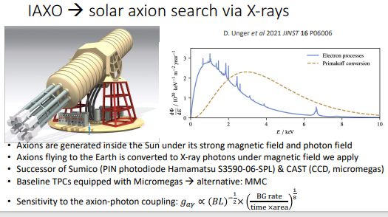
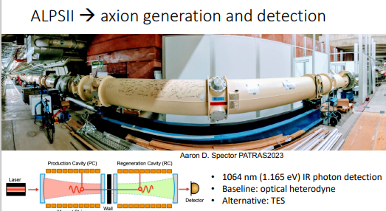

Slide 12
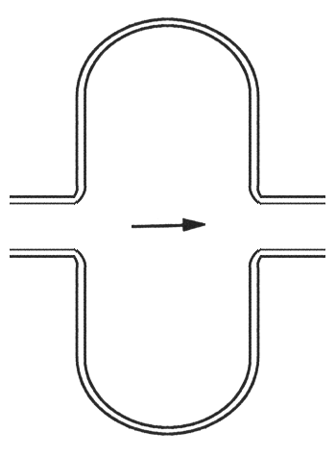
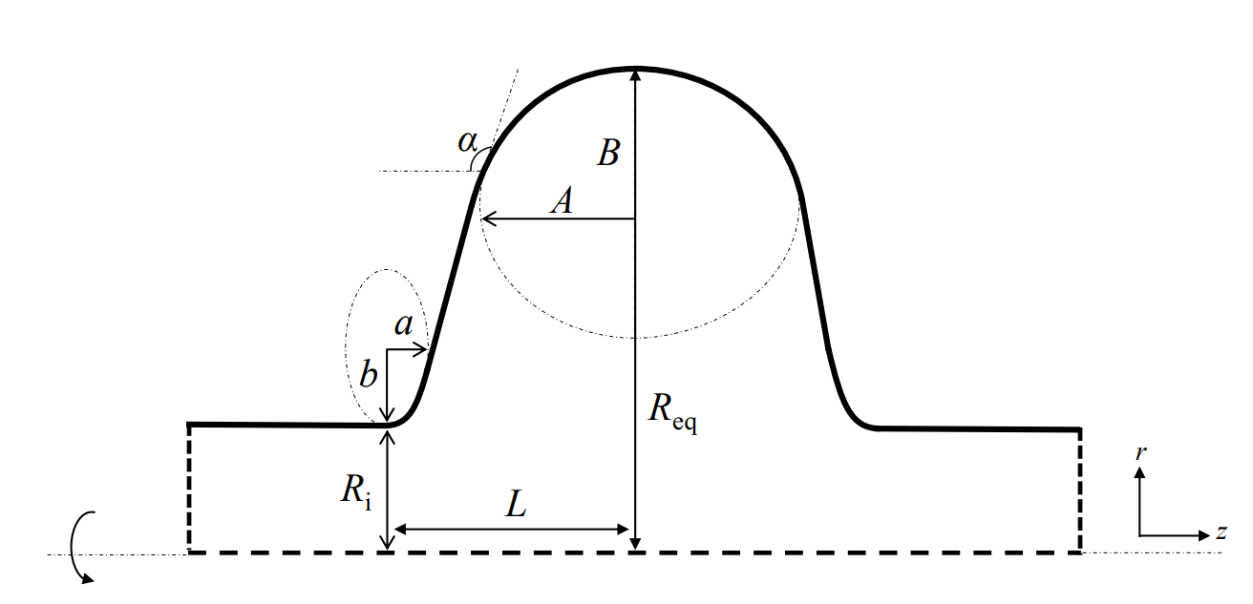
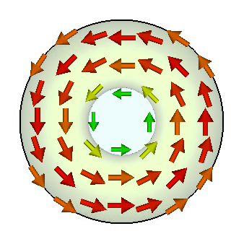
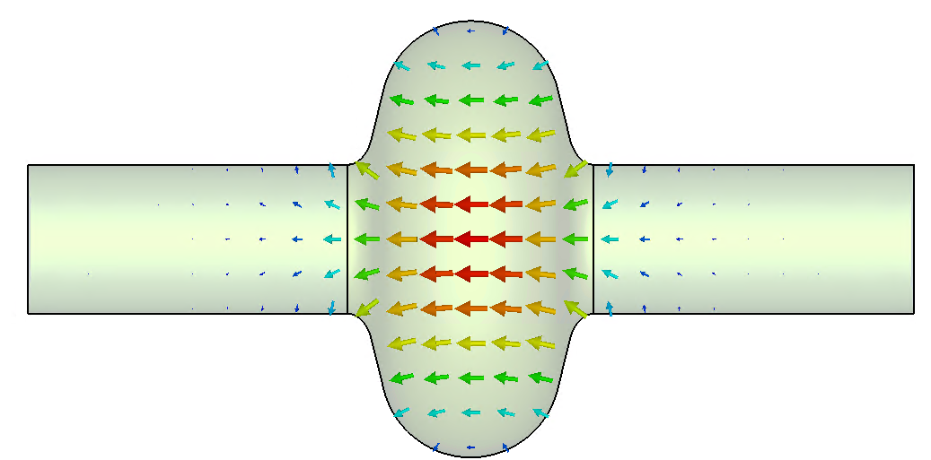
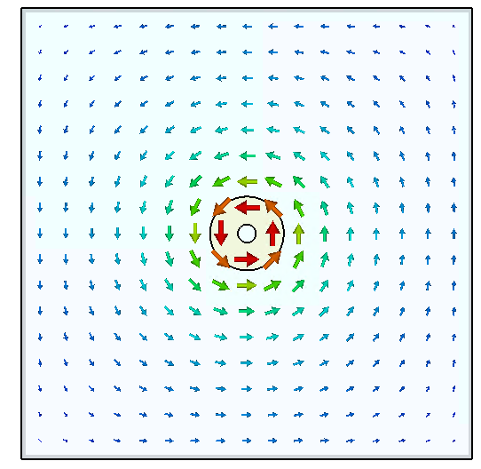
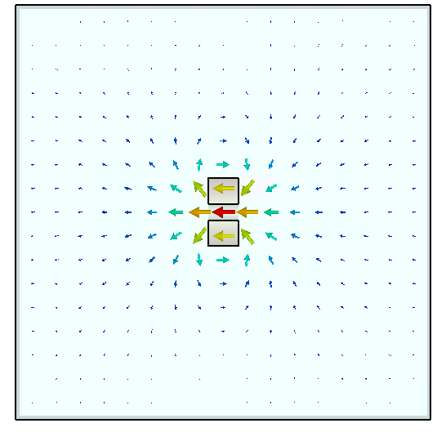
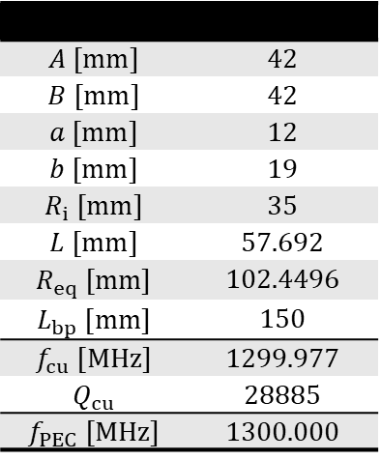
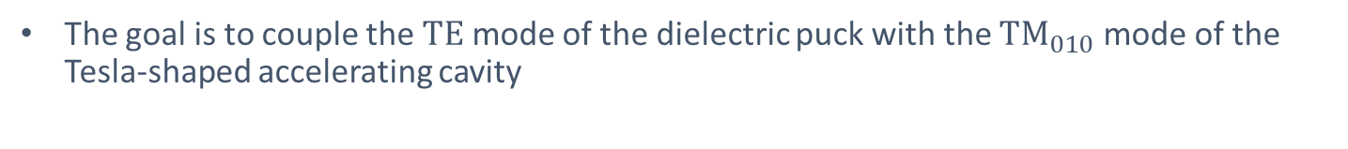

Tesla cavity and dielectric puck modes
The goal is to couple the $TE$ mode of the dielectric puck with the ${TM}_{010}$ mode of the Tesla-shaped accelerating cavity
https://arxiv.org/abs/2410.05831
E_{a}
$$L_{bp}$$
E-field
H-field
$$A [mm]$$ | $$42$$
$$B [mm]$$ | $$42$$
$$a [mm]$$ | $$12$$
$$b [mm]$$ | $$19$$
$$R_{i} [mm]$$ | $$35$$
$$L [mm]$$ | $$57.692$$
$$R_{eq} [mm]$$ | $$102.4496$$
$$L_{bp} [mm]$$ | $$150$$
$$f_{cu} [MHz]$$ | $$1299.977$$
$$Q_{cu}$$ | $$28885$$
$$f_{PEC} [MHz]$$ | $$1300.000$$
Tesla cavity:
$$f_{cu}=1299.977 MHz$$
$$Q_{cu}=28885$$
Dielectric puck:
$$f_{puck}=1101.956 MHz$$
$$Q_{puck}=1.01e4$$
$R_{eq}$ optimized to tune $f$ to 1.3 GHz

Slide 13
Courtesy Walter Venturini CERN Preliminary measurements of Frequency variations at 1.85 K (VNA) vs time performed by Lorena Vega (2023) (non optimized)
Tests performed connecting 1.3 GHz cavity to VNA:
Fixed temperature: Helium vapor pressure = 20 mbar (with pressure controller).
Power: 10 dBm

Slide 14
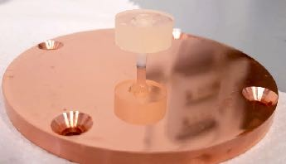
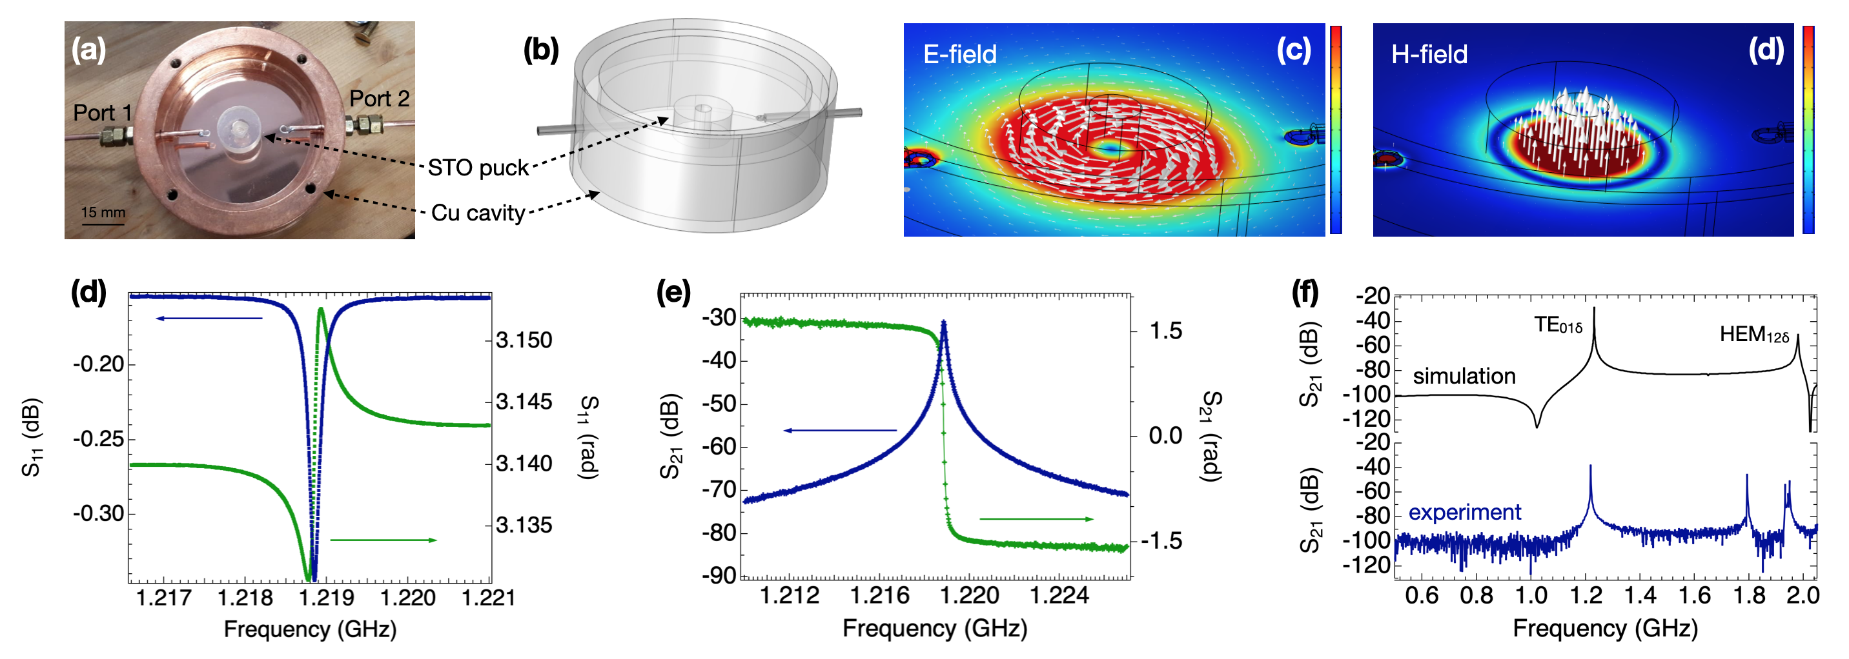
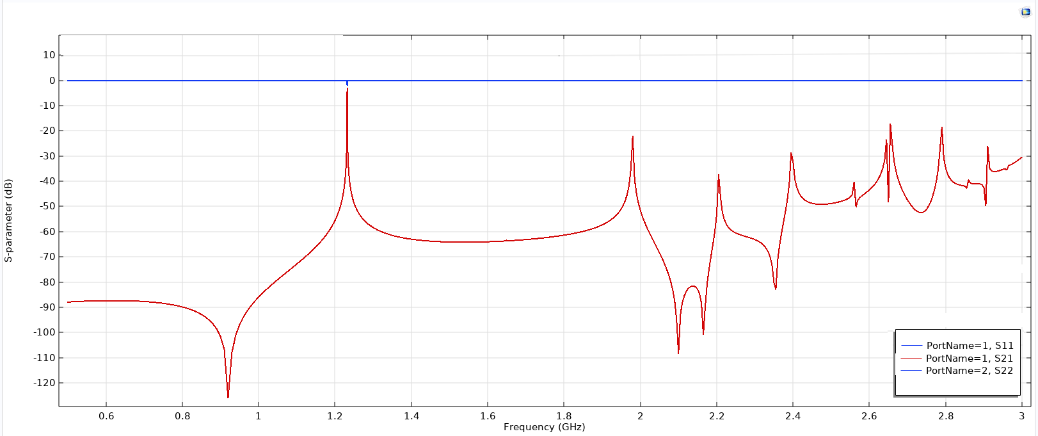
Dielectric resonators
https://arxiv.org/abs/2410.05831
Test of SrtiO3 dielectric resonators
Fundamental mode ^{TE}01δ
Permittivity | Loss tangent | Frequency (GHz)
318 | 1E-04 | 1.23
STO crystal: radius: a height: d hole radius: a
FIG. 1. Characterization of the STO resonator at room temperature. (a) Photograph showing the STO puck and Cu cavity used in the experiments. (b) Sketch of the model used for simulations (COMSOL Multiphysics). The top cap is not shown. (c,d) Simulated distribution of the root-mean-square electric and magnetic field for the TE01δ mode (εr = 318). (d,e) Plots of reflection (S11) and transmission spectra (S21) measured at room temperature (incident power 0 dBm). The amplitude is shown in blue, the phase in green. (f) Comparison between simulated and experimental S21 spectra. The peak at 1.22 GHz is reproduced by the simulated TE01δ mode, while the dip displayed by the simulation at ≈ 1 GHz is below the background transmission of the cavity (−100 dB). The peak at 1.8 GHz is probably related to the hybrid HEM12δ mode, although in this case the simulation shows a mismatch of ≈ 200 MHz.

Slide 15
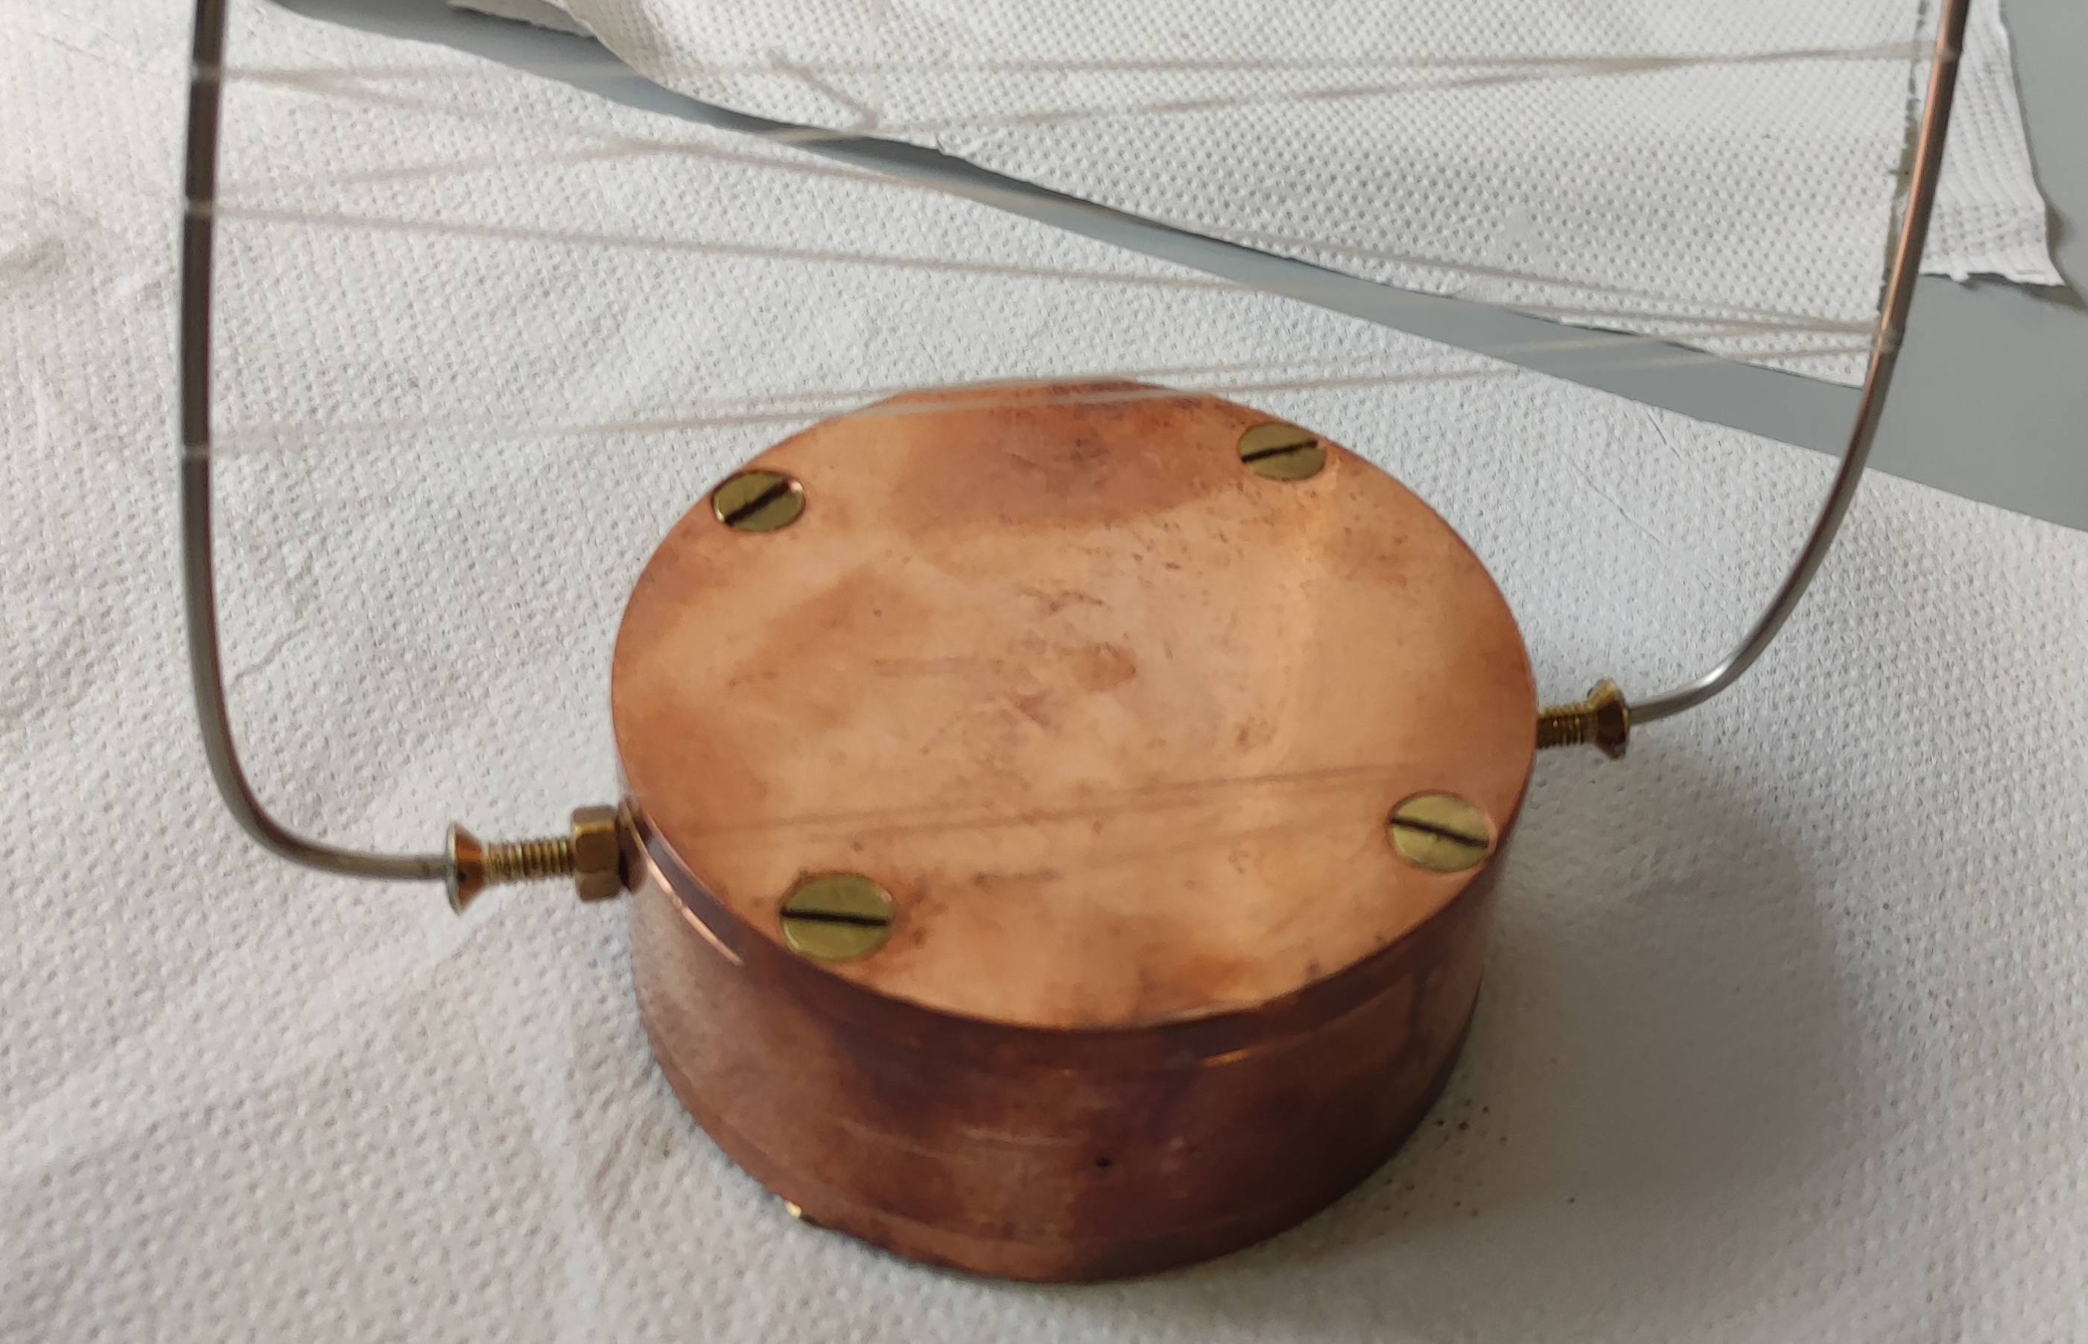
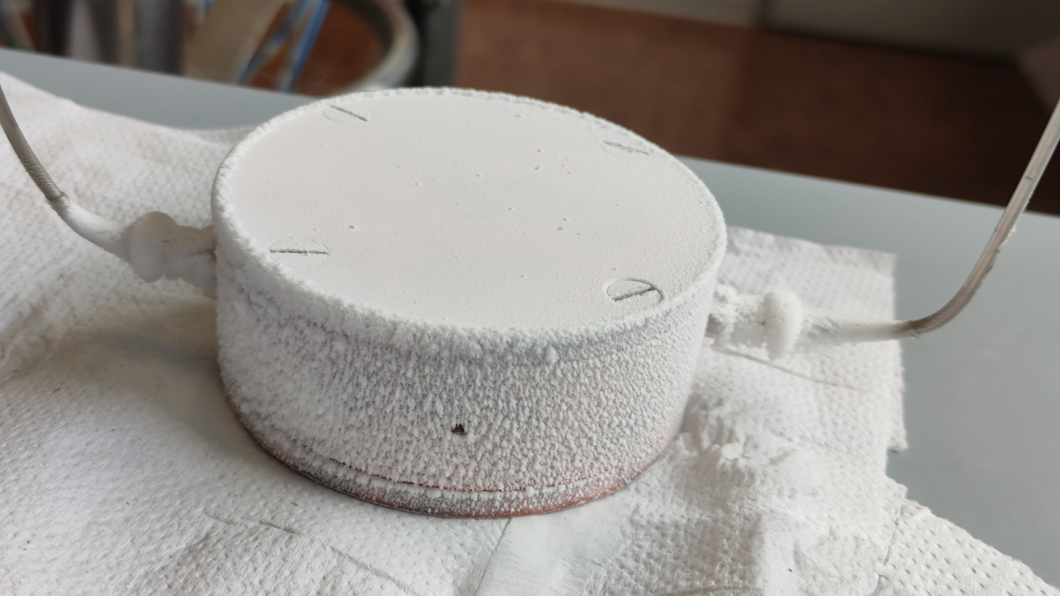
STO Cu Cavity - Temperature Comparison
T-Room Copper Cavity
77 K Copper Cavity
Temperature | Copper Cavity | Dielectric Crystal | Resonant Frequency | Q Factor | Loss | S Parameter
298,15 K 25°C) | Closed Cavity | STO | 1.207 GHz | 7295 | -18.35 dB | S21
77 K (-196 °C) | Closed Cavity | STO | 478.64 MHz | 16348 | -20.64 dB | S21

Slide 16
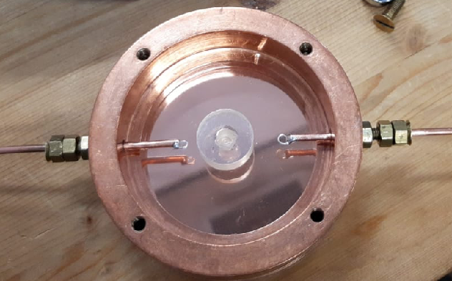
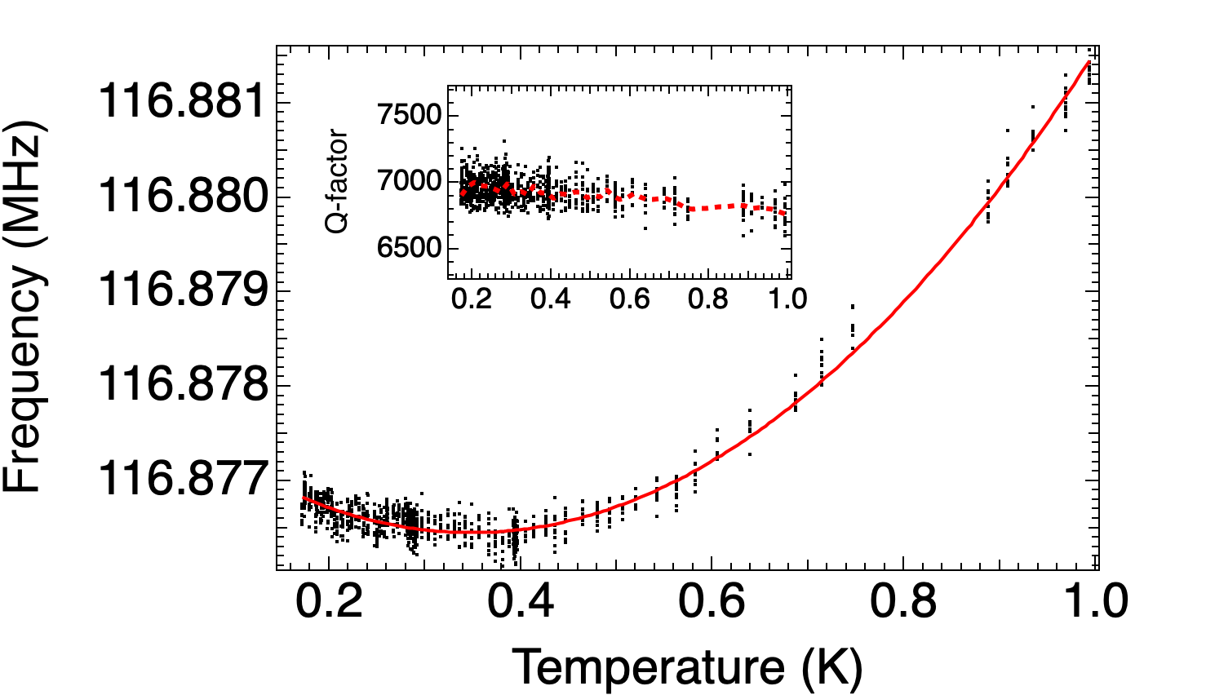
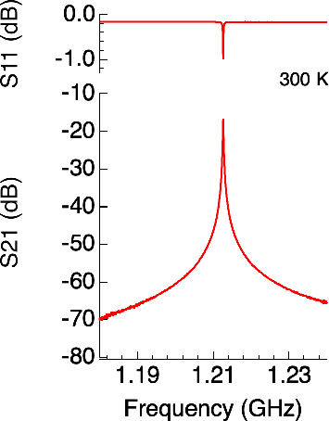
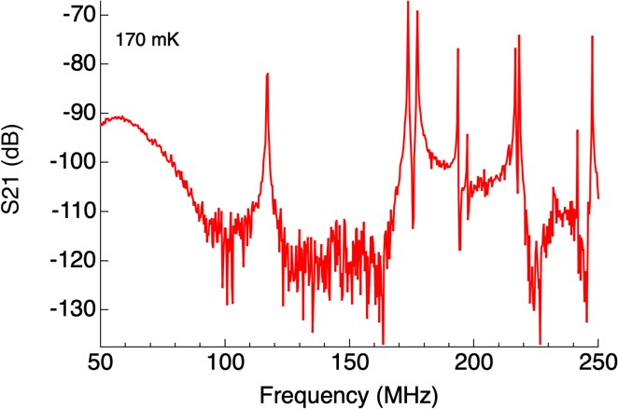
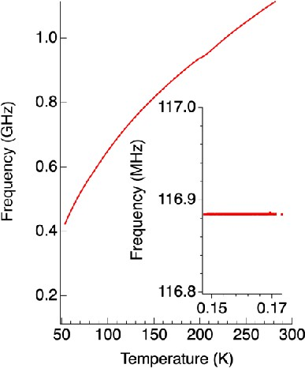
Dielectric resonators SrTi03
K´
TE_{01δ}, f₀ = 1.22 GHz, Q_{L} ≈ 8000
mK
TE_{01δ}, f₀ = 116 MHz, Q_{L} ≈ 10000
ϵ_{r}(STO) ≈ 30000 @
mK
averaged frequency drift: 50 Hz

Slide 17
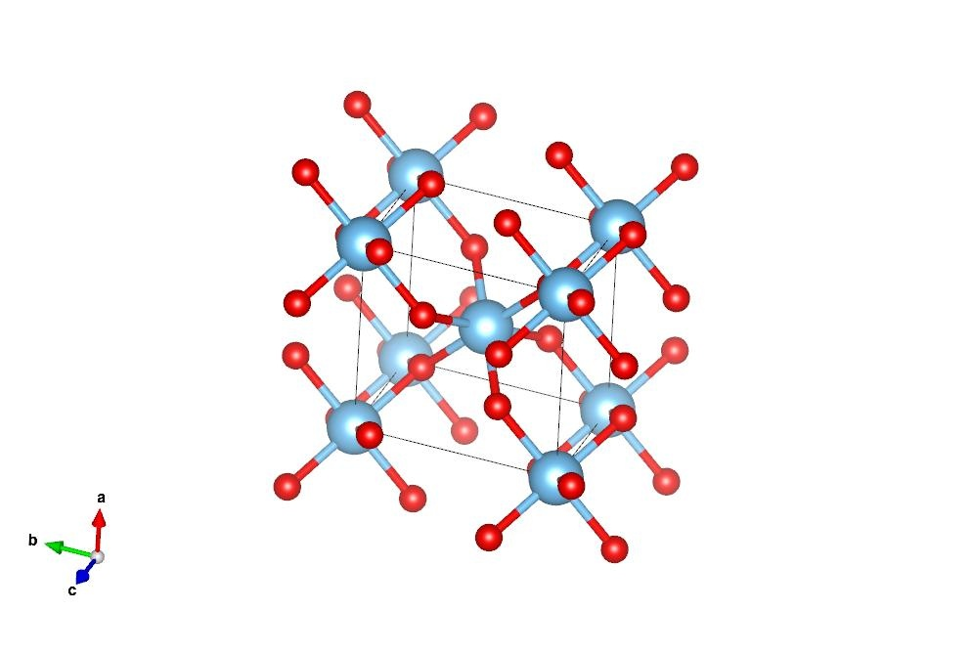
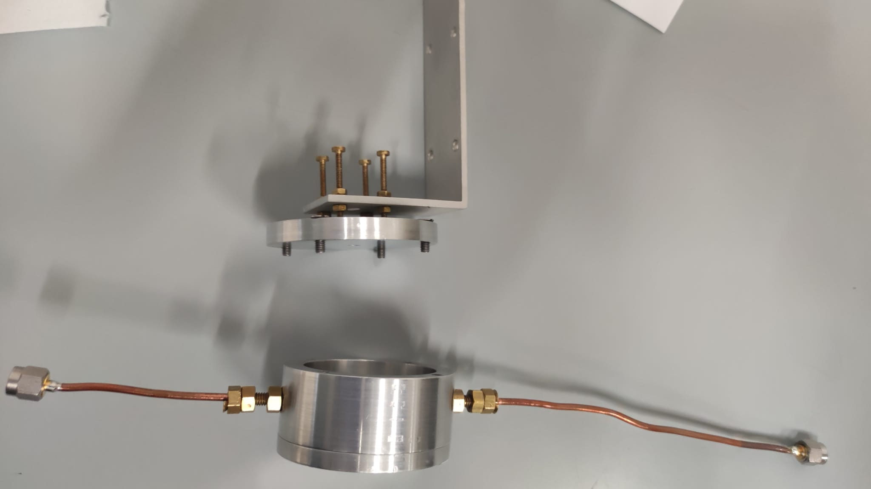
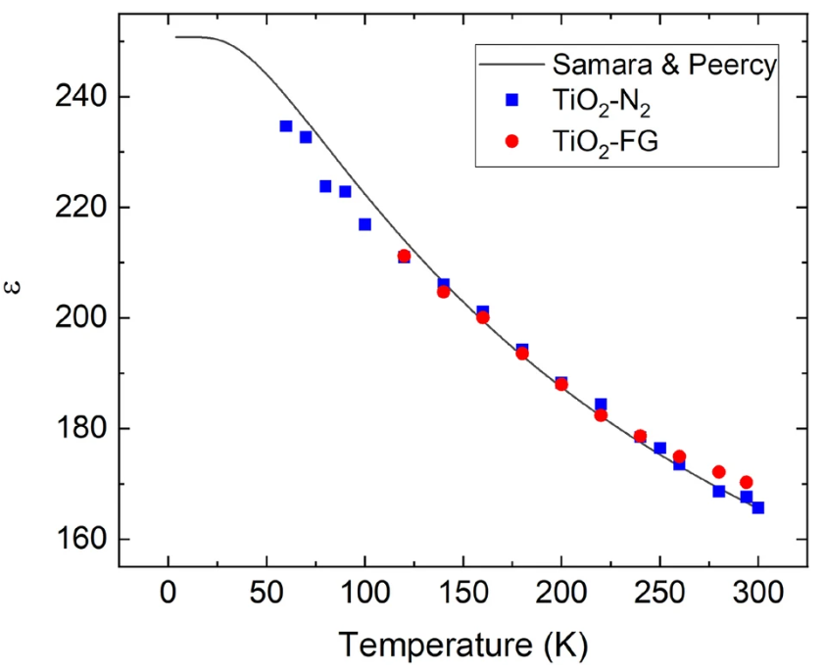
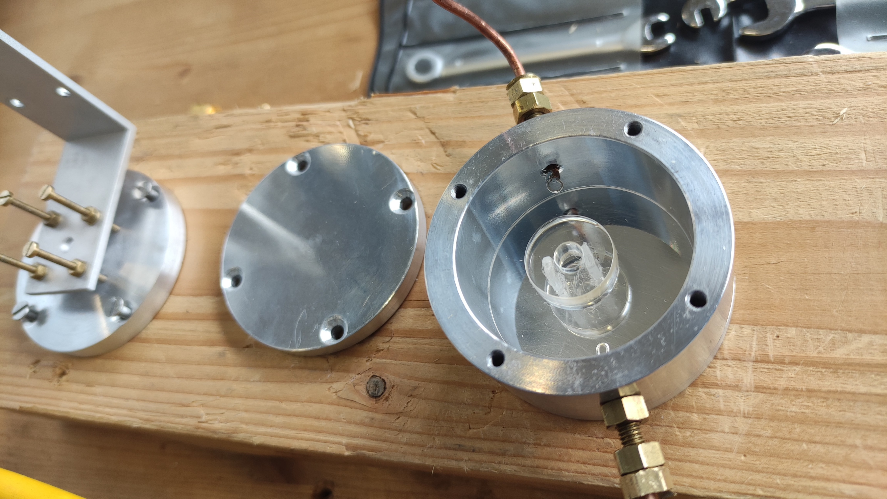

Rutile TiO2
The permittivity of TiO2 may be fitted over the whole temperature range by the the same relation for perovskite-type crystals:
$\text{ε}$ = $A_{0}+\frac{C_{0}}{\frac{1}{2}{ T}_{1}\coth{(\frac{{ T}_{1}}{2T}}) −{ T}_{0}}$
Where:
T is temperature
A₀, C₀, T₁ and T₀ are fitting parameters
Unit cell of TiO₂.
Structure data from COD-database with COD-code 1534781. (Figure: Mario Mäkinen.)
T-Room Al Cavity
Dimensions similar to SrtiO3 Puck
Temperature | Copper Cavity | Dielectric Crystal | Resonant Frequency | Q Factor | Loss | S Parameter
298,15 K 25°C) | Closed Cavity | TiO2 | 2.150 GHz | 21490 | -21.08 dB | S21
77 K (-196 °C) | Closed Cavity | TiO2 | 1.925 GHz | 92949 | -16.39 dB | S21
Temperature dependence of the permittivity (ε) of TiO₂
On the permittivity of titanium dioxide – J. Bonkerud (2021)

Slide 18


courtesy Photec Company
4K Stage
Peak: 2756.4016 MHz
-3dB: 2756.3993 MHz
-3dB: 2756.4042 MHz
0.8 K Stage
Thermometer mounted at 0.8 K stage (behind the cavity)
Q> 650000

Slide 19








Eigenmode analysis Cu Cavities
The dielectric material is positioned within the cavity to explore the principle of coupling between the two fundamental modes of the resonators → at around $ε_{r}=230$ strong mode mixing happens
Tesla mode is identified by its higher $R/Q$
$$ε_{r}=230$$
Mode 1:
$$f=1278.494 MHz$$
$$Q=1.487e4$$
$$R/Q=60.6 Ω$$
50 mm radial shift
Mode 2:
$$f=1315.208 MHz$$
$$Q=1.510e4$$
$$R/Q=55.4 Ω$$

Slide 20




Terminologies
First mode
Second mode
Notch

Slide 21





Eigenmode analysis in PEC cavity
The entire surface of the cavity is changed to PEC and the frequency, quality factor and R/Q of the first two modes are calculated

Slide 22



Frequency domain analysis Cu cavities
Two antennas are positioned on opposite sides of the cavity to examine the transmission between them
The technical aspects, including the optimal positioning of the dielectric within the cavity, how to secure it, and the suitable excitation scheme, are yet to be explored.

Slide 23




Parameter sweep in $ε_{r}$
Phase derivative has high peaks at mode 1, mode 2 and notch frequencies
Phase derivative amplitude is larger for modes with larger quality factor
Phase derivative amplitude for the notch seems to have constant amplitude

Slide 24



Frequency sensitivity
Black curve data are taken from analytic formula
Derivative
Mode 1 and Mode 2 sensitivities to changes in εr are lower than those of the dielectric puck alone. The notch sensitivity is very similar to that of the dielectric puck alone. In all cases, no amplification is observed, as the sensitivities cannot exceed those of the dielectric puck alone!!

Slide 25


Frequency domain analysis in PEC cavity
The entire surface of the cavity is changed to PEC and the frequency, quality factor and R/Q of the first two modes are calculated

Slide 26



Slide 27



Slide 28




FIG. 9. The measurement setup (a) and measurement results of the coupled elliptical cavity with the STO puck over a narrow frequency range (b) and a wide frequency range(c). The STO puck is fixed to the flange via a long ceramicrod at roffset=19 mm. Two long antennas were used for the S2,1 measurement: one at the flange center and the other at roffset=-19 mm. Note that the elliptical cavity used for the measurements had a slightly different shape than the one used for the simulations, causing a small change of the resonance modes of the cavity. An εr of 300 is assumed in the simulation.

Slide 29
Conclusions
- We have studied the hybrid system composed by a high-Q TESLA-shaped elliptical cavity and STO resonator, and investigated the effect of parameters, such as STO permittivity, puck dimensions and position within the cavity, that govern the coupling between the electromagnetic modes.
-Finite-element simulations show that the hybrid system offers great versatility to tune the coupling strength and achieve the strong coupling regime.
-These results are supported by test measurements carried out at room temperature using a copper cavity and a STO puck, and by the low temperature characterization of the STO resonator, which shows resonant frequency of 0.1 GHz and Q-factor of 10000 and er =30000 at0.16 K.
-The hybrid system show potential for the realization of microwave sensors in which the sensitivity of the STO puck to selected physical quantities is exploited as the active element, while frequency or phase measurements on the high-Q cavity are used to efficiently detect such changes.
-In particular, the application of the hybrid system in bolometers exploiting the temperature dependence of the STO permittivity has been discussed.
-Our results are useful to design dedicated experiments at low temperature allowing the direct test of sensitivity and tunability of the proposed hybrid system in high precision frequency-domain measurements.
We thank Giovanni Romano, Fritz Casper, Sergio Calatroni, Akira Miyazaki, Walter Venturini, Alick Mcpherson, Giovanni Carugno, Marco Affronte , Micheal Tobar

