Slide 1
Design and modelling of practical JTWPA
Sergio Pagano, Carlo Barone, Giovanni Carapella, Claudio Guarcello and Angela Nigro
University of Salerno, Physics Department and INFN Gruppo Collegato Salerno,
via Giovanni Paolo II 132, 84084 - Fisciano (SA), Italy

Slide 2
Outline of the presentation
Our projects and involved people
Ultra-low level microwave signal amplifiers
Josephson Traveling Wave Parametric Amplifiers
Expected vs obtained performances
JTWPA modeling
JTWPA realization
Directions of development

Slide 3
Our projects
We are operating within three large projects, financed by Spoke 6 through Bandi a Cascata
NbJTWPA Niobium-based Josephson Arrays for Parametric Amplification
This project aims at the development of high-quality quantum limited parametric amplifiers based on engineered arrays of Josephson junction to provide a reliable interface the quantum and to allow the integration of different materials and technologies.
HIQRES High-Q Superconducting Resonators for Quantum Applications
This project will develop thin film superconducting resonators with the goal to obtain quality factors in excess of 10^6 in the few photon regime. This will be done using non-traditional materials, such as niobium nitride or tantalum.
QSENS X-band Superconducting Amplifiers for Quantum Sensing
This project aims at developing traveling-wave parametric amplifiers based on Josephson junction arrays (JTWPA) to replace conventional broadband HEMT amplifiers for the detection of single photons in the microwave domain for application in quantum sensing
Involved people
Sergio Pagano, Carlo Barone, Giovanni Carapella, Angela Nigro, Claudio Guarcello, Fabrizio Bobba, Ofelia Durante, Adolfo Avella, Roberta Citro, Francesco Romeo, Amedeo Ferrentino, Alessandro Mauro

Slide 4
Josephson Traveling Wave Parametric Amplifiers
Key points:
Superconducting parametric amplifiers are the optimal solution for quantum limited noise amplification in the microwave region
Wide bandwidth microwave amplifiers are key enabling technologies for scaling up the number of qubits in superconducting quantum processors and for the realization of array of quantum sensors
Josephson junctions are nonlinear elements where the inductance can be modulated by the flowing current and therefore can realize nonlinear transmission lines where parametric amplification can occur on a wide frequency band

Slide 5


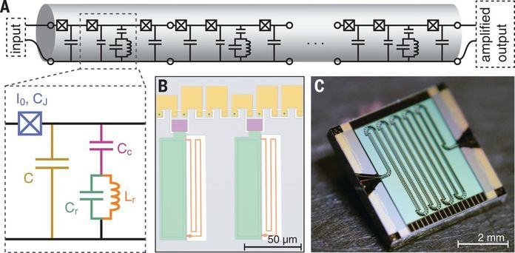
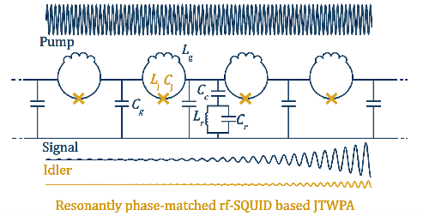
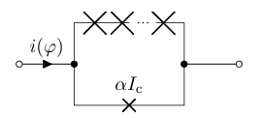


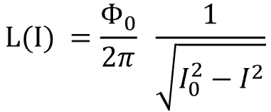


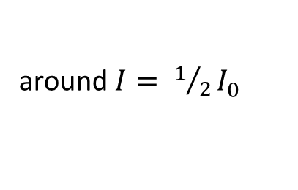
Josephson Traveling Wave Parametric Amplifiers
4WM
$$I =I_{0}\sin{φ}$$
$$V =L(I) \frac{dI}{dt}$$
$$L(I) =\frac{Φ_{0}}{2π} \frac{1}{\sqrt{I_{0}^{2}−I^{2}}}$$
$$V =\frac{Φ_{0}}{2π} \frac{dφ}{dt}$$
around $I=0$
Josephson junction as nonlinear inductor
3WM
around $I= 1/2I_{0}$
SNAIL
C. Macklin et al., A near–quantum-limited Josephson traveling-wave parametric amplifier, Science, V 350, 6258, pp 307-310, 2015
P. Livreri, et al. “Microwave Quantum Radar based on a Josephson Traveling wave Parametric Ampliﬁer and a Phase-Conjugate Receiver.” .

Slide 6
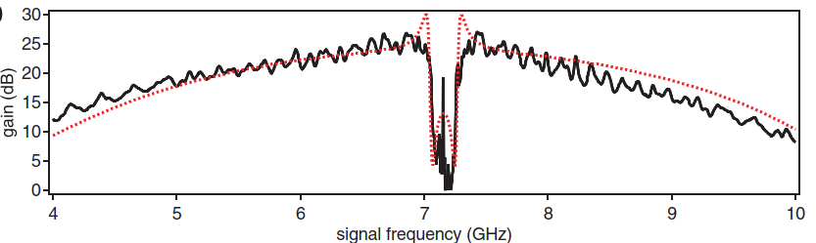
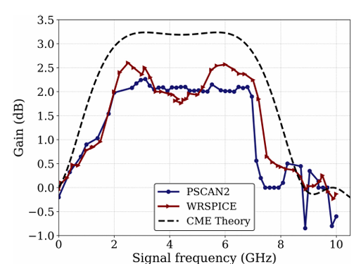
Expected vs obtained performances
Basic theory predicts gain exponentially increasing with line length..
Two operation modes: 4WM and 3WM, controllable by external parameters: DC current or magnetic field
Line dispersion induces dephasing which limits achievable gain. Proposed solution are: resonant phase matching, spatial modulation of line parameters, left handed TL, etc
Modeling through quasi analitycal approaches overestimates gain
Simplified assumptions of undepleted pump, and few modes are not consistent with results from numerical simulations of whole dynamical system
Experimentally gain ripples, unwanted resonances, reduced gain and bandwidth are observed
C. Macklin et al, Science , 350 (6258), 307-310, 2015
A. Yu. Levochkina, et al., IEEE TAS, 34, NO. 3, MAY2024

Slide 7
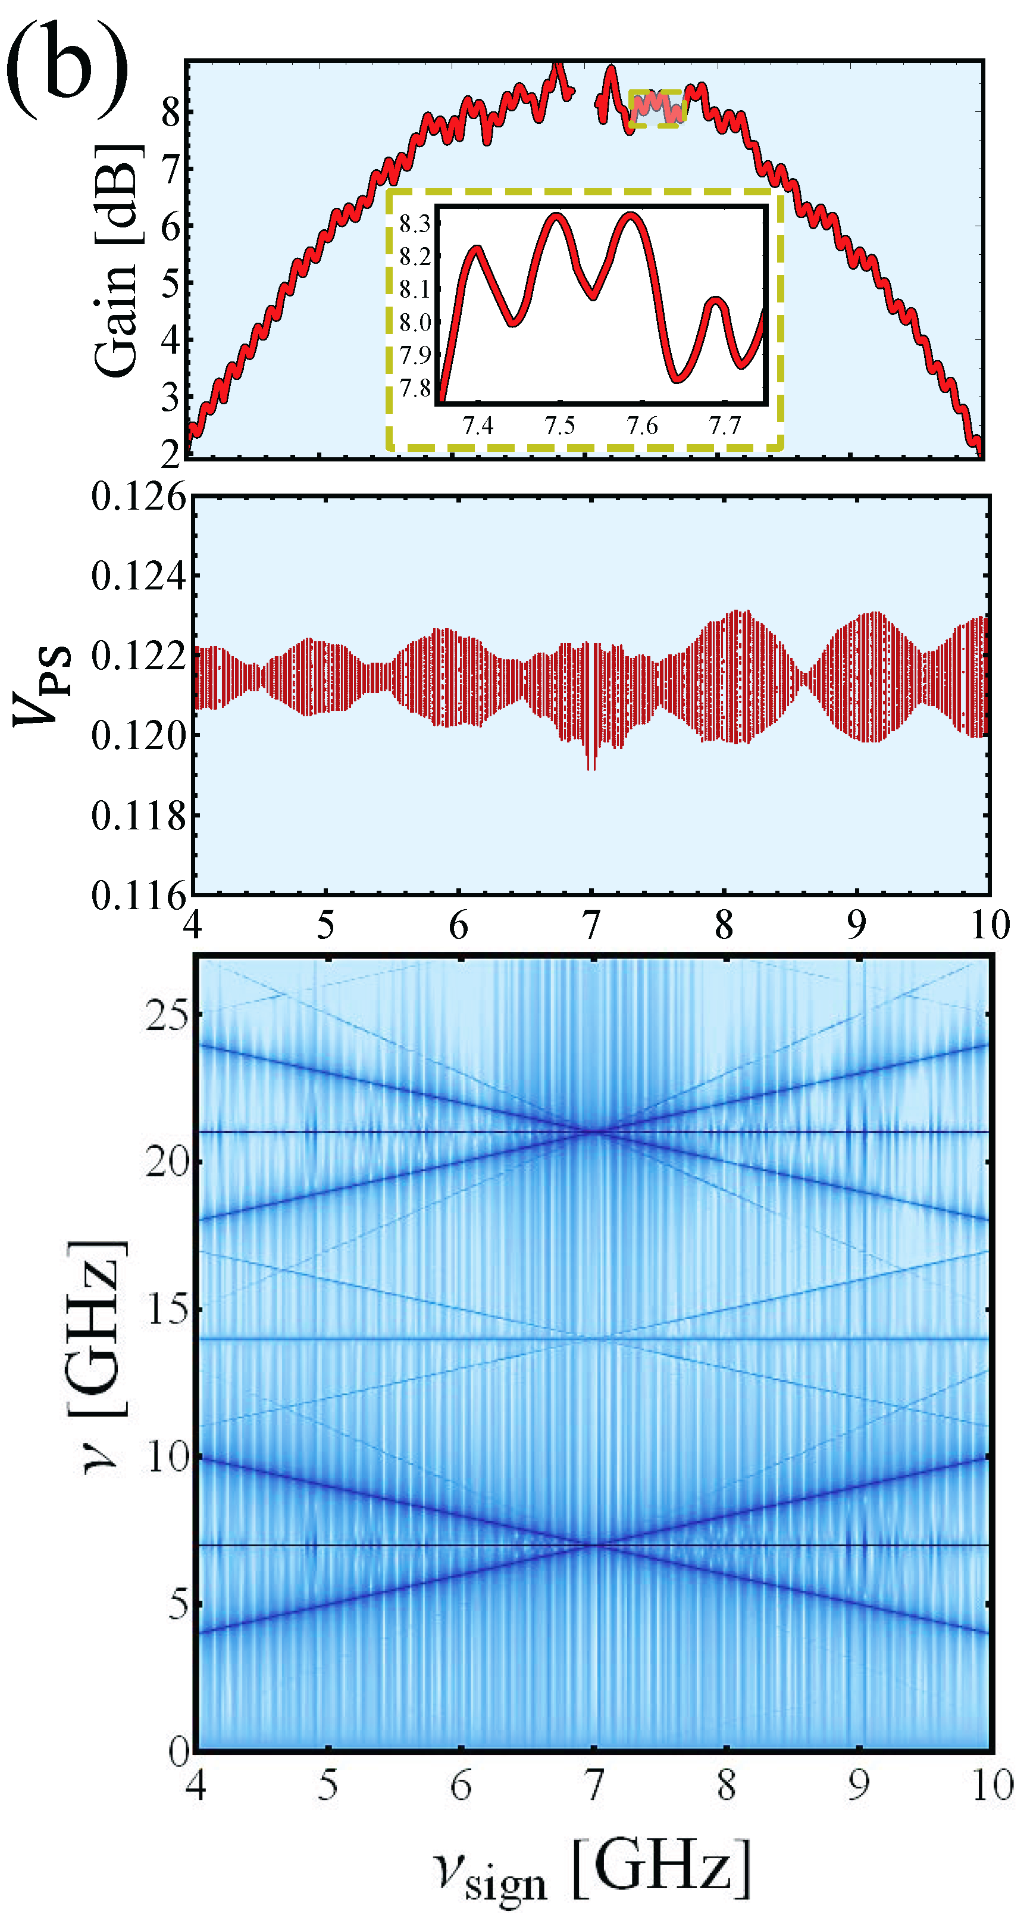
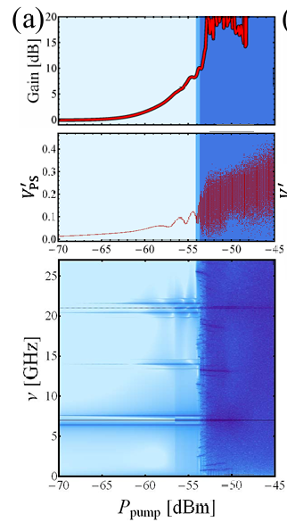
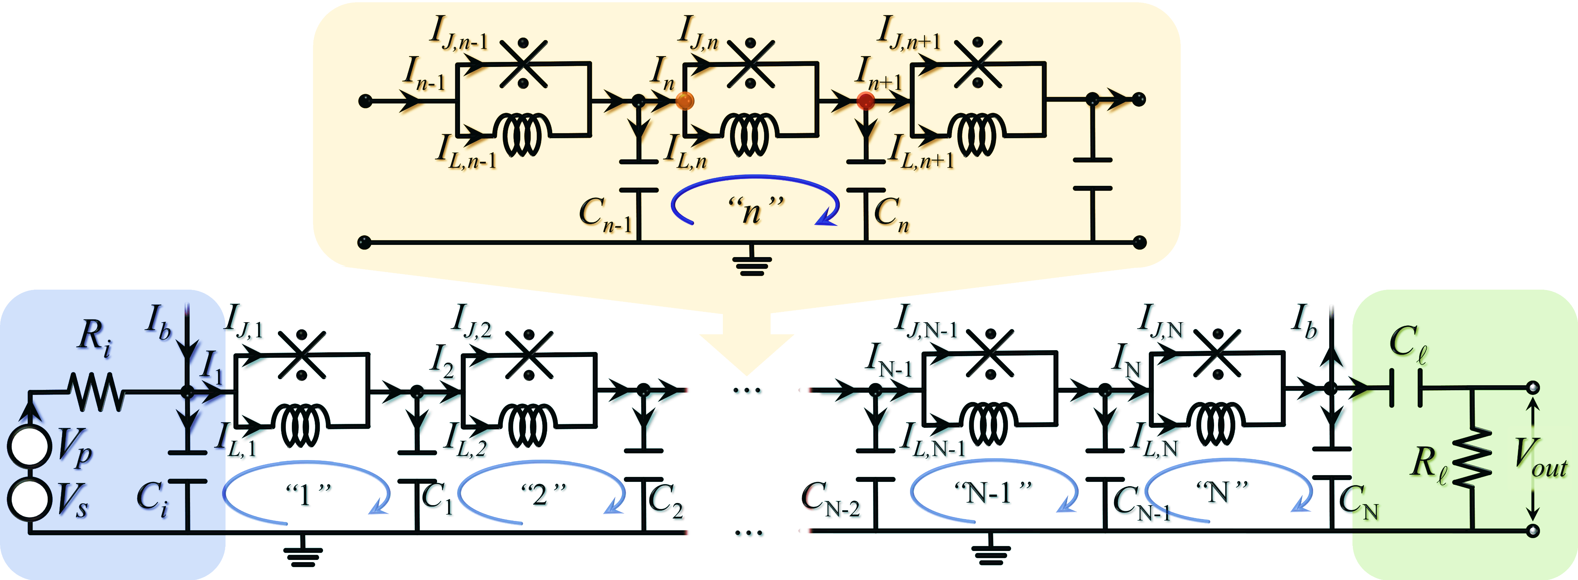
JTWPA modeling
Time domain simulations of the complete dynamical system is necessary
to find optimal configurations and optimal components values
to investigate effect of random variation of parameters
to check for the existence of unwanted modes
C. Guarcello, et al., Chaos, Solitons Fractals 189, 115598 (2024)

Slide 8
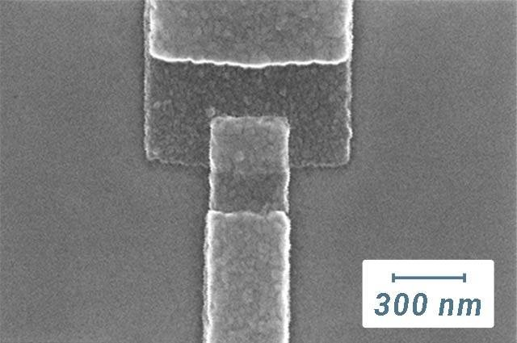
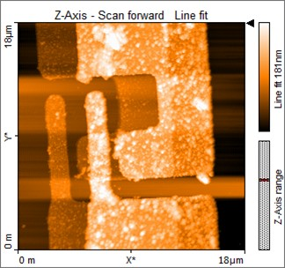
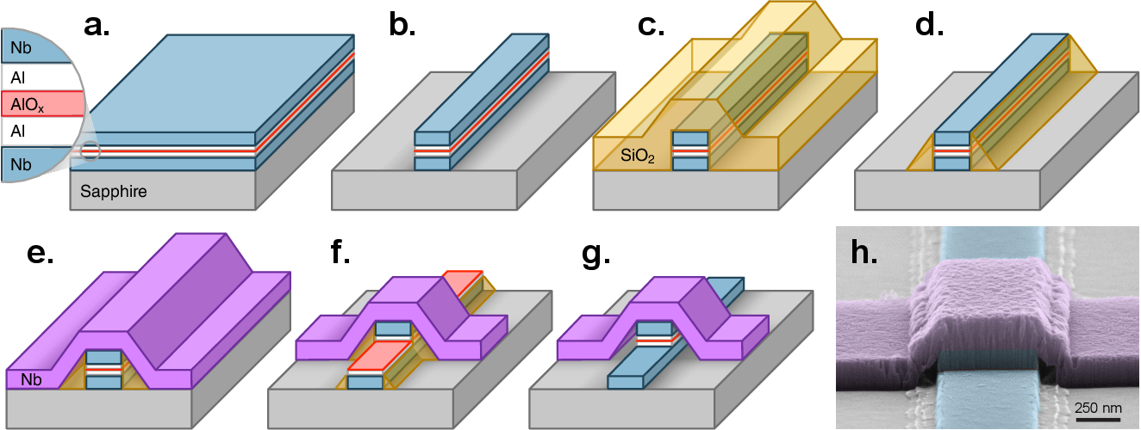
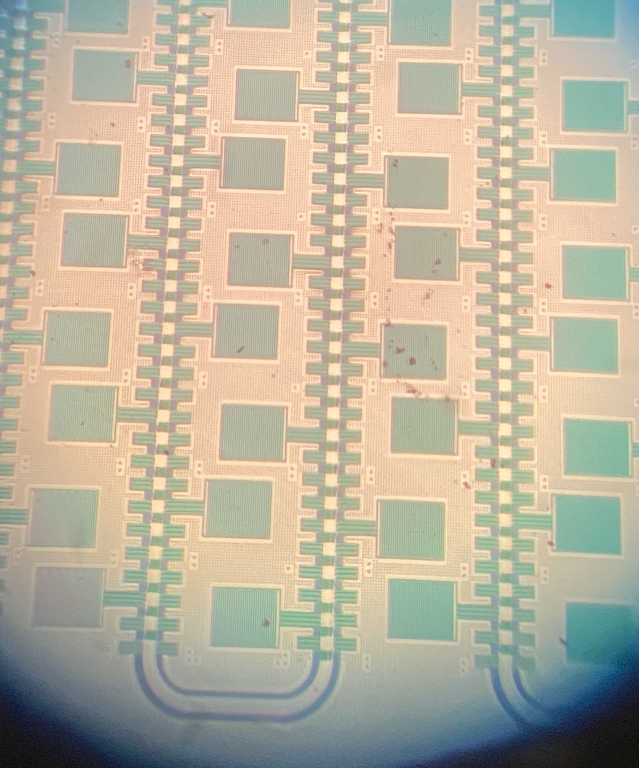
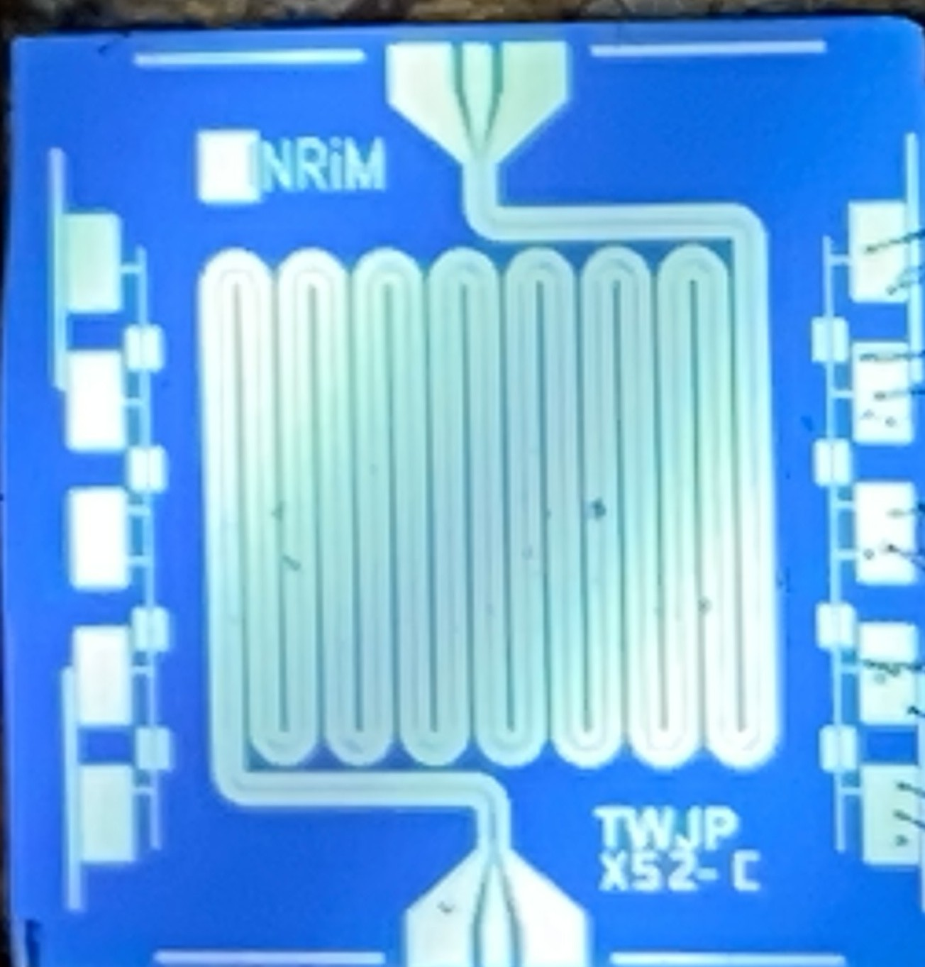
JTWPA realization
Aluminum easy fabrication
reproducibility of junction characteristics
sensitive to stray magnetic field
Niobium robust and reproducible process
different values for critical currents,
minimum sizes, stray capacitances
more resilient to stray magnetic field
Transmission line cell size, number of cells (100-1000),
meander structure, unwanted couplings,
signal reflections
A. Anferov et al., Improved coherence in optically defined niobium trilayer-junction qubits, Phys. Rev. Appl. 21, 024047, 2024
Courtesy of INRiM – INFN DARTWARS project

Slide 9
Directions of development
Up to the end of the projects
Design and simulations of JTWPA using different cell configurations (SNAIL, RF-SQUIDs) and available tools, EM simulations, time domain simulations
Find optimal values for components (JJ, capacitors, inductors, resonators) also in consideration of fabrication technology constraints (trilayer Nb technology, SNAP, Al technology, mixed technologies)
Realize and characterize test chip JTWPA
After the end of the project
Provide a reliable experimental platform for development of superconducting readout electronics for the integration of NQSTI developed quantum devices.
Fully up to date fabrication facility for Nb (and Al) – based circuits

