Slide 1
Low power microwave photon detector based on Superconducting Qubit Network
PNRR Partenariato Esteso
NATIONAL QUANTUM SCIENCE AND TECHNOLOGY INSTITUTE “NQSTI”
Spoke 6 Quantum Integration
A6.3.3 Superconducting quantum networks
A6.3.3.1 Mikhail Lisitskiy SPIN CNR
A6.3.3.2 Berardo Ruggiero ISASI CNR
Mikhail Lisitskiy
SPIN- CNR Institute of Superconductors, Innovative Materials and Devices,
mikhail.lisitskiy@spin.cnr.it
Secondo Congresso Nazionale di NQSTI Roma , 07 Febbraio 2025

Slide 2
Co-authors of the presentation:
Valentina Di Meo¹, Berardo Ruggiero², Carmela Bonavolontà², Paolo Vanacore², Claudio Gatti³, Fabio Chiarello⁴, Giorgio Brida⁵, Emanuele Enrico⁵, Luca Fasolo⁵, Luca Oberto⁵, Mikhail Fistul⁶, Gregor Oelsner⁷, Eugeni Ill’chev⁷, Patrick Navez⁸, Alexandre Zagoskin⁸, and Paolo Silvestrini^{9,2}
1. SPIN CNR ,Via Campi Flegrei 34, I- 80078, Pozzuoli (Naples), Italy
2. ISASI CNR ,Via Campi Flegrei 34, I- 80078, Pozzuoli (Naples), Italy
3. LNF INFN , Via Enrico Fermi 54, I- 00044 , Frascati (Rome), Italy
4. IFN CNR , Via Fosso del Cavaliere 100, I- 00133 , Rome, Italy
5. INRiM, Strada delle Cacce 91, I-10135 , Turin Italy
6. Ruhr University Bochum, Universitätsstraße 150, D-44801, Germany
7. Leibniz Institute of Photonic Technology, Albert-Einstein-Straße 9, D-07745 Jena, Germany
8. Loughborough University, LE11 3TU, Loughborough, United Kingdom
9. Università degli Studi della Campania “L. Vanvitelli”, Dipartimento di Matematica e Fisica, Viale Lincoln 5, I- 81100 Caserta, Italy
Secondo Congresso Nazionale di NQSTI Roma , 07 Febbraio 2025

Slide 3
State of the art of conventional microwave detectors
Low-barrier Schottky diode (LBSD)
Agilent LBSD 8484A
Power range:
-70 dBm (100 pW) to -20 dBm (10 mW)
Frequency range:
10 MGz -18 GHz
Secondo Congresso Nazionale di NQSTI Roma , 07 Febbraio 2025

Slide 4
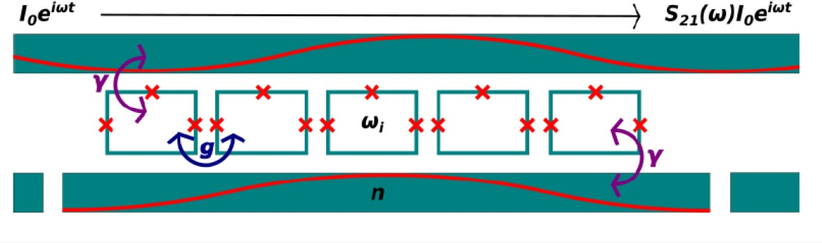

Theory of SQN detector based on collective quantum states
Theoretical setup of the SQN detector.
ac Stark effect (in electric field)
blue line n=0
red line n=1
green line n=2
A generic quantum-mechanical model of disodered interacting SQN coupled to a low-dissipative resonator and transmission line
An amplitude of the main resonance drastically increases as the interaction overcomes the disoder, and the collective state is formed
In the presence of a weak non-resonant photon electric field, the position of resonances depends on the number of photons, i.e. the collective ac Stark effect is obtained
is average qubit frequency
γ is the coupling strength between a single qubit and a resonator
M.V.Fistul et al, Phys. Rev. B, 105, 104516 (2022))
Secondo Congresso Nazionale di NQSTI Roma , 07 Febbraio 2025

Slide 5
Working principle of the SQN detector of a single microwave photon
Δω_{S}
- Stark shift related to a single MW photon
S₂₁
|CS>
Δω_{S}ℏ
Coherent collective
quantum state
ω_{c}ℏ
ω_{q}ℏ
|0>
ω_{c}-Δω_{S}
ω_{c}
ω_{ph}
ω
A SQN embedded in a resonator produces collective quantum states.
In the presence of external microwave signal the frequency shift of the collective mode takes place because of the AC Stark effect.
E
Single microwave photon
with frequency ω_{ph}
Magnetic field
Secondo Congresso Nazionale di NQSTI Roma , 07 Febbraio 2025

Slide 6
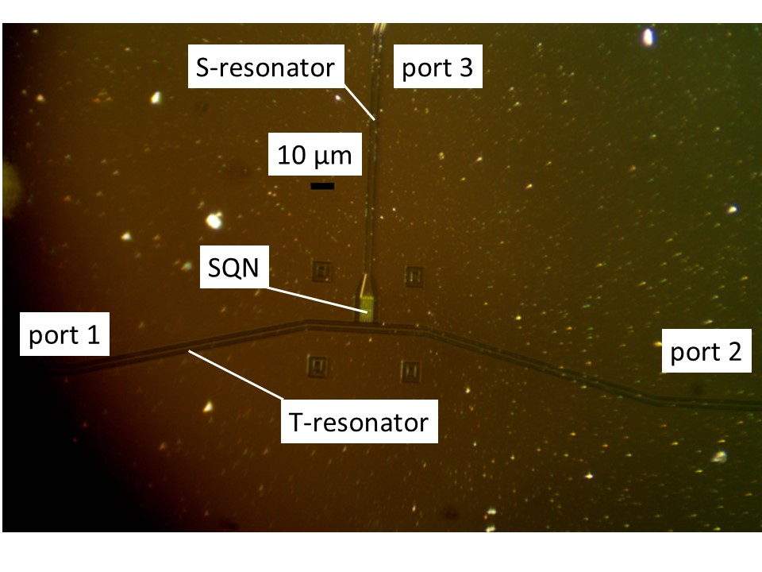
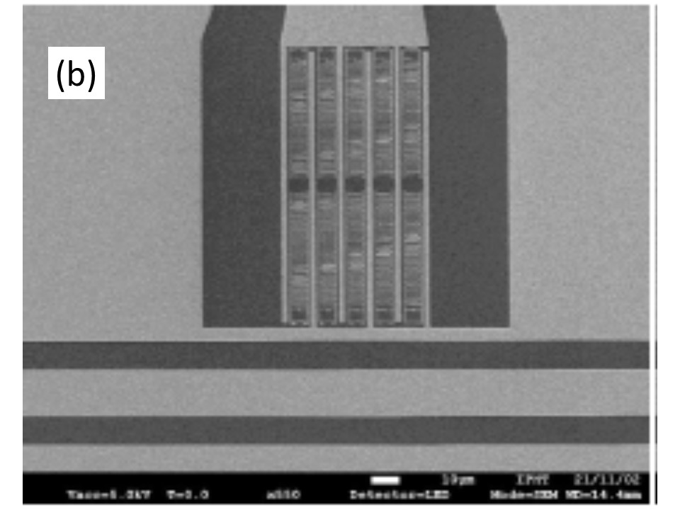
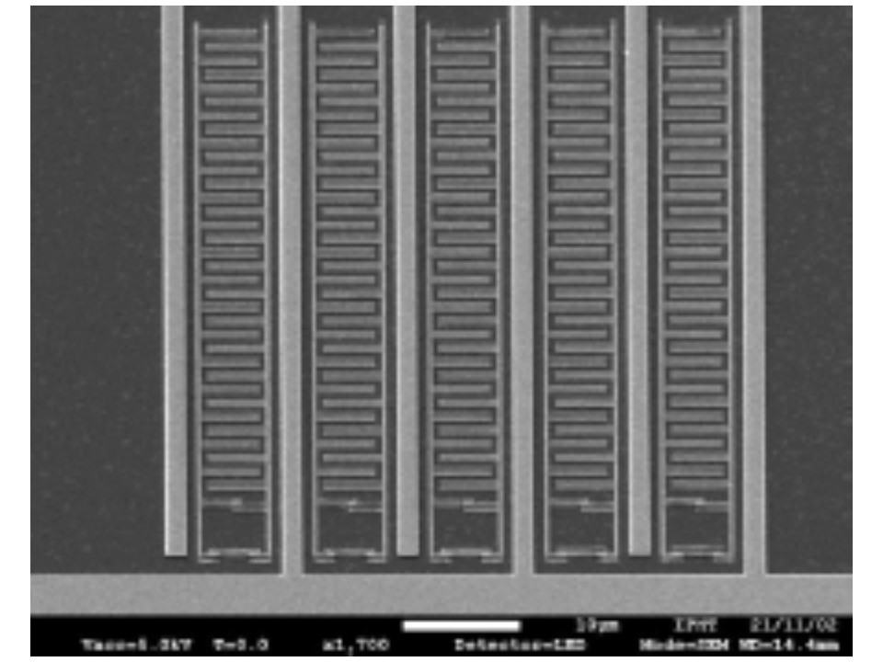
T-type two resonator SQN with 10 capacitor shunted flux qubits
The Leibniz Institute of Photonic Technology (Leibniz IPHT), Jena Germany
The resonators are fabricated by depositing a 200 nm thick Nb film on a silicon substrate that is structured by the RIE. The flux qubits are made of Al Josephson-junctions fabricated by two angle shadow evaporation technique. Every flux qubit of the SQN consists of a 6x4.5 μm² loop with three Josephson junctions. Two junctions are designed to have identical size of 0.2x0.87 µm² while the third is scaled by a factor α < 1. For qubits of the SQN measured here, the factor α = 0.8.
Optical image of the T-type SQN with 10 C-shunted flux qubitswith two resonators
SEM picture of the coplanar capacitor which connects the S-resonator with T-resonator. 10 qubis are embidded inside the coplanar capacitor
SEM image of five flux qubits shunted by coplanar capacitors
Zoomed SEM image of the flux qubit loop
Secondo Congresso Nazionale di NQSTI Roma , 07 Febbraio 2025

Slide 7
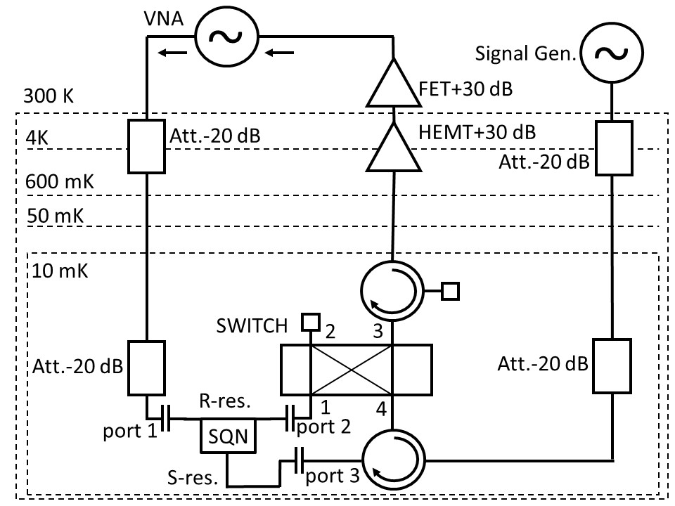
Microwave part of experimental set-up
Measurements of fabricated T-type SQN were carried out at the National Laboratory of Frascati (LNF) (Italy) in a Leiden Cryogenics CF-CS110-1000 dilution refrigerator at temperature of 15 mK.
Port 3
Signal
resonator
SQN
Port 1
Readout resonator
Port 2
Experimental set-up for double tone microwave measurements of the T-type SQN
Cabling of T-type three terminal device
Secondo Congresso Nazionale di NQSTI Roma , 07 Febbraio 2025

Slide 8
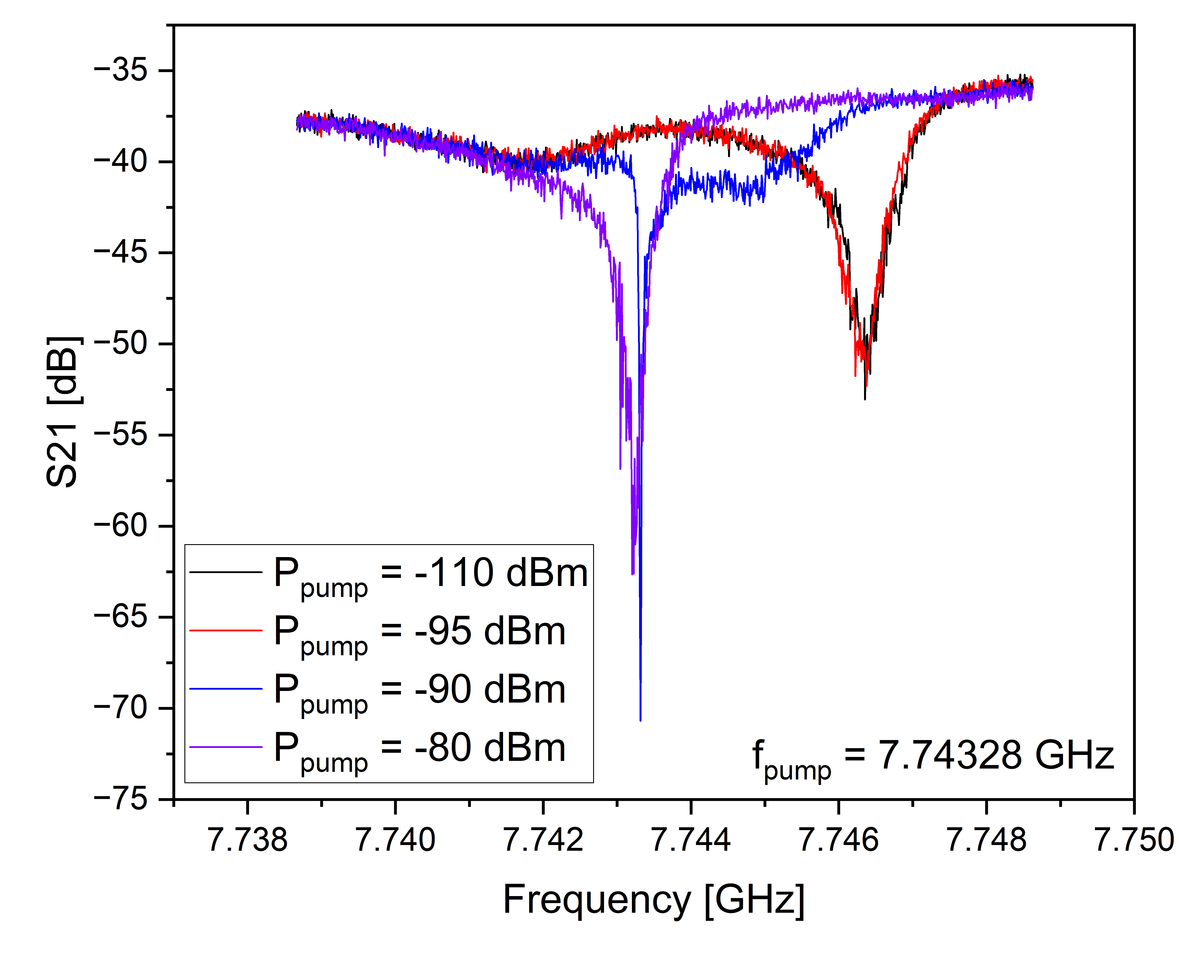
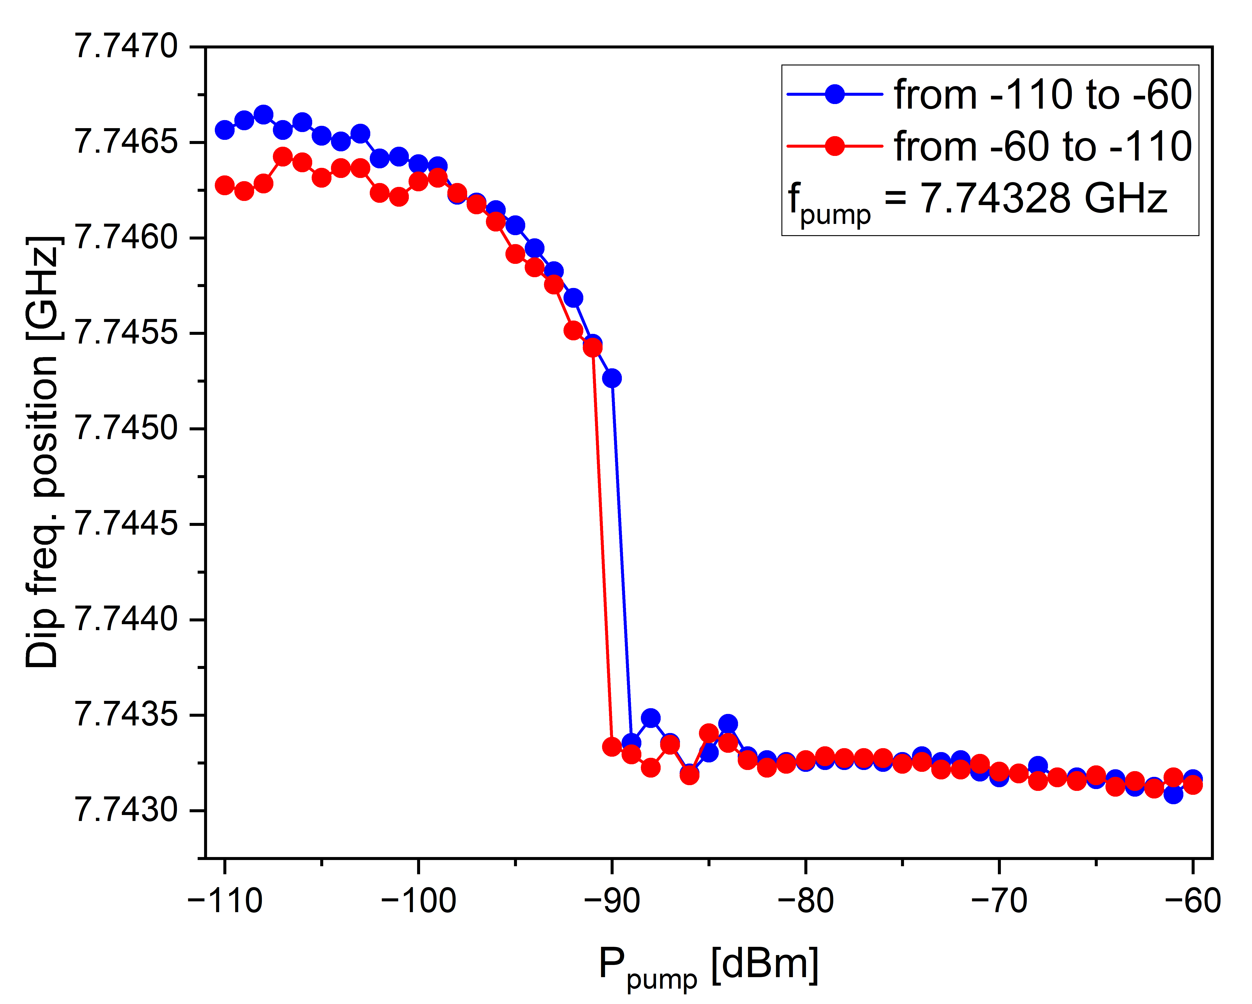
Measurement of two-tone spectra of the T-type two resonator SQN -device
First tone signal for measurements of transmission coefficient S₂₁ between port 1 and port 2 of the readout resonator : VNA outputpower was -40 dbm, (-100 dbm at the device)
Second tone signal of different power and frequencies: Rohde & Schwarz SMA100B was connected to the Port 3 of the signal resonator. The output power of the generator was varied from -40 dbm to -20 dbm. Frequency variation was from 7.741 GHz to 7.751 GHz
Port 3
Port 1
Port 2
First-tone Port 1-Port 2 -transmission coefficient S₂₁ vs VNA-frequency dependencies recorded at different powers of the second-tone signal of frequency of 7.74328 GHz applied to the Port 3 (increasing of power). T=15 mK , zero magnetic field.
Dependence of the frequency position of the resonant drop reported in left figure as a function of the power of the second-tone signal.
Secondo Congresso Nazionale di NQSTI Roma , 07 Febbraio 2025

Slide 9
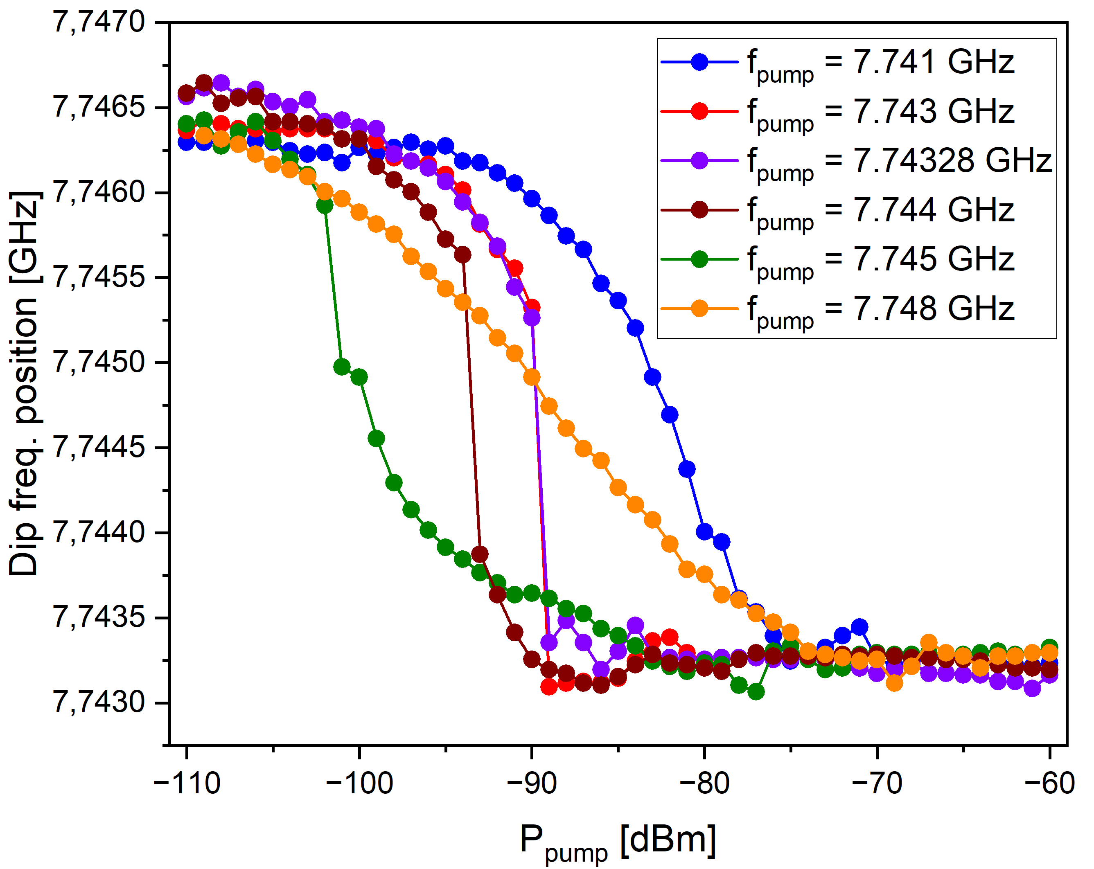
Experiment on dip position of the first tone S₂₁ frequency dependence on power and frequency of the second tone signal.
We observed the sensibility of the frequency position of the resonant drop both to the power of pump signal and to pump signal frequency.
Secondo Congresso Nazionale di NQSTI Roma , 07 Febbraio 2025

Slide 10
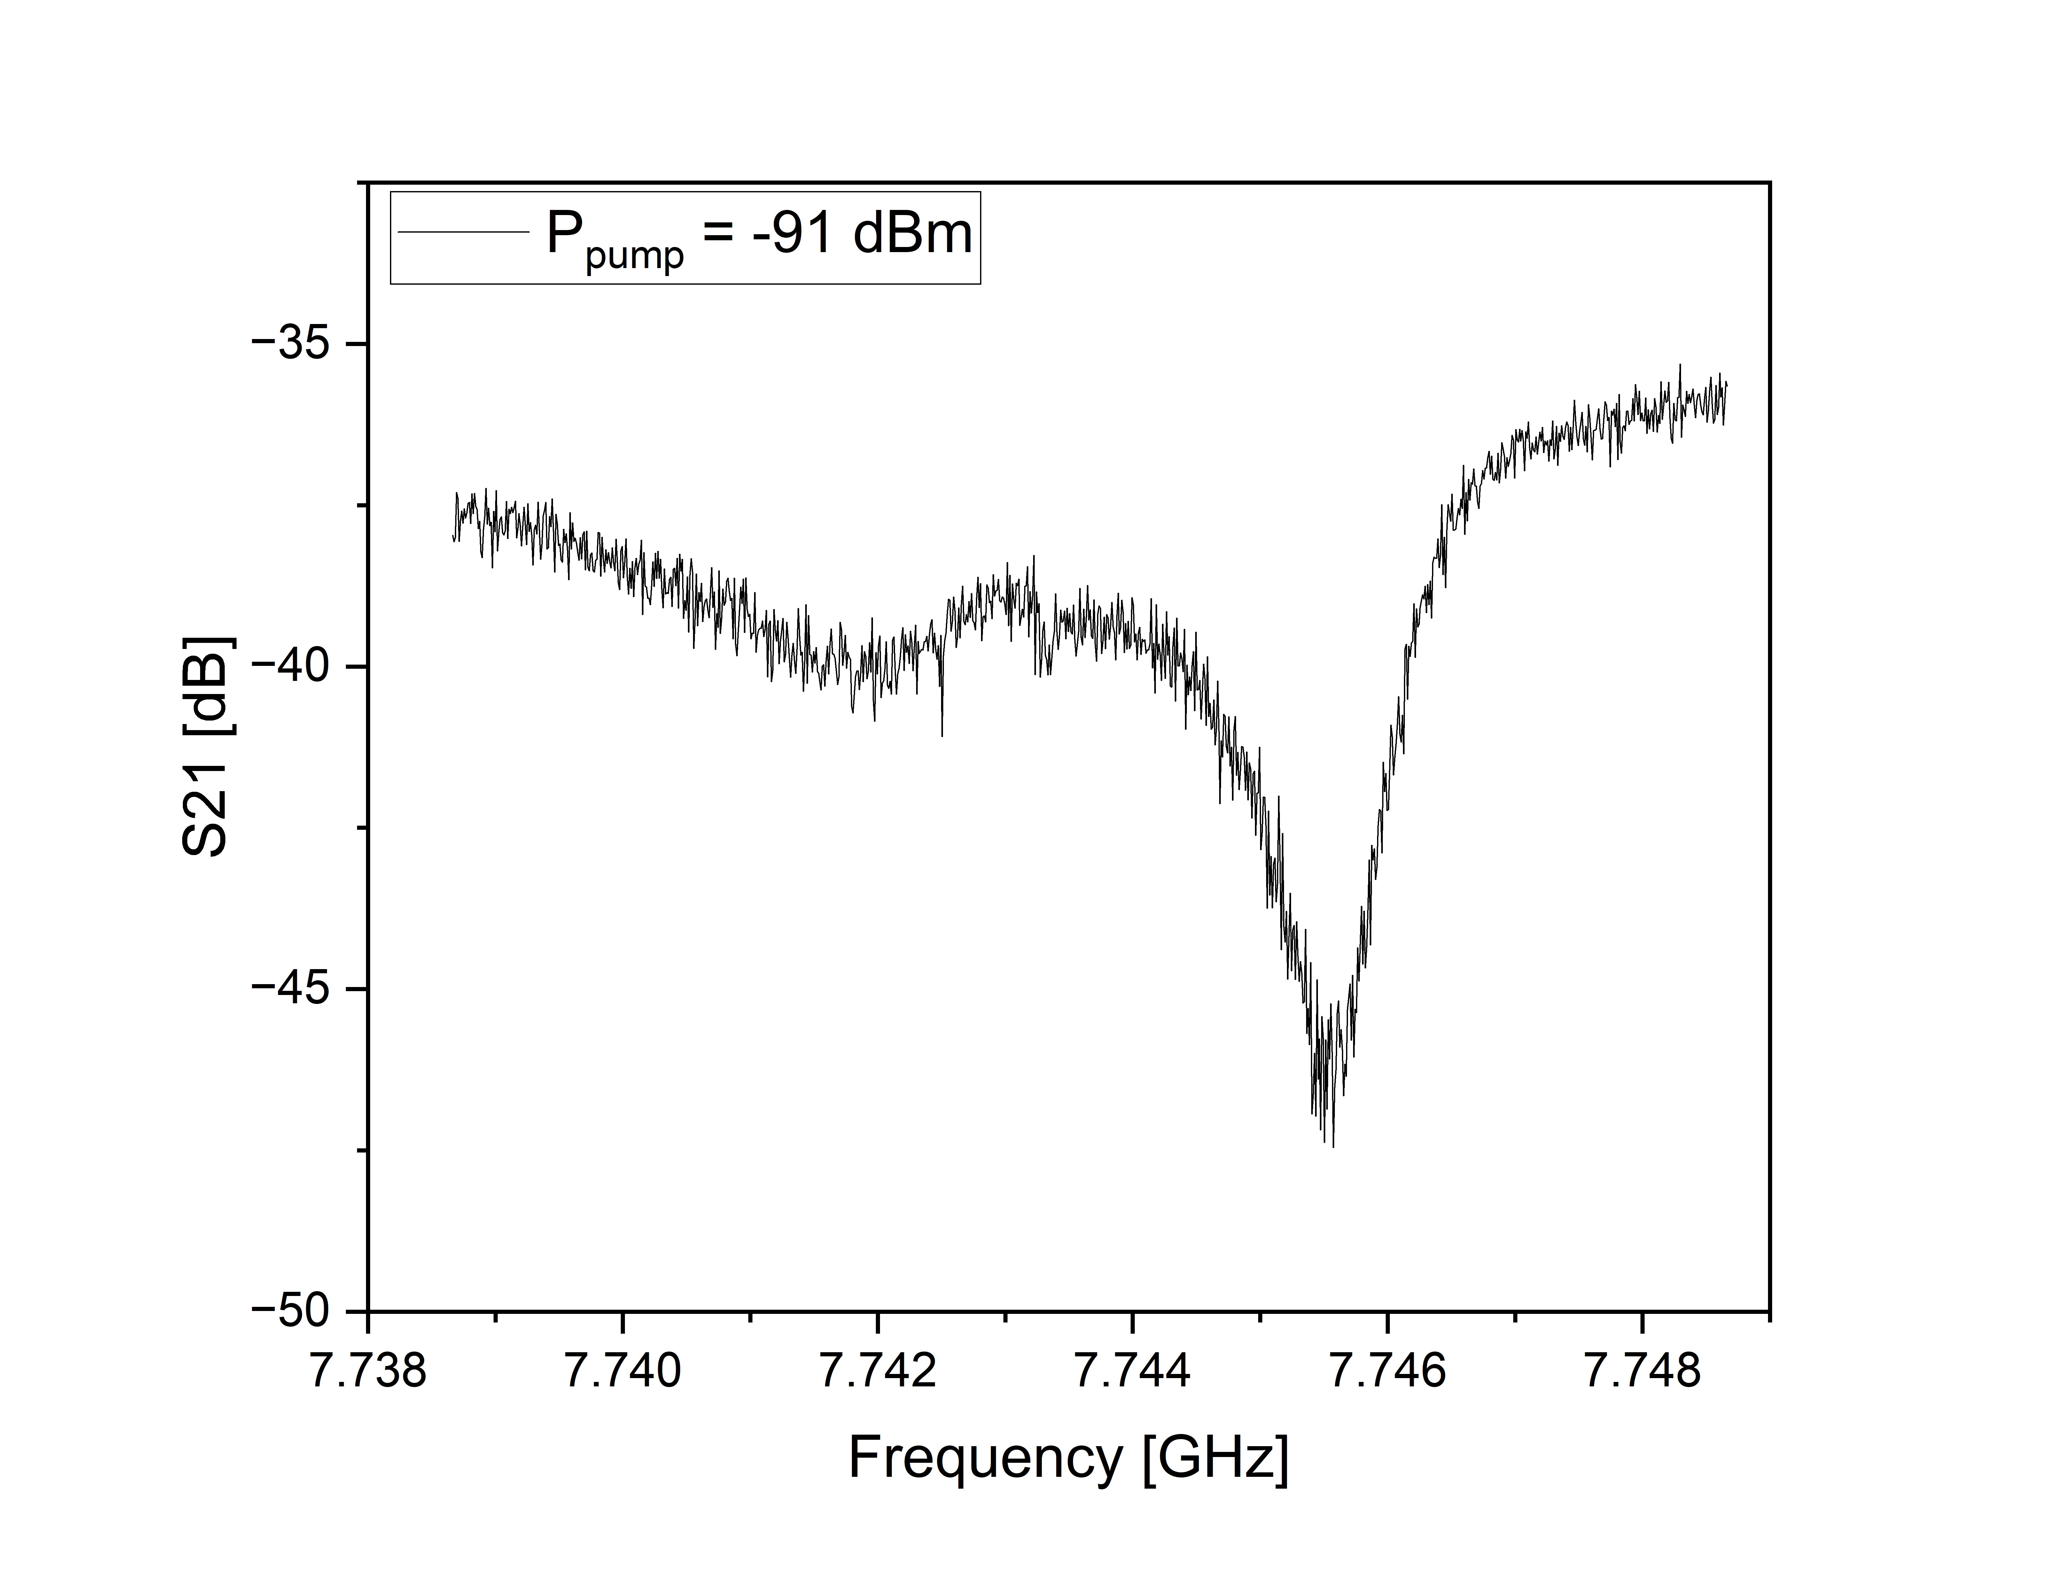
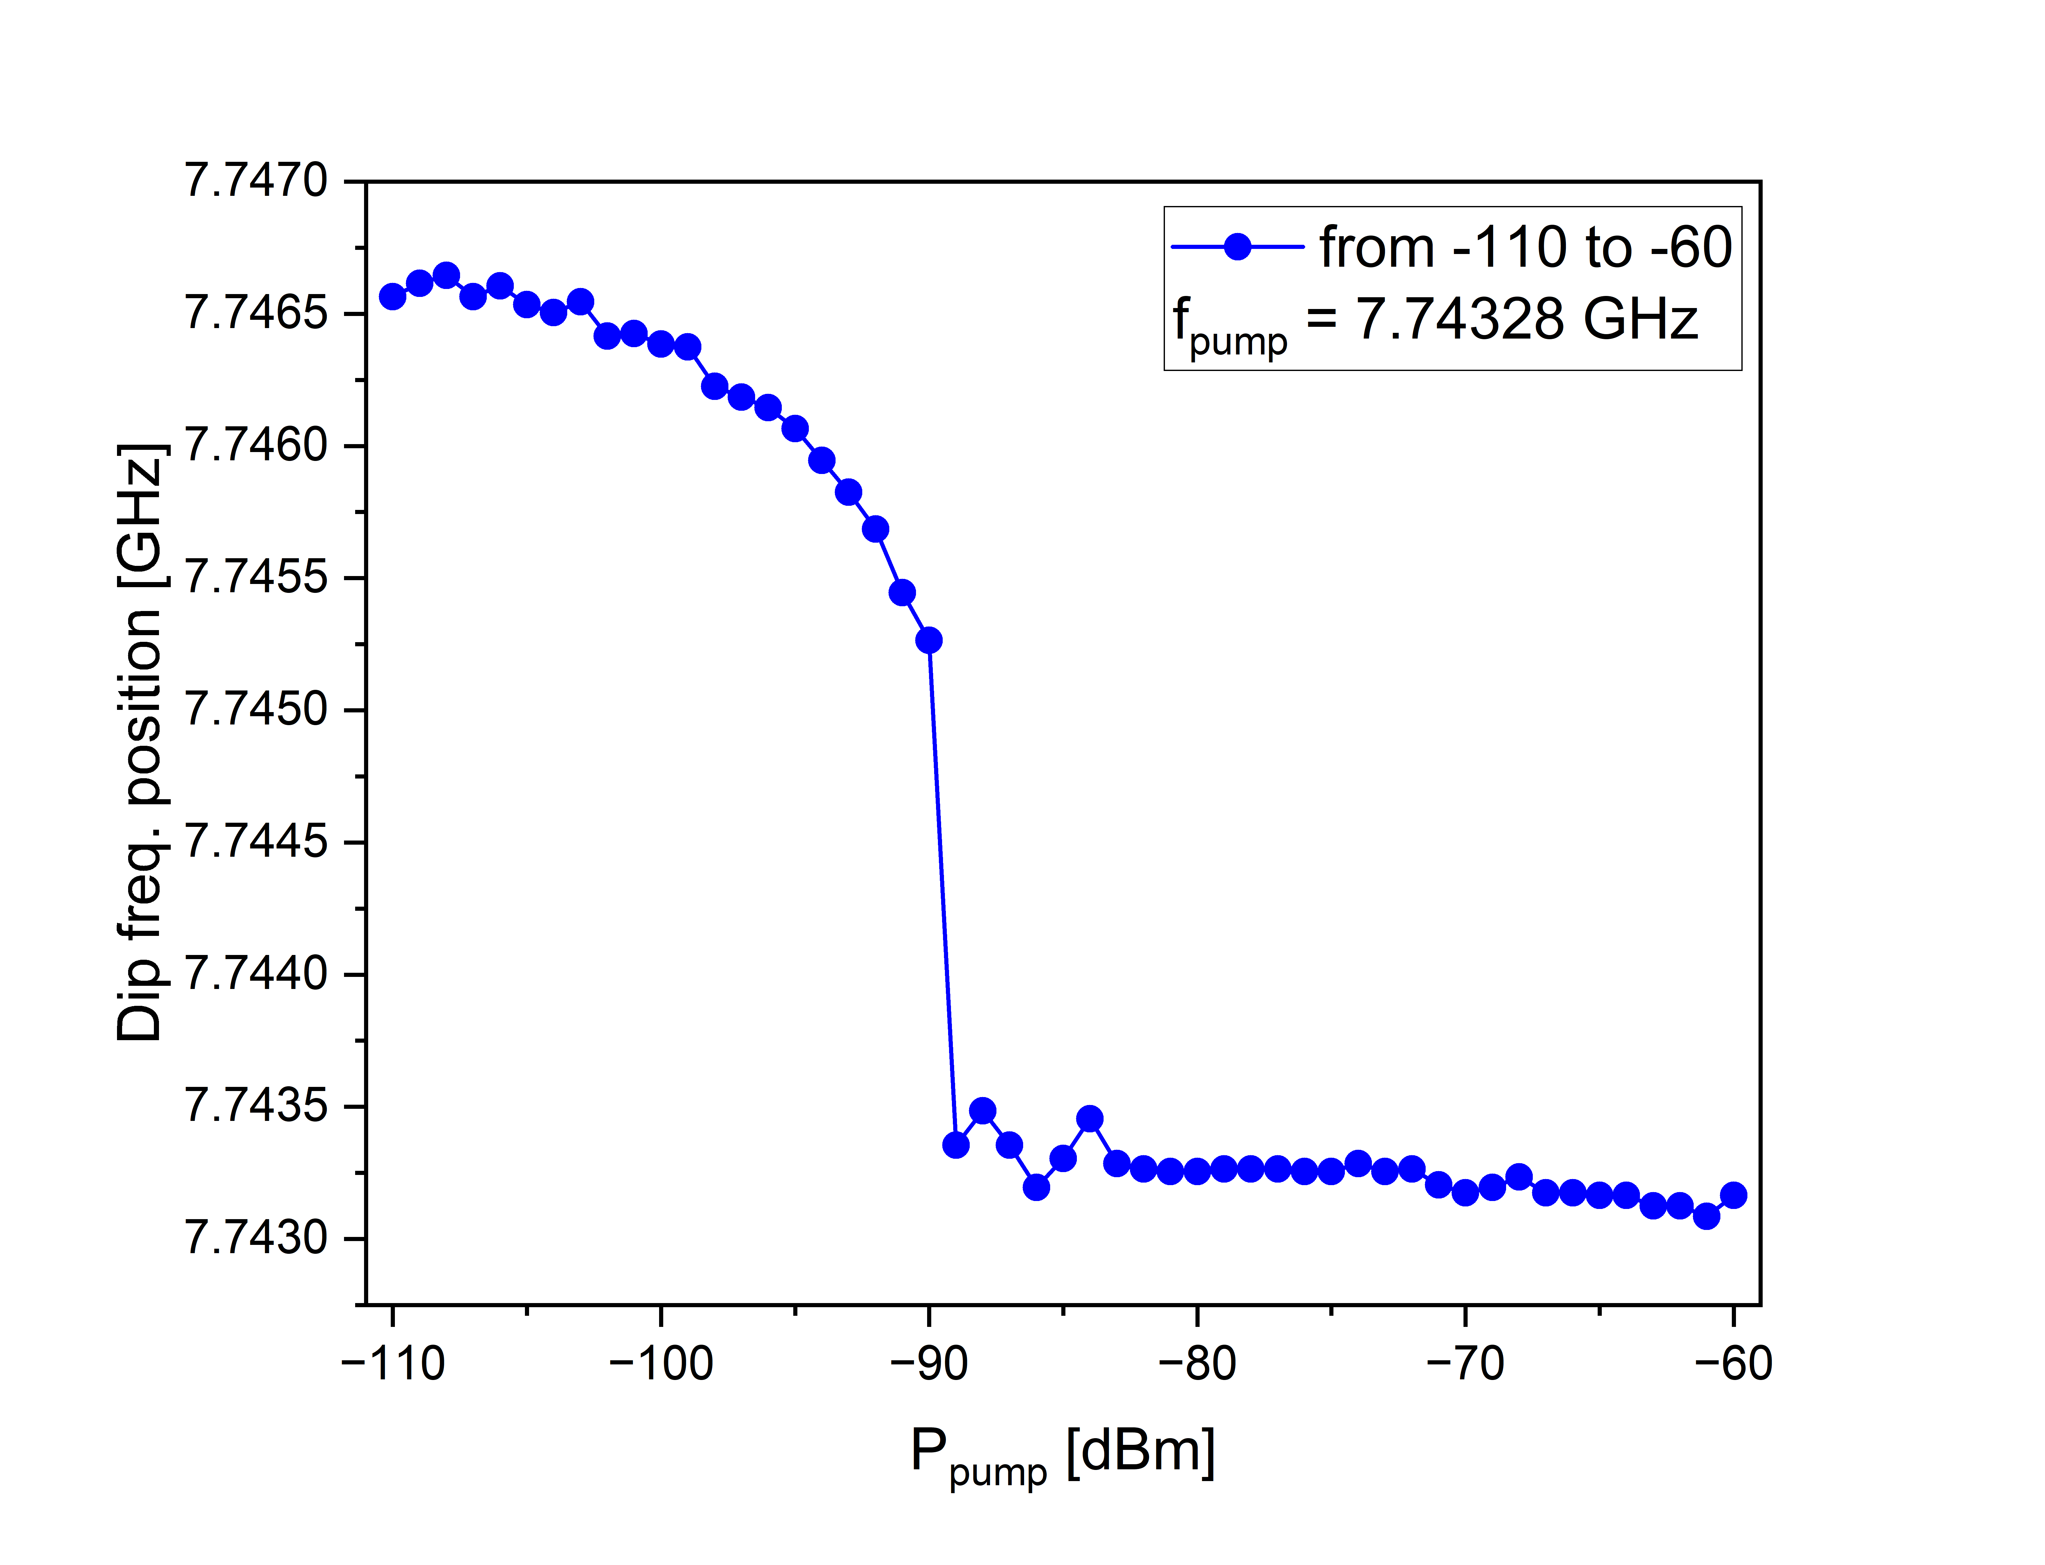
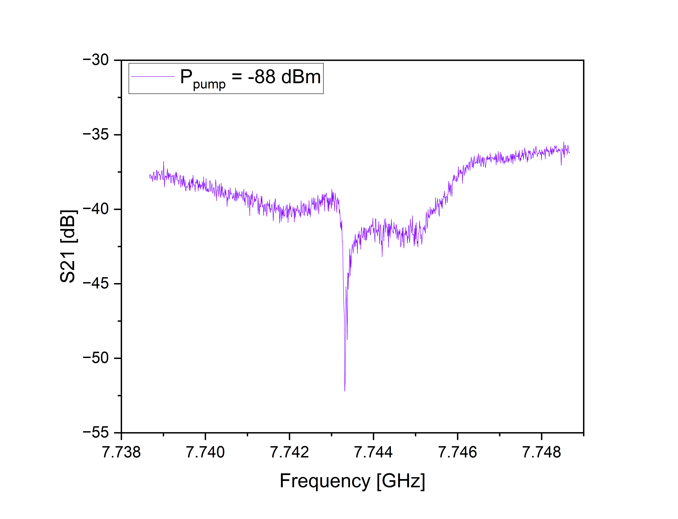
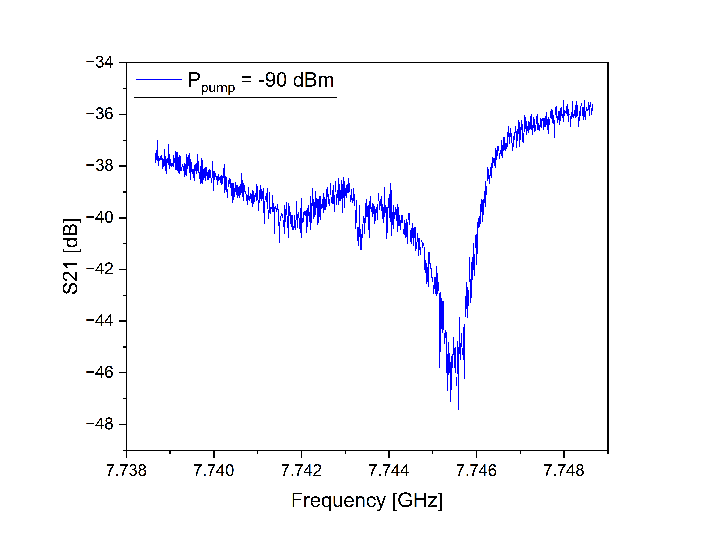
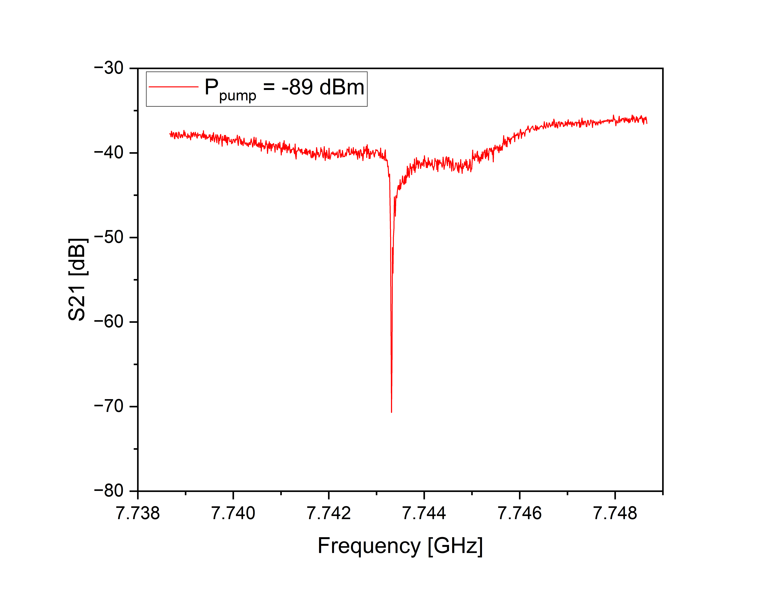
Evolution of the first tone S₂₁ with increasing second tone power for bistability
dependences.
Secondo Congresso Nazionale di NQSTI Roma , 07 Febbraio 2025

Slide 11
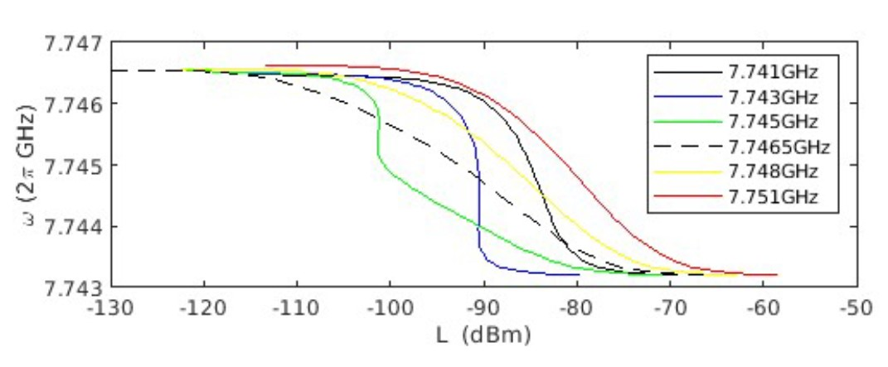
Theoretical description of the dip position on the signal power
Theoretical model is based on a non-linear multiphoton interaction between pump microwave signal and a qubit system of the SQN where the frequency shift is the sum of the multiphoton AC Stark shift values of each qubit. (P. Navez et al, in preparation).
Theoretically predicted values of frequency shift versus the input power in dBm
Secondo Congresso Nazionale di NQSTI Roma , 07 Febbraio 2025

Slide 12
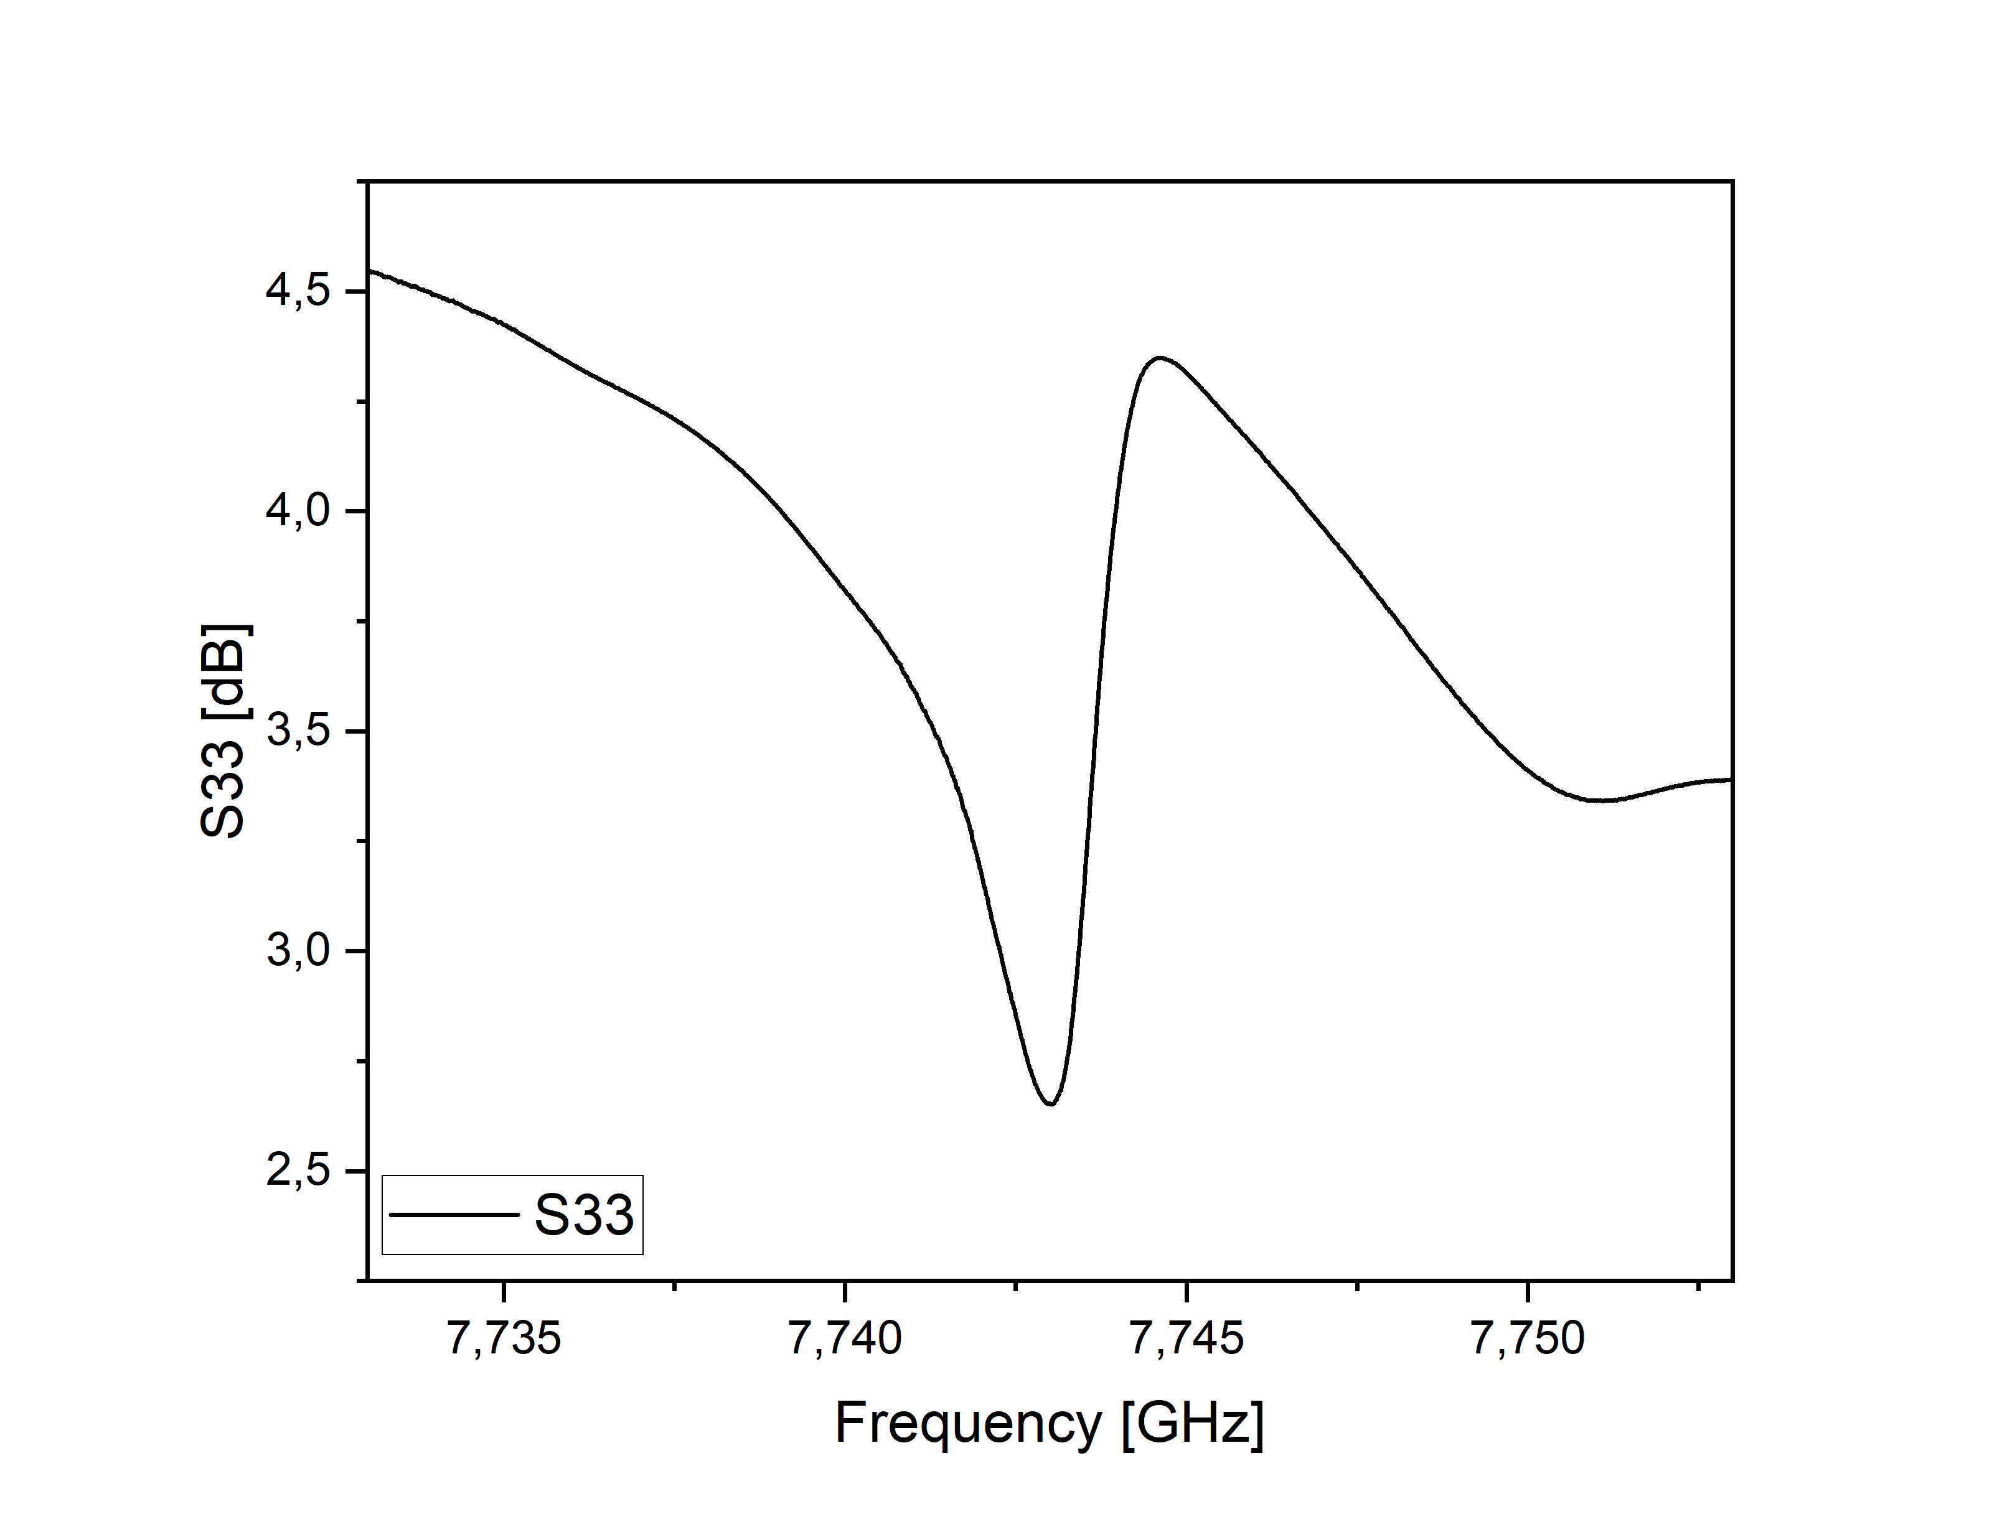
Photon number calculation
Chen Q. et al ,
Phys. Rev. B, 106 (21)
(2021)
N is the average number of photons per period stored in the sensing resonator
P₃ is the second tone power applied to the sensing resonator
Q_{l} is the loaded quality factor
Q_{c} is the coupling quality factor
f₀ is a resonant frequency
𝑄𝑐=|𝑄𝑐|exp(−𝑖𝜙)
Defrance F. et al, Physical Review Materials,
8(3) (2024)
Secondo Congresso Nazionale di NQSTI Roma , 07 Febbraio 2025

Slide 13
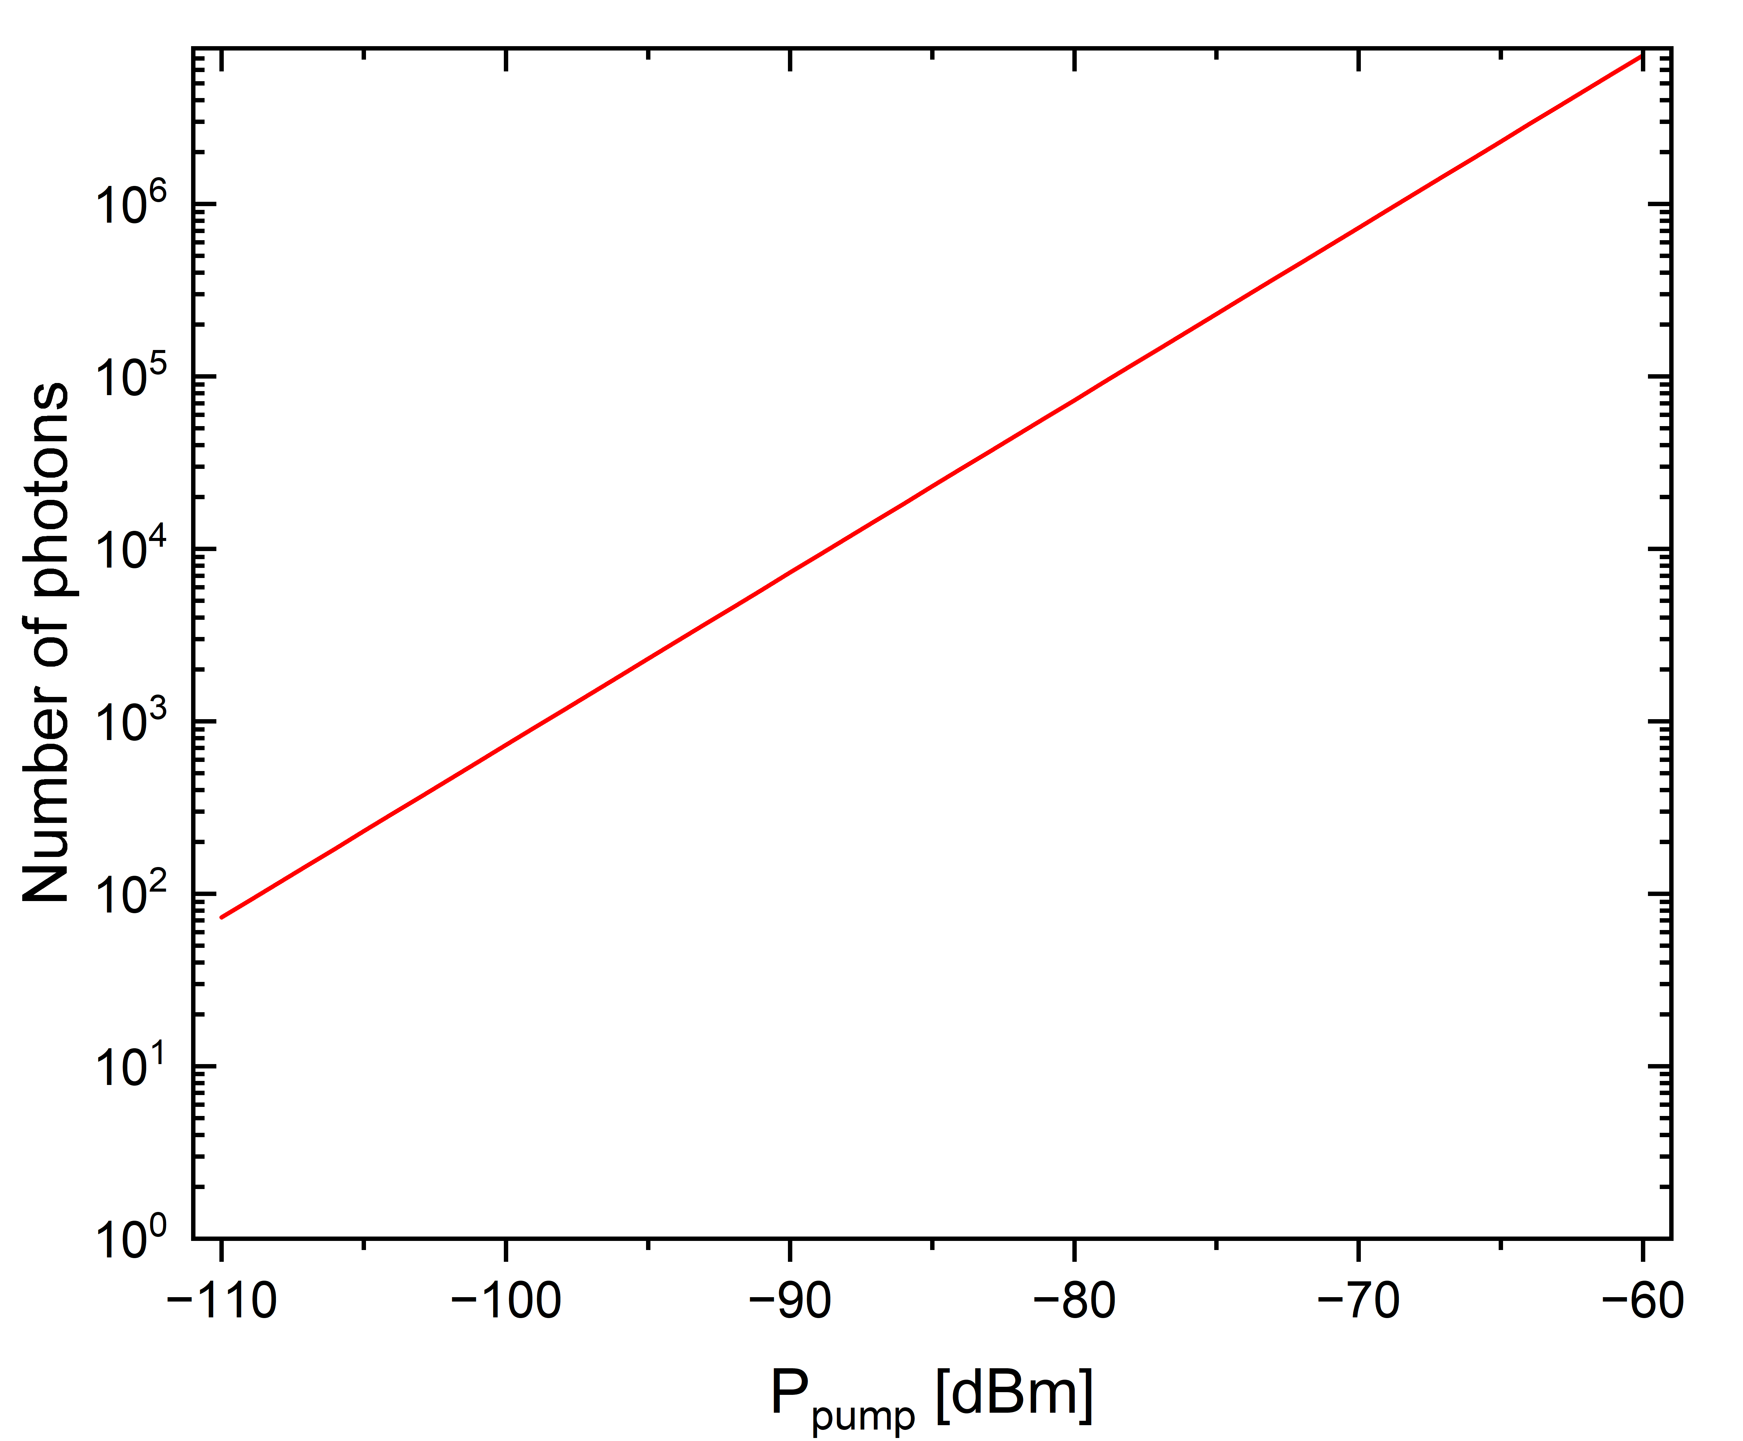
Average number of photons per period stored in the sensing resonator
Secondo Congresso Nazionale di NQSTI Roma , 07 Febbraio 2025

Slide 14
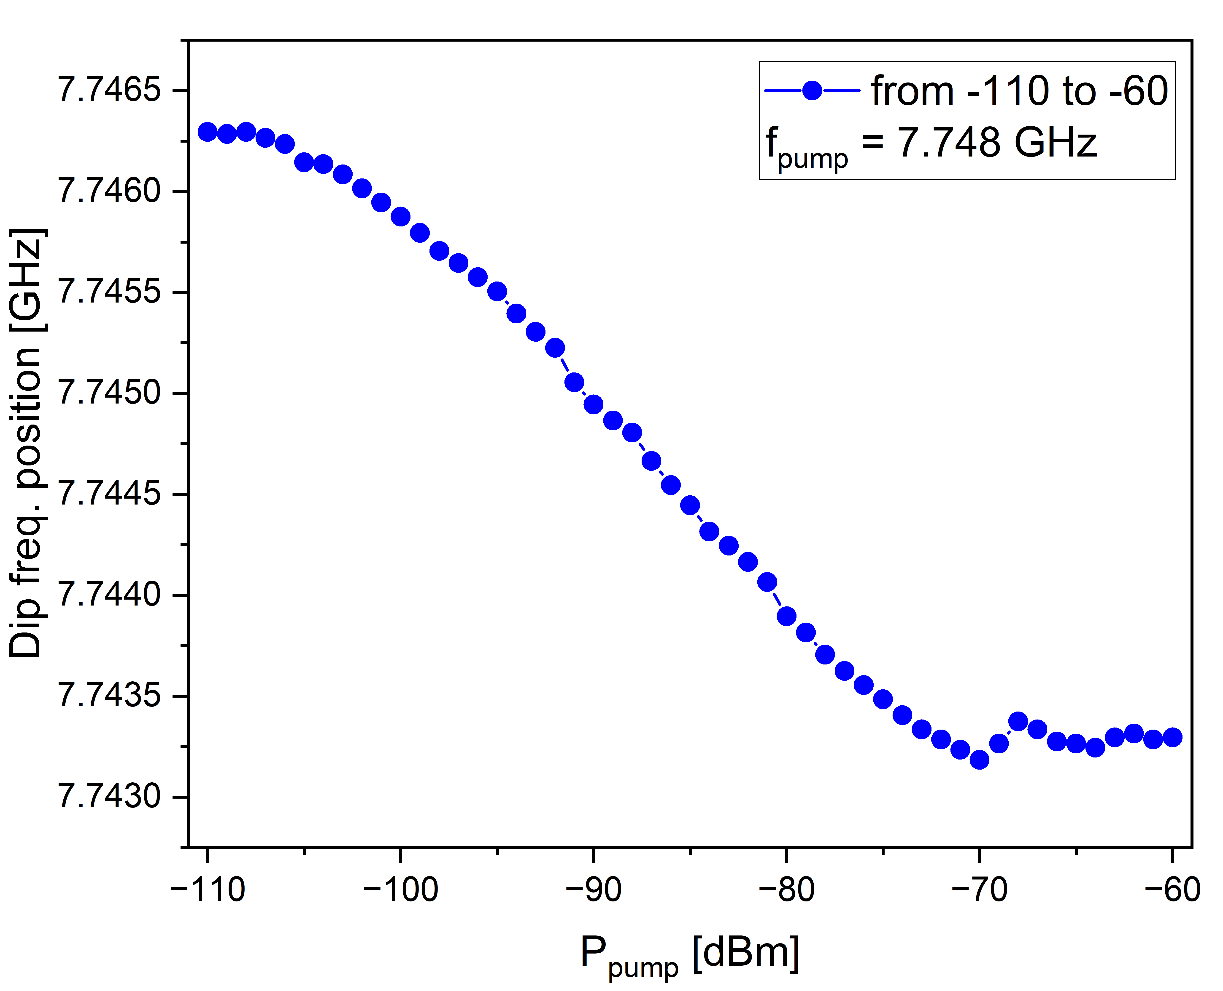
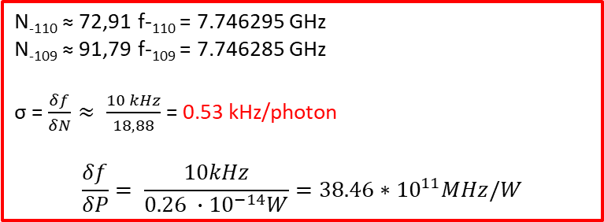
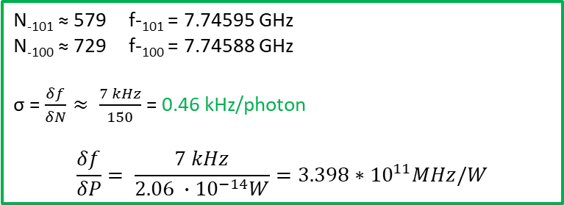
Sensitivity without bistability
N₋₁₁₀ ≈ 72,91 f-₁₁₀ = 7.746295 GHz
N₋₁₀₉ ≈ 91,79 f-₁₀₉ = 7.746285 GHz
σ = $\frac{δf}{δN}≈ \frac{10 kHz}{18,88}$ = 0.53 kHz/photon
$$\frac{δf}{δP}= \frac{10kHz}{0.26 ∙{10}^{−14}W}=38.46∗{10}^{11}MHz/W$$
N₋₁₀₁ ≈ 579 f-₁₀₁ = 7.74595 GHz
N₋₁₀₀ ≈ 729 f-₁₀₀ = 7.74588 GHz
σ = $\frac{δf}{δN}≈ \frac{7 kHz}{150}$ = 0.46 kHz/photon
$$\frac{δf}{δP}= \frac{7 kHz}{2.06 ∙{10}^{−14}W}=3.398∗{10}^{11}MHz/W$$
Secondo Congresso Nazionale di NQSTI Roma , 07 Febbraio 2025

Slide 15
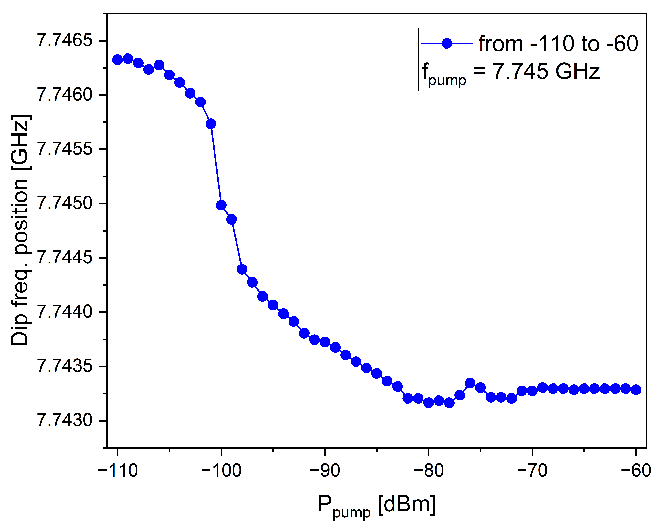


Sensitivity with bistability
N₋₉₀ ≈ 7.29*10^3 f-₉₀ = 7.745265 GHz
N₋₈₉ ≈ 9.18*10^3 f-₈₉ = 7.74335 GHz
σ = $\frac{δf}{δN}≈ \frac{2 MHz}{1.89 ∙{10}^{3}}$ = 1 kHz/photon
$$\frac{δf}{δP}= \frac{2 MHz}{0.26 ∙{10}^{−12}W}=7.69∗{10}^{12}MHz/W$$
N₋₁₀₁ ≈ 579 f-₁₀₁ = 7.745735 GHz
N₋₁₀₀ ≈ 729 f-₁₀₀ = 7.744985 GHz
σ = $\frac{δf}{δN}≈ \frac{1 MHz}{150}$ = 6 kHz/photon
$$\frac{δf}{δP}= \frac{1 MHz}{2.06 ∙{10}^{−14}W}=4,85∗{10}^{13}MHz/W$$
Secondo Congresso Nazionale di NQSTI Roma , 07 Febbraio 2025

Slide 16
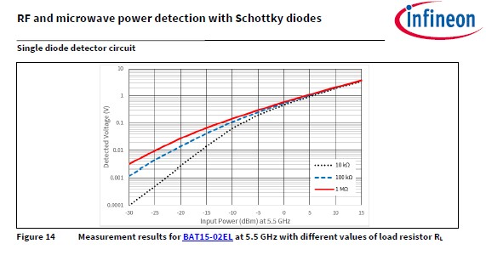
Microwave power range: SQN detector –vs- Schottky diode detector
-30 dBm - -15 dBm @5.5 GHz
Agilent LBSD 8484A
-110 dBm - -75 dBm @7.748 GHz
-70 dBm - -20 dBm @10 MGz -18 GHz
Secondo Congresso Nazionale di NQSTI Roma , 07 Febbraio 2025

Slide 17
Conclusions
We theoretically predicted and experimentally demonstrated that SQN detector with collective quantum state permits to detect a low power microwave signal with a frequncy of 7.748 GHz in the range between -110 dBm and -75 dBm which is lower than the microwave power range of conventional Schottky detector.
The detector sensitivity of SND device is suitable to count a few photons with a frequencies related to bistability regime.
Secondo Congresso Nazionale di NQSTI Roma , 07 Febbraio 2025

Slide 18
Thank you for your attention!
Secondo Congresso Nazionale di NQSTI Roma , 07 Febbraio 2025

