Slide 1

Indium Phosphide Monolithical Integration of a Photonic Source Device Independent Quantum Random Number Generator
Lorenzo De Marinis¹, Peter Seigo Kincaid¹, and Giampiero Contestabile¹
¹Scuola Superiore Sant’Anna, TeCIP Institute, 56122 Pisa, Italy
lorenzo.demarinis@santannapisa.it
Lorenzo De Marinis, Ph.D.
Assistant Professor, Scuola Superiore Sant’Anna
Quantum and neuromorphic photonics group

Slide 2
Where do we need Randomness?
Science
Finance
Logistics
Scheduling & dispatching sims
Sthocastic
simulations
Seed-up Monte Carlo sims
Simulate
Computational chemistry
Portfolio optimization
Inventory optimization
Optimize
Stochastic strategic
planning
Predict
Drug
discovery
Risk assesment
Notes:
The min-entropy is the negative logarithm of the most likely outcome

Slide 3
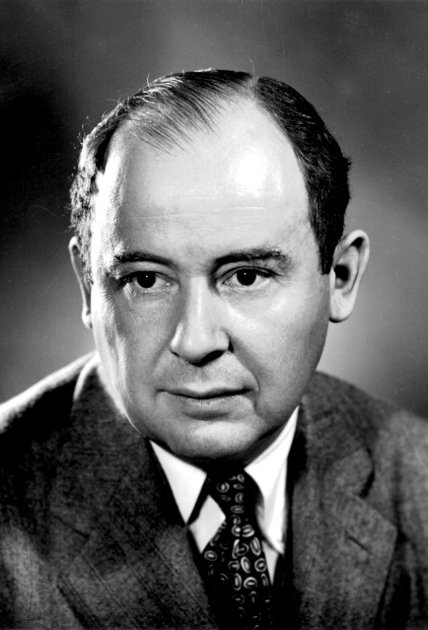
“Anyone who considers arithmetical methods of producing random digits is, of course, in a state of sin”
John Von Neumann - "Various techniques used in connection with random digits.”
John von Neumann, Collected Works 5 (1963): 768-770.
Notes:
Nowadays, common solutions based on pseudo or classical random number generators rely on deterministic processes, which are in principle predictable. On the contrary, quantum mechanics guarantees, from a theoretic point of view, that the outcome of the measurement is completely unpredictable.

Slide 4

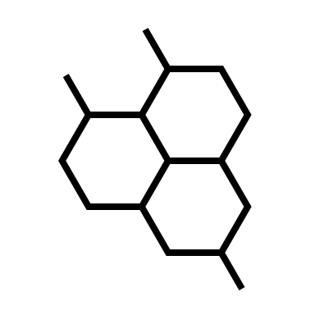
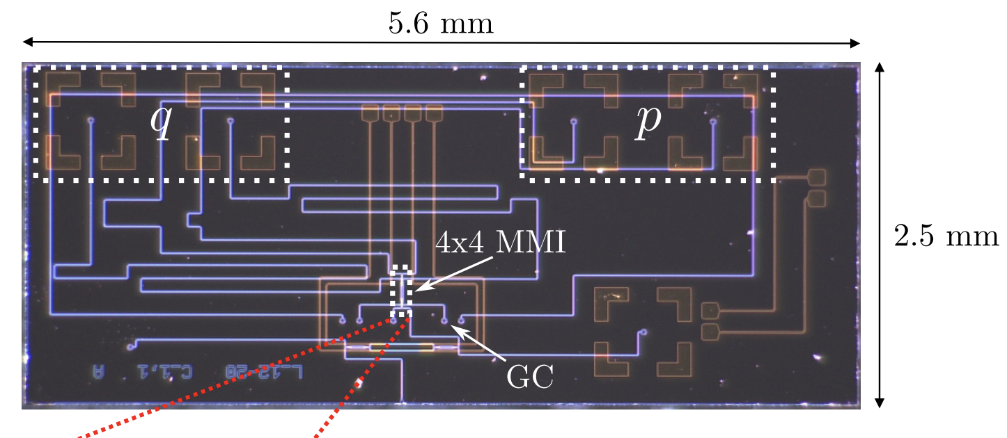
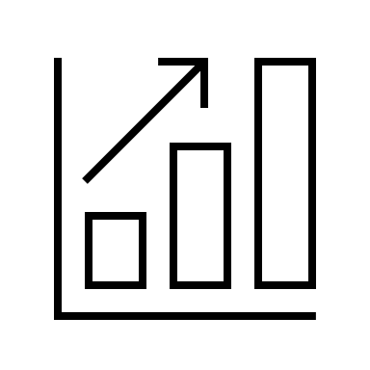
Why Quantum Photonics for QRNG?
Quantum photonics provide the best ingredients for a QRNG
Unpredictability
No patterns
Performance
Can be implemented by integrated chips!
Bertapelle, Tommaso, et al. "High-speed source-device-independent quantum random number generator on a chip." arXiv preprint arXiv:2305.12472 (2023).
Notes:
The min-entropy is the negative logarithm of the most likely outcome

Slide 5
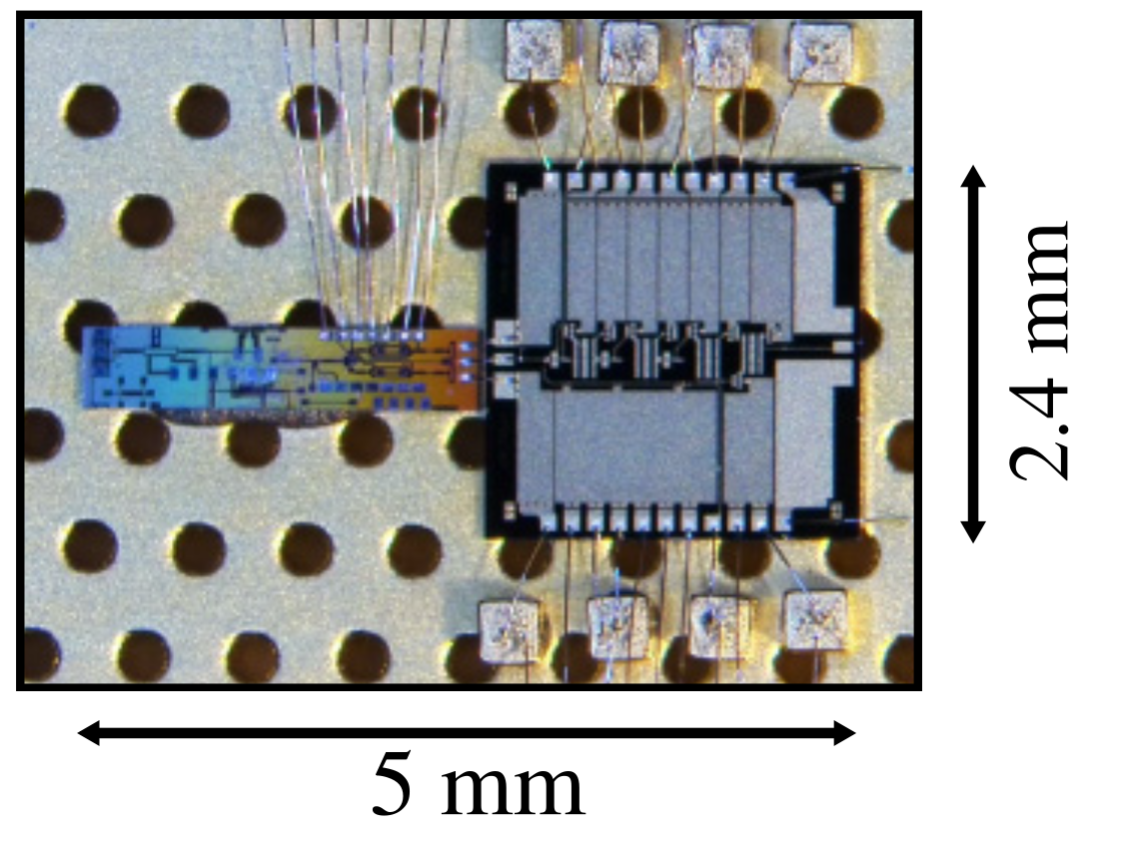
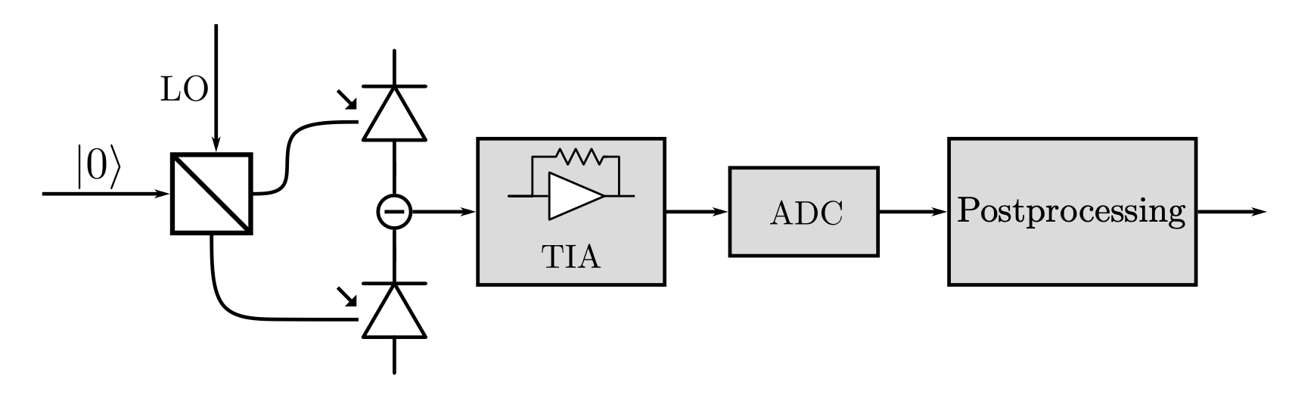
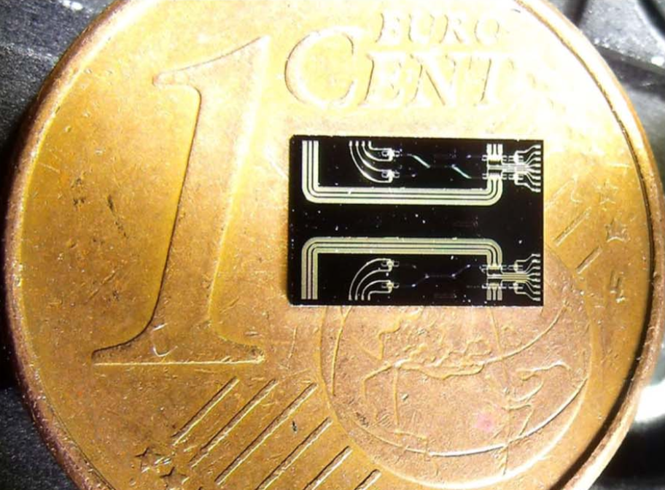
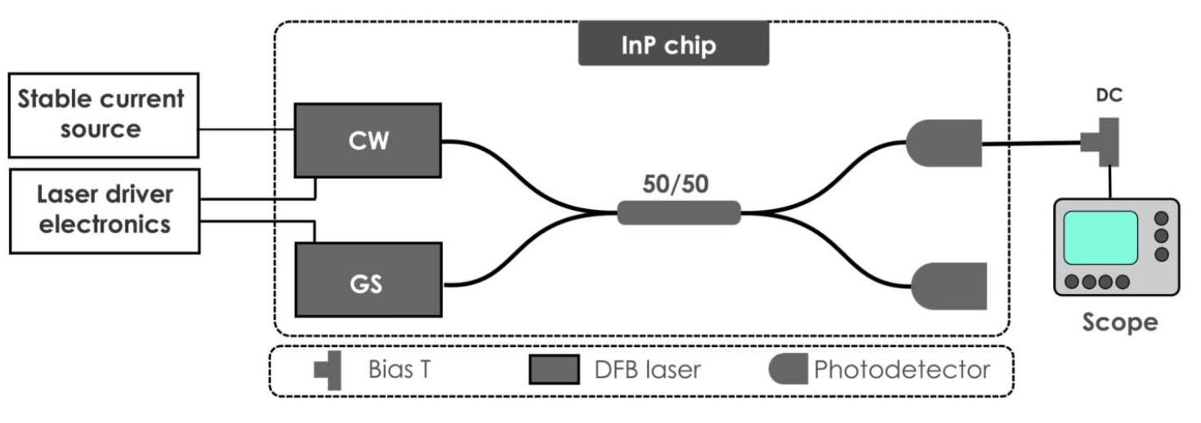
Variety of Methods
Vacuum Fluctuations Homodyne detection
Bruynsteen, Cédric, et al. "100-Gbit/s integrated quantum random number generator based on vacuum fluctuations." PRX quantum 2023
Two laser interference and heterodyne detection
Abellan, Carlos, et al. "Quantum entropy source on an InP photonic
integrated circuit for random number generation” Optica 2016

Slide 6
Imperfections - Classes of QRNG
Imperfections in
phisycal devices
Leak of information
Fully trusted QRNG
Easy to realize
Fast generation
Require calibration
Device independent
No assumptions
Secure even if the device is compromised
Are these philosophy?
Semi device independent
Weak assumptions
Feasible realization
Fast generation
Notes:
in a paranoid scenario (the usual framework of device-independent protocols), any imperfection in the physical realization of a quantum random number generator (QRNG) may leak information correlated with the generated numbers, the so-called side information. Such classical or quantum correlations could be exploited by an eavesdropper to correctly guess the measurement outcomes. The maximal amount of randomness that can be extracted in presence of such side information is given by the so-called quantum conditional min-entropy.
Several approaches have been proposed to lower bound it, depending on the number of assumptions required on the devices used in the generator. For “fully trusted” QRNGs, the min-entropy can be evaluated because pure input states and well characterized measurement devices are assumed (see ref. 6 for more details).
In contrast, device-independent (DI) protocols, by exploiting entanglement, do not need any assumption: the violation of a Bell inequality directly bounds the min-entropy, without the need of trusting the generated state and the used measurement devices. Fully trusted QRNG, including all the commercial ones, are easy to realize, but they require strong assumptions for their use in cryptography. On the contrary, DI protocols offer the highest level of security, but their realization is still too demanding for any practical use.

Slide 7
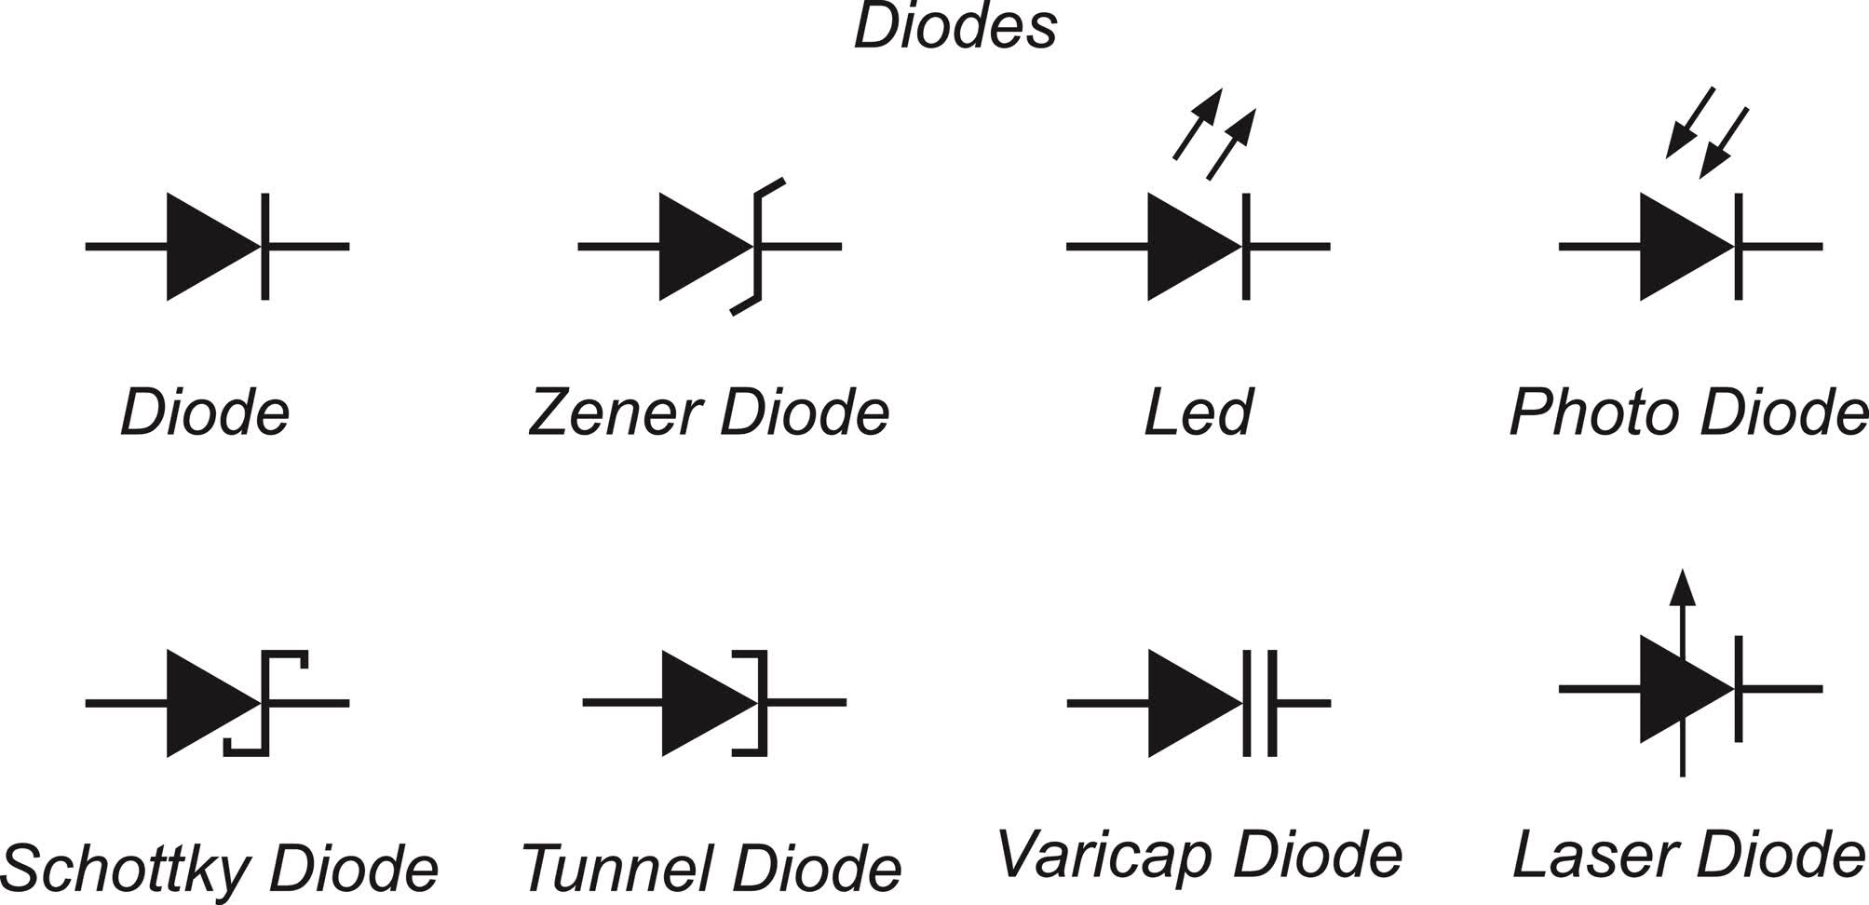
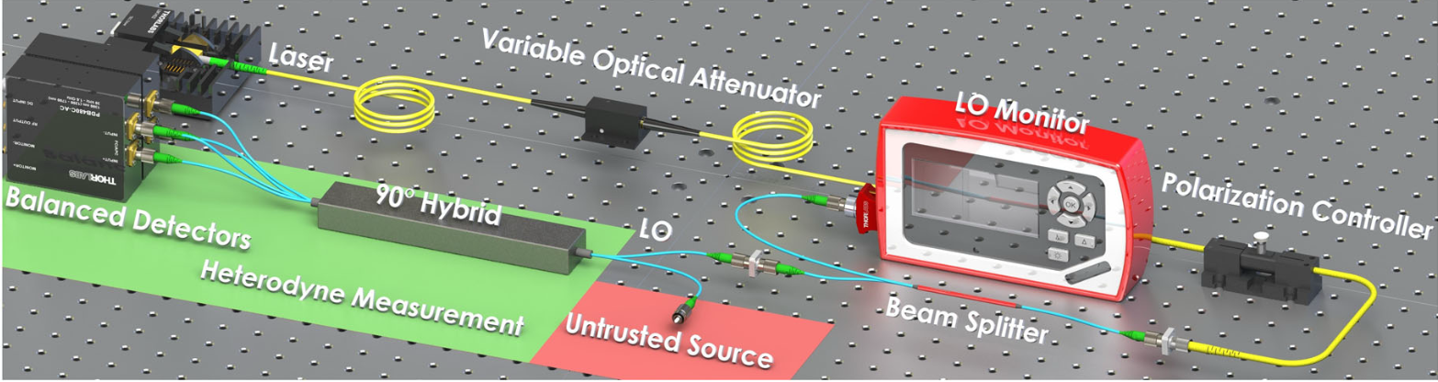
Source-Device-Independent Heterodyne QRNG
Variable optical attenuator
VOA
90° Hybrid
p
Quadratures
Diode Laser
Untrusted source
q
Balanced Photodetector
Marco Avesani, et al. "Source-device-independent heterodyne-based quantum random number generator at 17 Gbps” Nat. Comm. 2018
Notes:
in a paranoid scenario (the usual framework of device-independent protocols), any imperfection in the physical realization of a quantum random number generator (QRNG) may leak information correlated with the generated numbers, the so-called side information. Such classical or quantum correlations could be exploited by an eavesdropper to correctly guess the measurement outcomes. The maximal amount of randomness that can be extracted in presence of such side information is given by the so-called quantum conditional min-entropy.
Several approaches have been proposed to lower bound it, depending on the number of assumptions required on the devices used in the generator. For “fully trusted” QRNGs, the min-entropy can be evaluated because pure input states and well characterized measurement devices are assumed (see ref. 6 for more details).
In contrast, device-independent (DI) protocols, by exploiting entanglement, do not need any assumption: the violation of a Bell inequality directly bounds the min-entropy, without the need of trusting the generated state and the used measurement devices. Fully trusted QRNG, including all the commercial ones, are easy to realize, but they require strong assumptions for their use in cryptography. On the contrary, DI protocols offer the highest level of security, but their realization is still too demanding for any practical use.

Slide 8
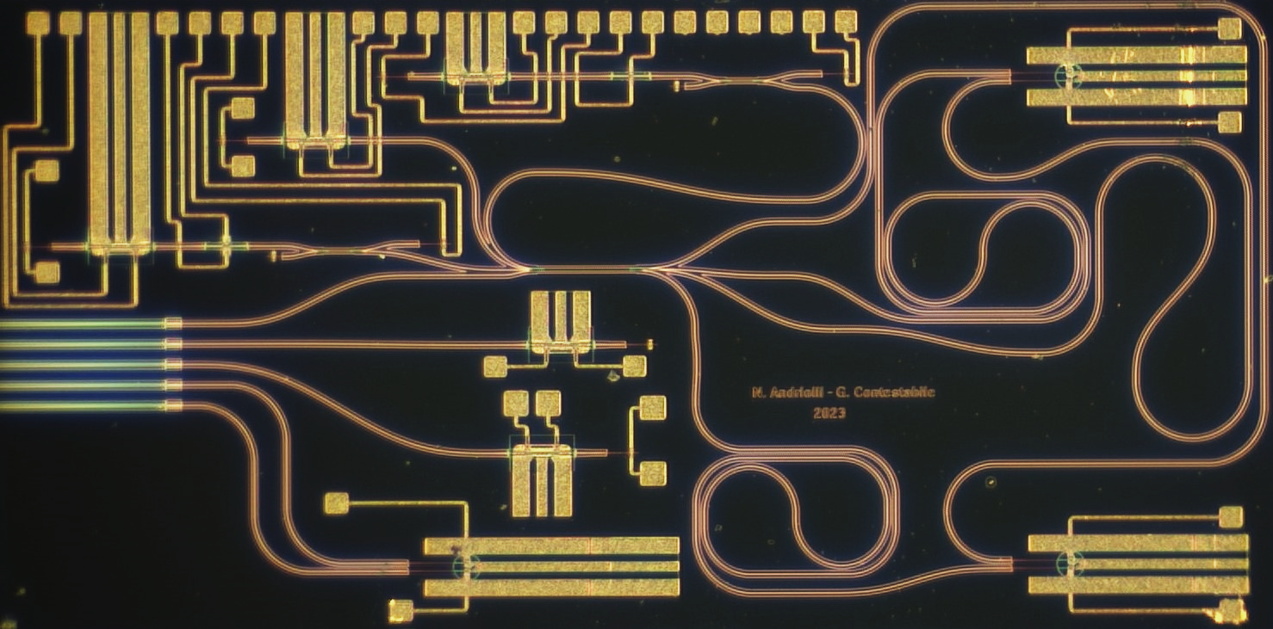
Indium Phosphide Integrated Implementation
8 mm
p
4x4 MMI
6 mm
Untrusted source
VOA
LO Laser
q
VOA
90° Hybrid
p
Diode Laser
Untrusted source
q
Notes:
in a paranoid scenario (the usual framework of device-independent protocols), any imperfection in the physical realization of a quantum random number generator (QRNG) may leak information correlated with the generated numbers, the so-called side information. Such classical or quantum correlations could be exploited by an eavesdropper to correctly guess the measurement outcomes. The maximal amount of randomness that can be extracted in presence of such side information is given by the so-called quantum conditional min-entropy.
Several approaches have been proposed to lower bound it, depending on the number of assumptions required on the devices used in the generator. For “fully trusted” QRNGs, the min-entropy can be evaluated because pure input states and well characterized measurement devices are assumed (see ref. 6 for more details).
In contrast, device-independent (DI) protocols, by exploiting entanglement, do not need any assumption: the violation of a Bell inequality directly bounds the min-entropy, without the need of trusting the generated state and the used measurement devices. Fully trusted QRNG, including all the commercial ones, are easy to realize, but they require strong assumptions for their use in cryptography. On the contrary, DI protocols offer the highest level of security, but their realization is still too demanding for any practical use.

Slide 9
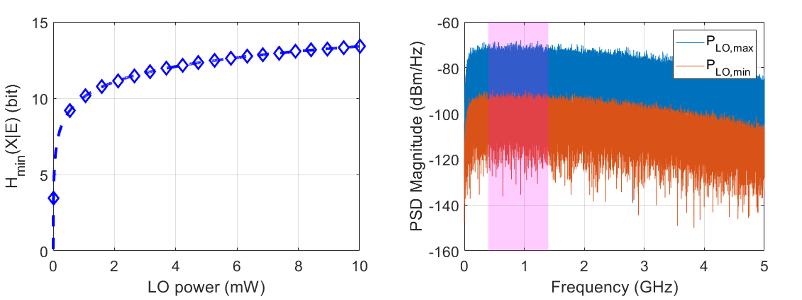
Expected Performance
Parameters
Max laser power 10 mW
Linewidth 5 MHz
RIN -140 dB/Hz
Dark current 10 nA
BPD BW 20 GHz
ADC 8-bit, 800 mV full scale
1 GHz
Bitrate ≈ 13.4 Gb/s
Notes:
in a paranoid scenario (the usual framework of device-independent protocols), any imperfection in the physical realization of a quantum random number generator (QRNG) may leak information correlated with the generated numbers, the so-called side information. Such classical or quantum correlations could be exploited by an eavesdropper to correctly guess the measurement outcomes. The maximal amount of randomness that can be extracted in presence of such side information is given by the so-called quantum conditional min-entropy.
Several approaches have been proposed to lower bound it, depending on the number of assumptions required on the devices used in the generator. For “fully trusted” QRNGs, the min-entropy can be evaluated because pure input states and well characterized measurement devices are assumed (see ref. 6 for more details).
In contrast, device-independent (DI) protocols, by exploiting entanglement, do not need any assumption: the violation of a Bell inequality directly bounds the min-entropy, without the need of trusting the generated state and the used measurement devices. Fully trusted QRNG, including all the commercial ones, are easy to realize, but they require strong assumptions for their use in cryptography. On the contrary, DI protocols offer the highest level of security, but their realization is still too demanding for any practical use.

Slide 10
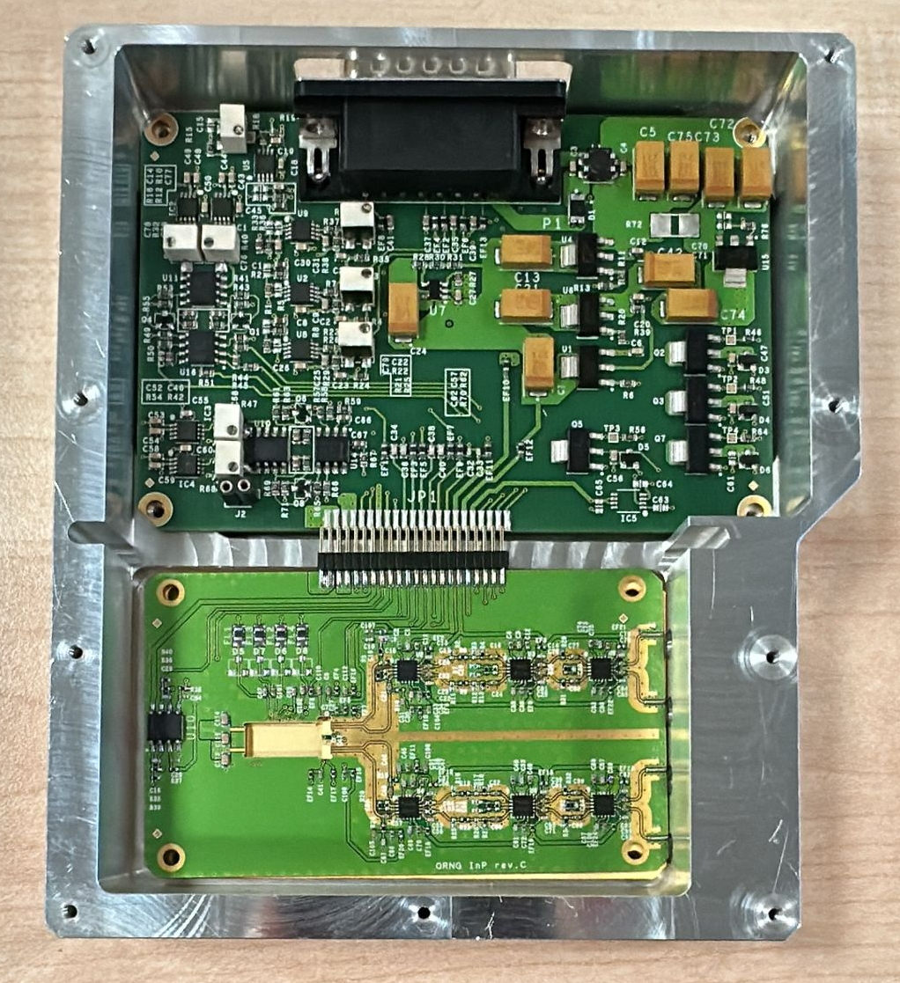
A Plug-and-Play Device
p
4x4 MMI
VOA
LO Laser
q

Slide 11
Photonic CV-QKD Link – Spoke 7
Alice
Fibre
Bob
90° Hybrid
I/Q Mod
I
Q
QRNG
Encoder
LO Laser
Do not miss the talk from Emanuele Parente “Achieving CV-QKD GG02 Performance with QAM modulation and Probabilistic Shaping in a Linear Quantum Channel Scenario”

Slide 12

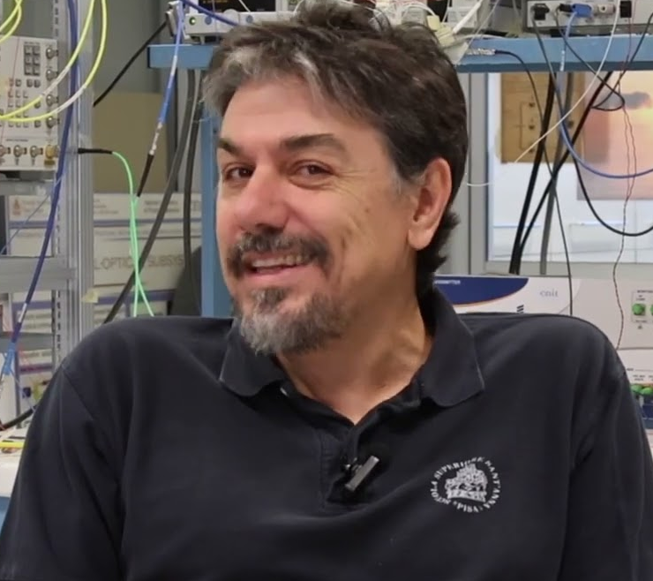
Acknowledgments
Dr. Peter Seigo Kincaid
Prof. Giampiero Contestabile
lorenzo.demarinis@santannapisa.it

